Slide 1
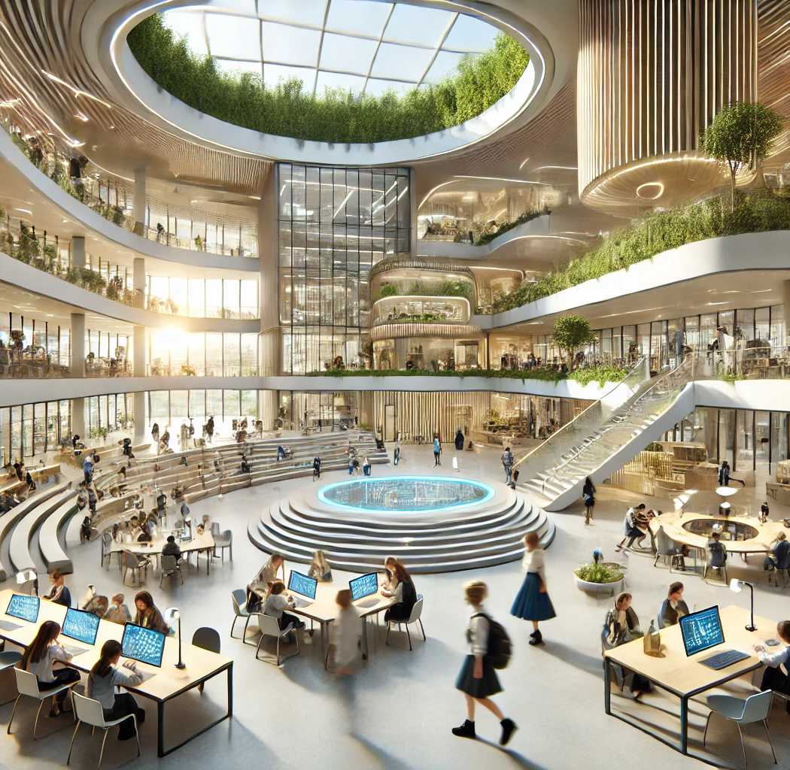

#edspaces
Supporting a Holistic Approach to Student Wellness
Thursday, November 6 8:00-9:00am

Slide 2
Speakers List
Virginia Marquardt, AIA, NCARB, LEED AP
Principal In Charge- HMC Architects
Alexis Garcia, Assoc. AIA
Project Designer - HMC Architects

Slide 3
Learning Objectives
1. Define the holistic approach to student wellness and analyze how that influences academic performance, attendance, behavior, social development, and long-term well-being, with an emphasis on Maslow’s Before Bloom theory—how foundational needs must be met before higher-level learning can occur.
2. Assess how school-based health centers expand healthcare access to surrounding communities, especially in underserved areas with limited medical resources, and their role in improving overall health outcomes for both students, their families, and the local community.
3. Explore how fostering student wellness through engaging spaces—encompassing physical, mental, and emotional well-being—contributes to developing well-rounded individuals who can thrive in society and investigate the role this plays in shaping a productive, resilient, and socially responsible community.
4. Examine successful models like the Wellness Centers at Los Angeles Unified School District (LAUSD)and discuss how thoughtful architectural design such as spatial design and biophilia, promotes student well-being and academic success while also improving community public health.

Slide 4



Agenda
Understand Holistic Student Wellness
How School-Based Health Centers Affect Student Success
Wellness Center Design & Guiding Principles

Slide 5


Who We Are
Founded with the purpose of anticipating community needs, HMC aims to create designs that have positive impact now and into the future.
140+
1300+
California Public School Districts Served
PreK-12 School Projects, Past 5 years
Notes:
7 Offices – Los Angeles, Ontario, Portland, Sacramento, San Diego, San Jose, Seattle

Slide 6
What is Student Wellness?
Holistic framework
Wellness extends beyond health services
PHYSICAL
HEALTH
MENTAL
HEALTH
EMOTIONAL
HEALTH
NUTRITION
SOCIAL
WELL- BEING
Notes:
wellness extends beyond health services — it’s about belonging and support systems

Slide 7
Audience Warm Up
Think back to your own school experience. Which resources did you have access to as a student that allowed you to focus on learning?

Slide 8
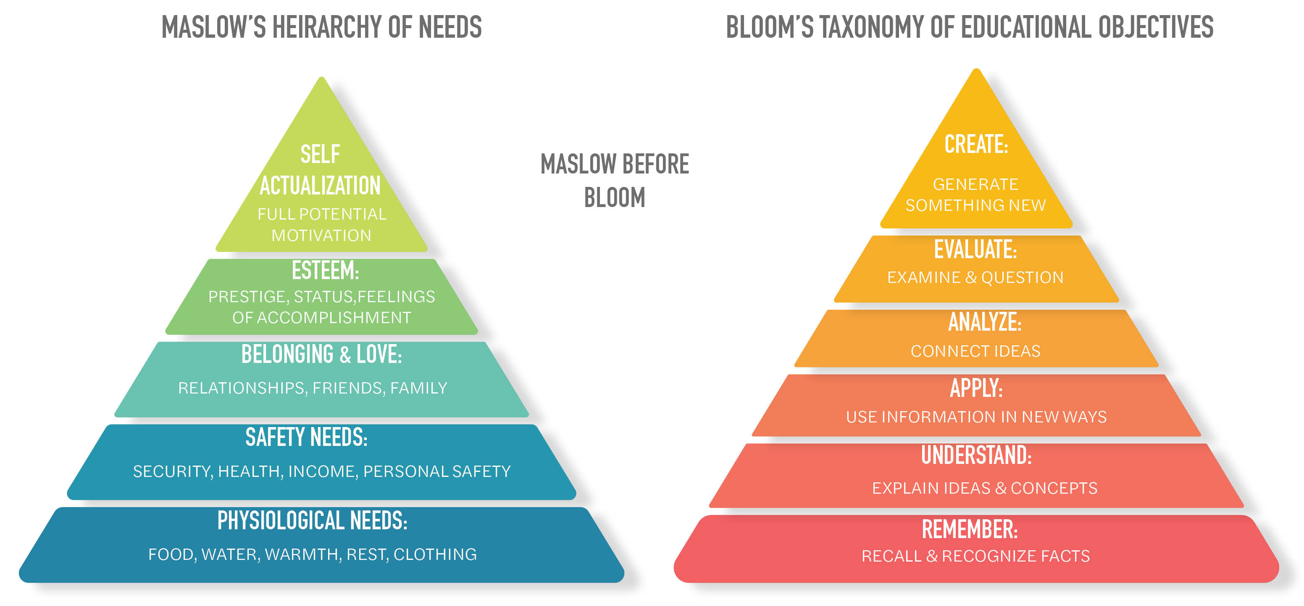
Maslow Before Bloom
Before academic success can be achieved, a student’s basic human needs must first be satisfied
Notes:
Foundational needs (safety, health, belonging) must be met before academic success.
The philosophical core of holistic design for learning environments.

Slide 9
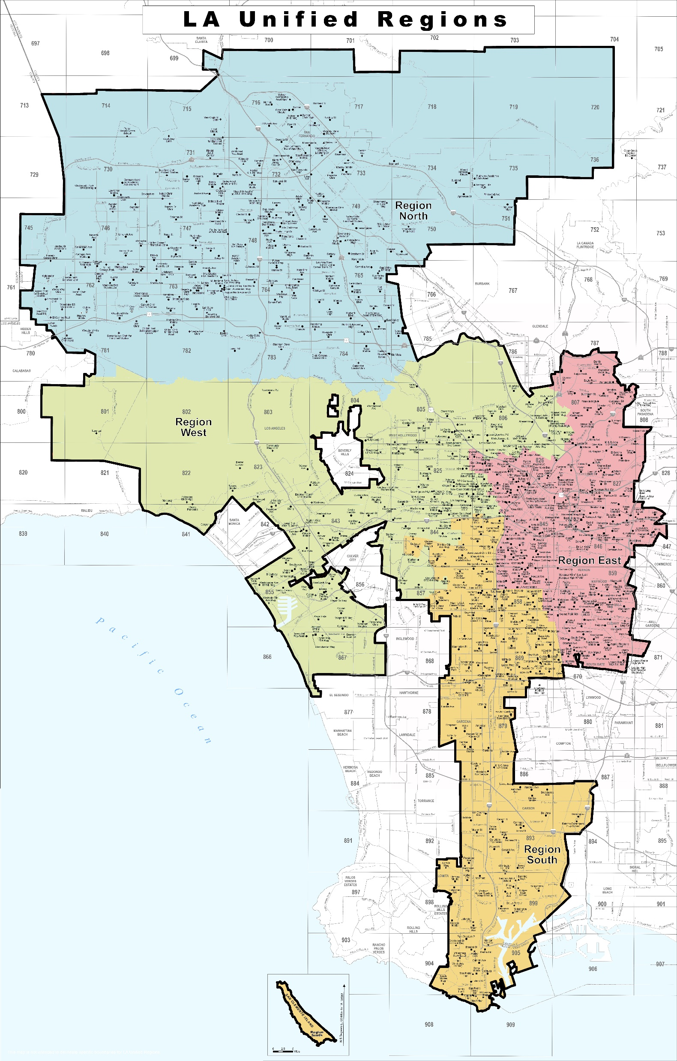

Los Angeles Unified School District
2nd largest school district in the country serving nearly 575,000 students
25,000+ Teachers
3,000 School Administrators
30,000+ Employees supporting students and communities
Notes:
Serving a area totaling 710 square miles. The city of Los Angeles and 25 cities in the LA county

Slide 10
Los Angeles Unified School District
OVER 81% OF STUDENTS QUALIFY FOR FREE OR REDUCED-PRICED MEALS
MEDIAN HOUSEHOLD INCOME
$66,539
ENGLISH & 97 LANGUAGES ARE SPOKEN IN LA UNIFIED SCHOOLS
APPROXIMATELY 15,000 STUDENTS EXPERIENCING HOMELESSNESS
LA County median household income $86,499
20.1% are English Learners
3.5% of current student population
19% increase since 2022
Serving over 680,000 meals a day
Source: https://www.lausd.org/opendata
Notes:
Serving area totaling 710 square miles. The city of Los Angeles and 25 cities in the LA county

Slide 11
Los Angeles Unified School District
Notes:
LAUSD serves many communities in need to support the whole child. Although there is much adversity, students can succeed by having accessible resources.

Slide 12



Los Angeles Unified School District
LAUSD reported 72.2% rate in 2015
National Graduation Average is 87.4%
LAUSD serves 878 K-12 Schools
86.1%
51
California Distinguished Schools
Graduation Rate
300+
200+
Dual Language Programs
Magnet Programs

Slide 13
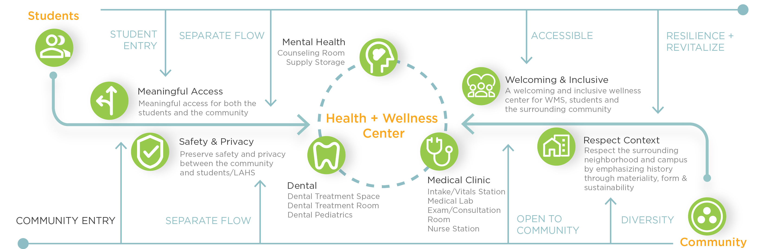
LAUSD Wellness Center Model
17 Wellness Centers District Wide
LAUSD Wellness Centers offer Comprehensive Health Care
Open to Families & School Community
Notes:
Comprehensive care : Physical Health, Mental Health, and Dental Health.
Serving the whole child and the community at large

Slide 14
LAUSD Wellness Center Model
3rd party community clinics & non-profit provider partnerships to offer services that the District is unable to provide
Convenient & trusted care without leaving school, serving the student, family and surrounding community
Accessible prevention, education, early intervention & screening

Slide 15
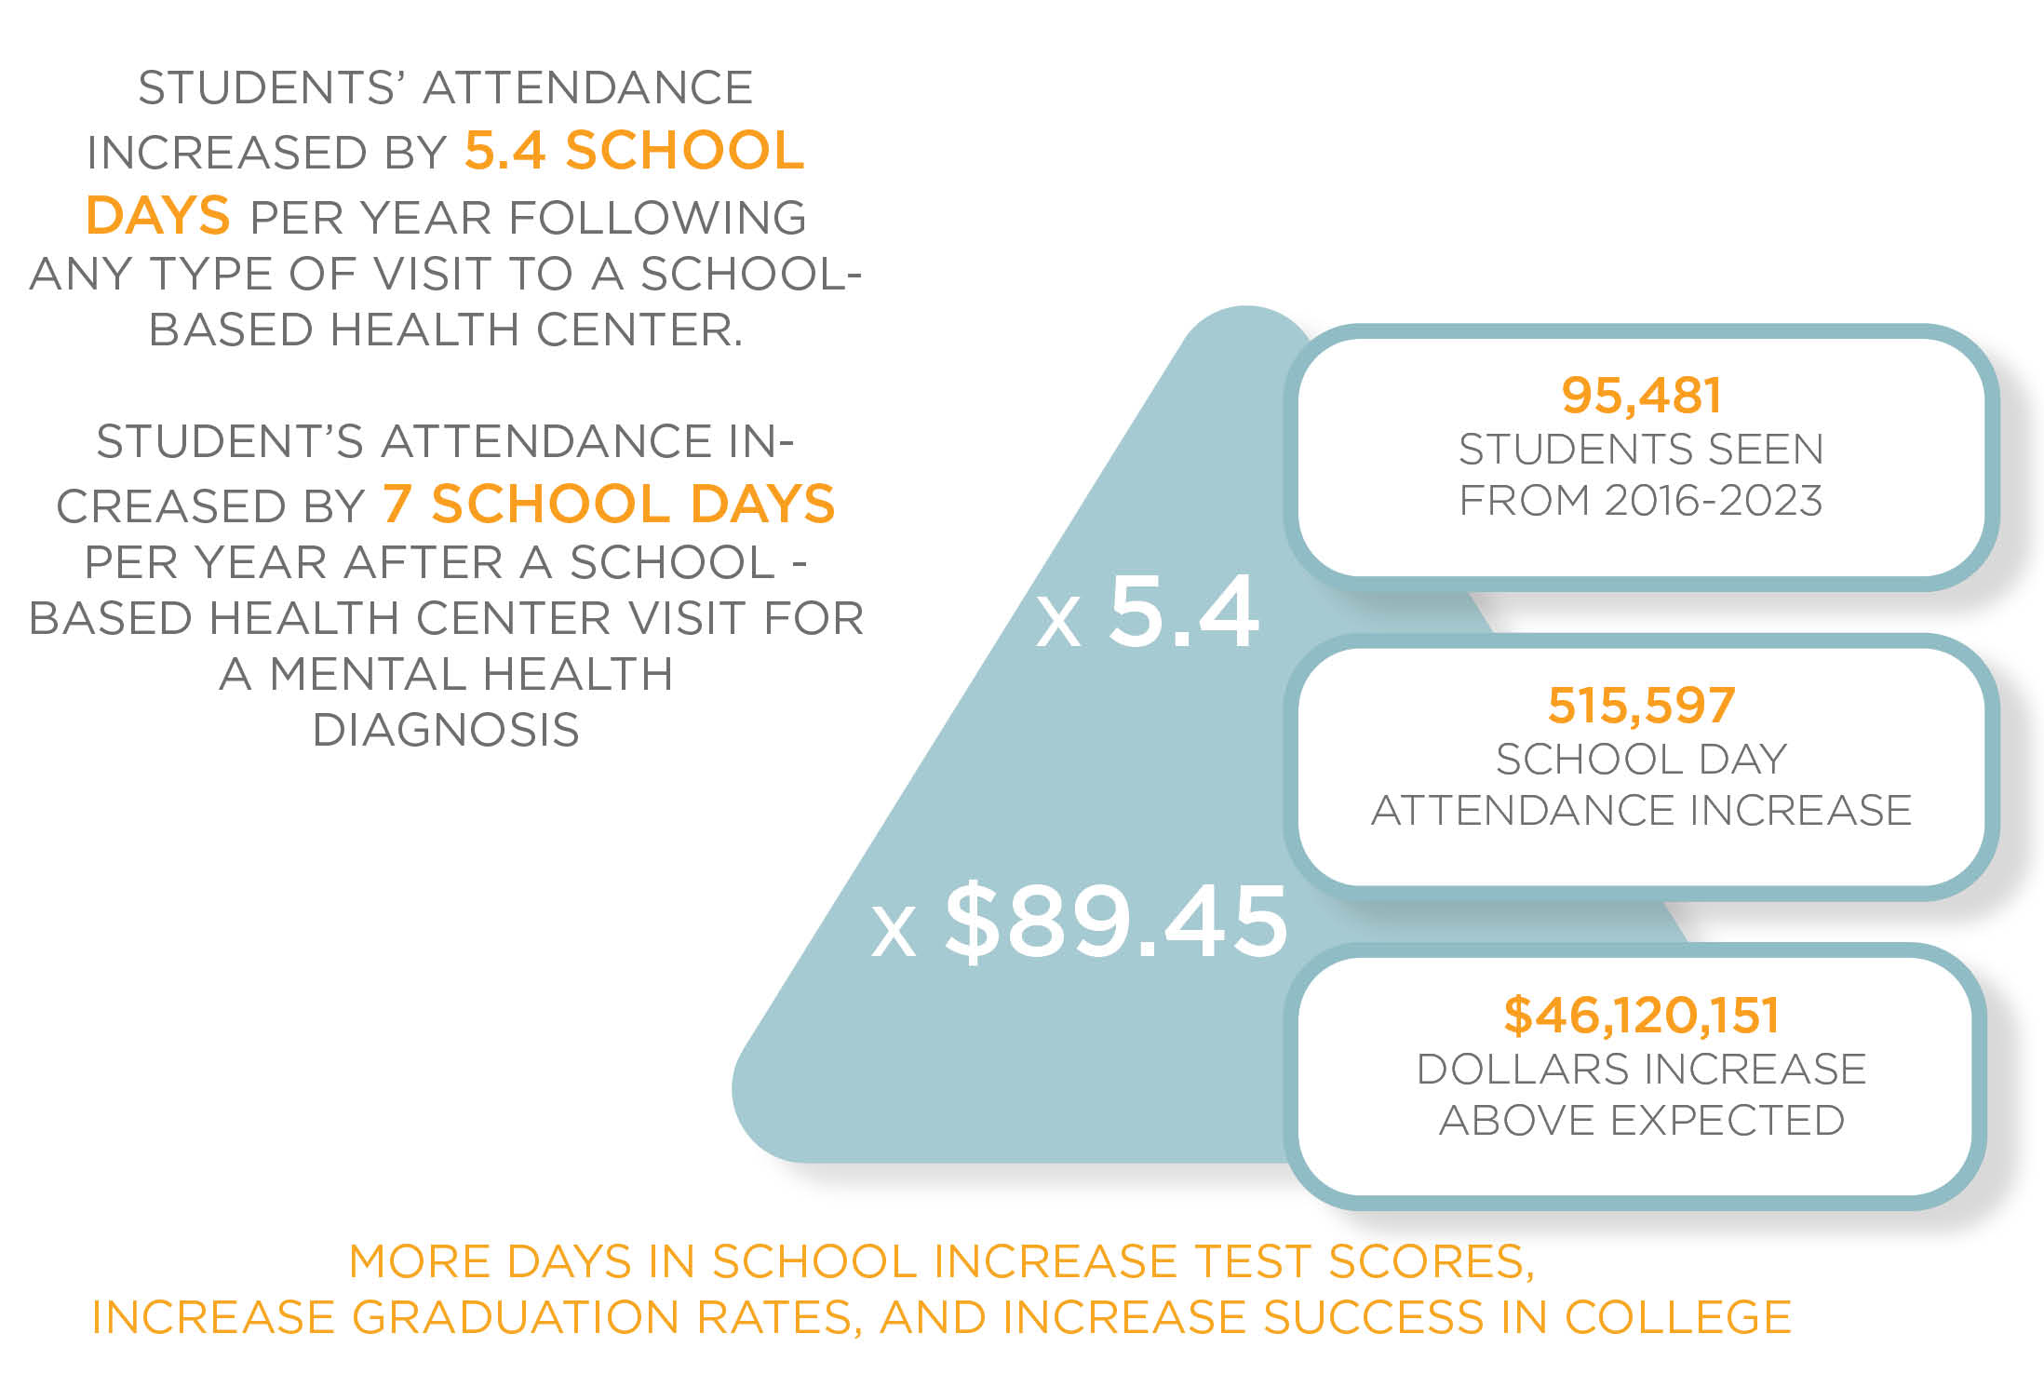
Whole Child Wellness
Healthy minds and bodies lead to better focus, attendance, and graduation rates.
School-based health services reduce course failures and dropouts.
Students’ attendance improves after visiting a school-based health center—boosting ADA funding that supports schools districtwide.
Lim, C., et al. School Attendance Following Receipt of Care From a School-Based Health Center. J. of Adol. Health. Sept 12, 2023.
https://www.lausd.org/Page/18488test scores and lower dropout rates. The Case for School-Based Health Centers | California School-Based Health Alliance

Slide 16
Rethinking Wellness Spaces
Which design elements would make you feel more comfortable in a health care setting?

Slide 17
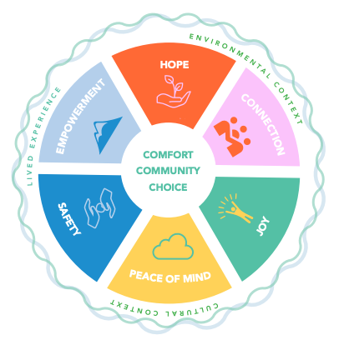
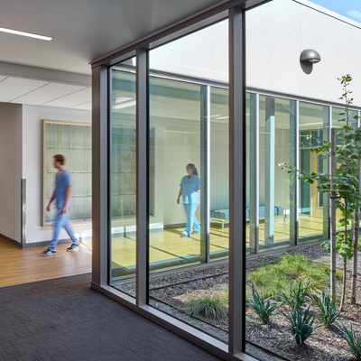
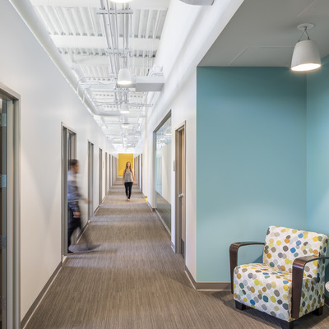
Design as a Wellness Tool
EVIDENCE/TRAUMA INFORMED DESIGN
CONNECTION TO NATURE/BIOPHILIA
COMFORTING INTERIORS

Slide 18
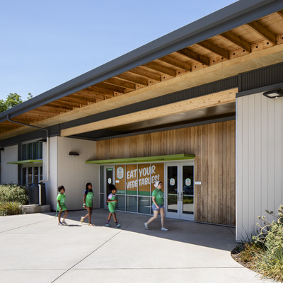
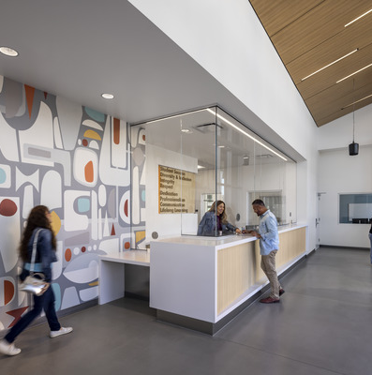
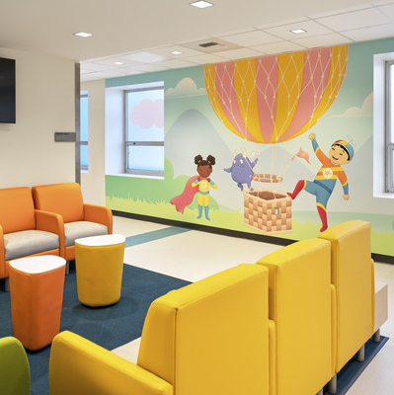
Design as a Wellness Tool
WELCOMING ENTRY
ENHANCED PRIVACY & SAFETY
PATIENT CHOICE/ CONTROL

Slide 19
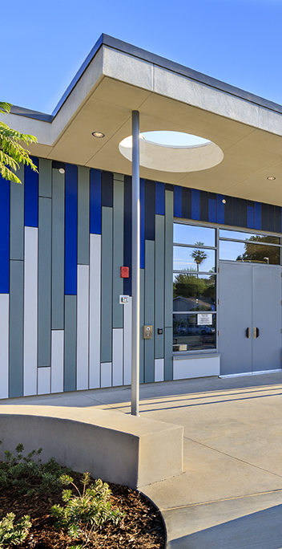
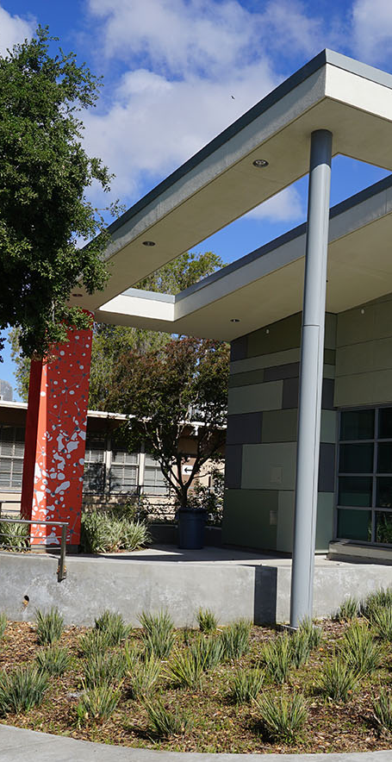
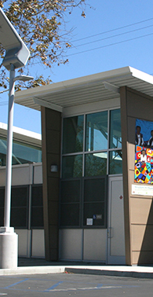
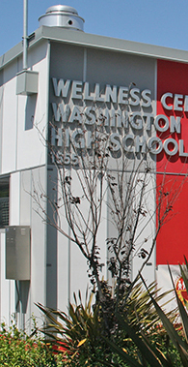
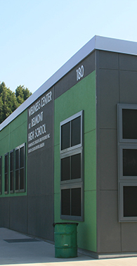
Design Principles
POSTIVE USER EXPERIENCE
CREATE A HEALING ENVIRONMENT
SUPPORT OPERATIONAL EFFICIENCY
ENCOURAGE COLLABORATION
PLAN FOR FLEXIBILITY
Patients, Students, Family Members, Visitors & Staff
Wellness-Orientated Design
Program & Space Planning
Integrated Spaces
Adaptable for Future Needs

Slide 20
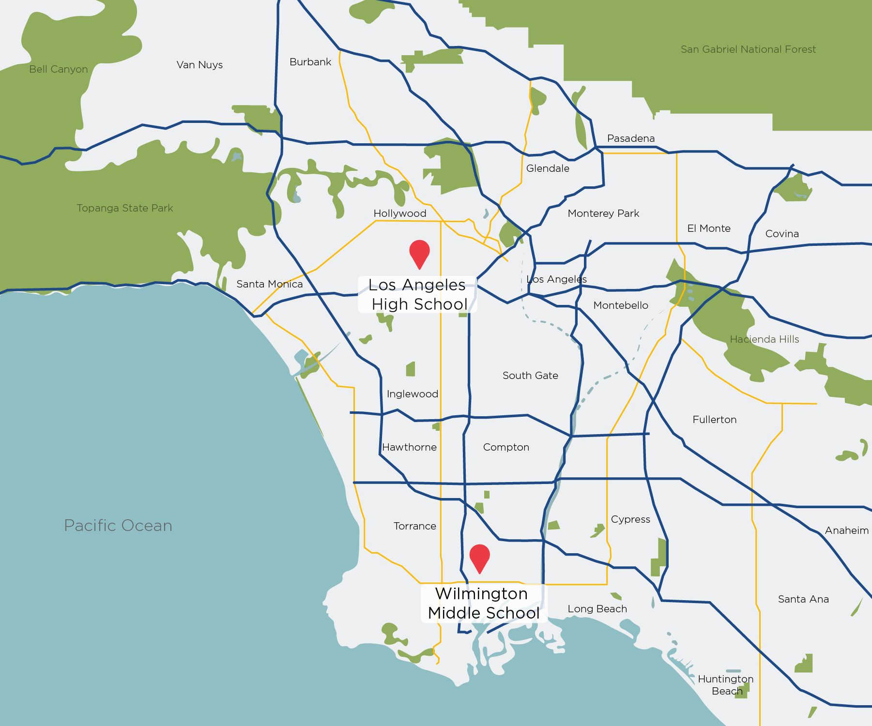


LAUSD Wellness Center Case Studies
Los Angeles High School
Wilmington Middle School

Slide 21
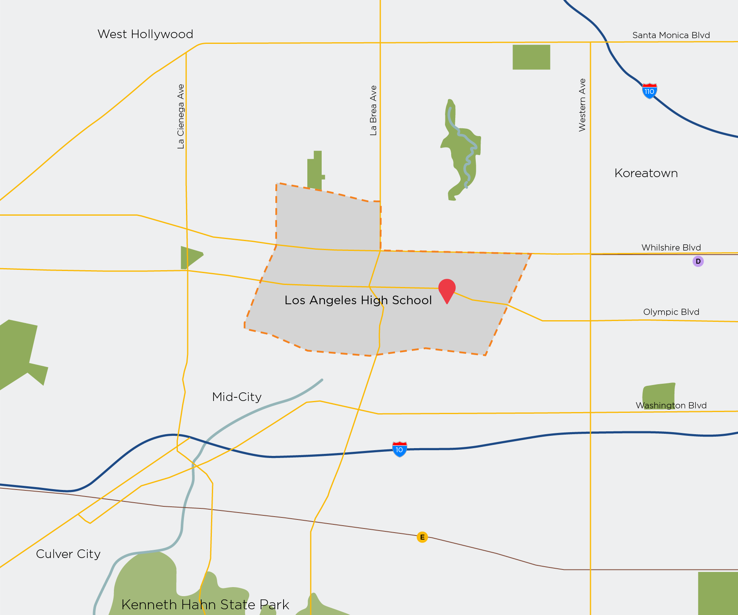
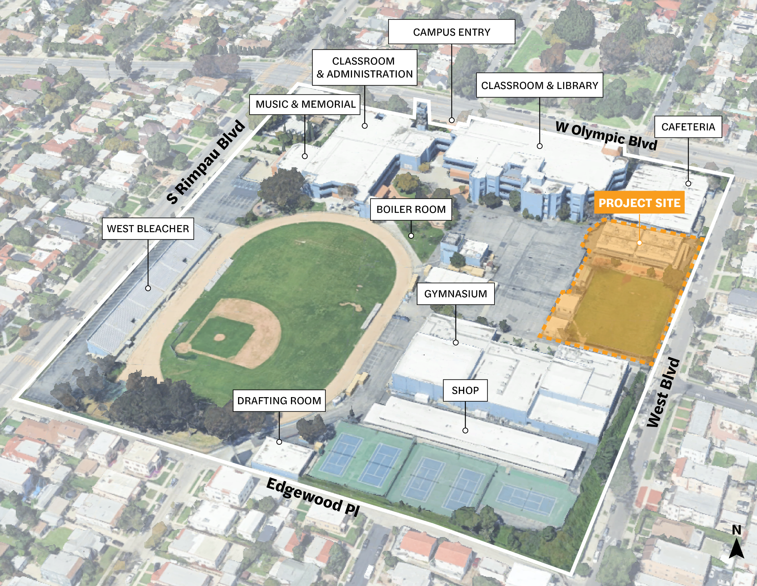
Case Study 1 – Los Angeles High School

Slide 22
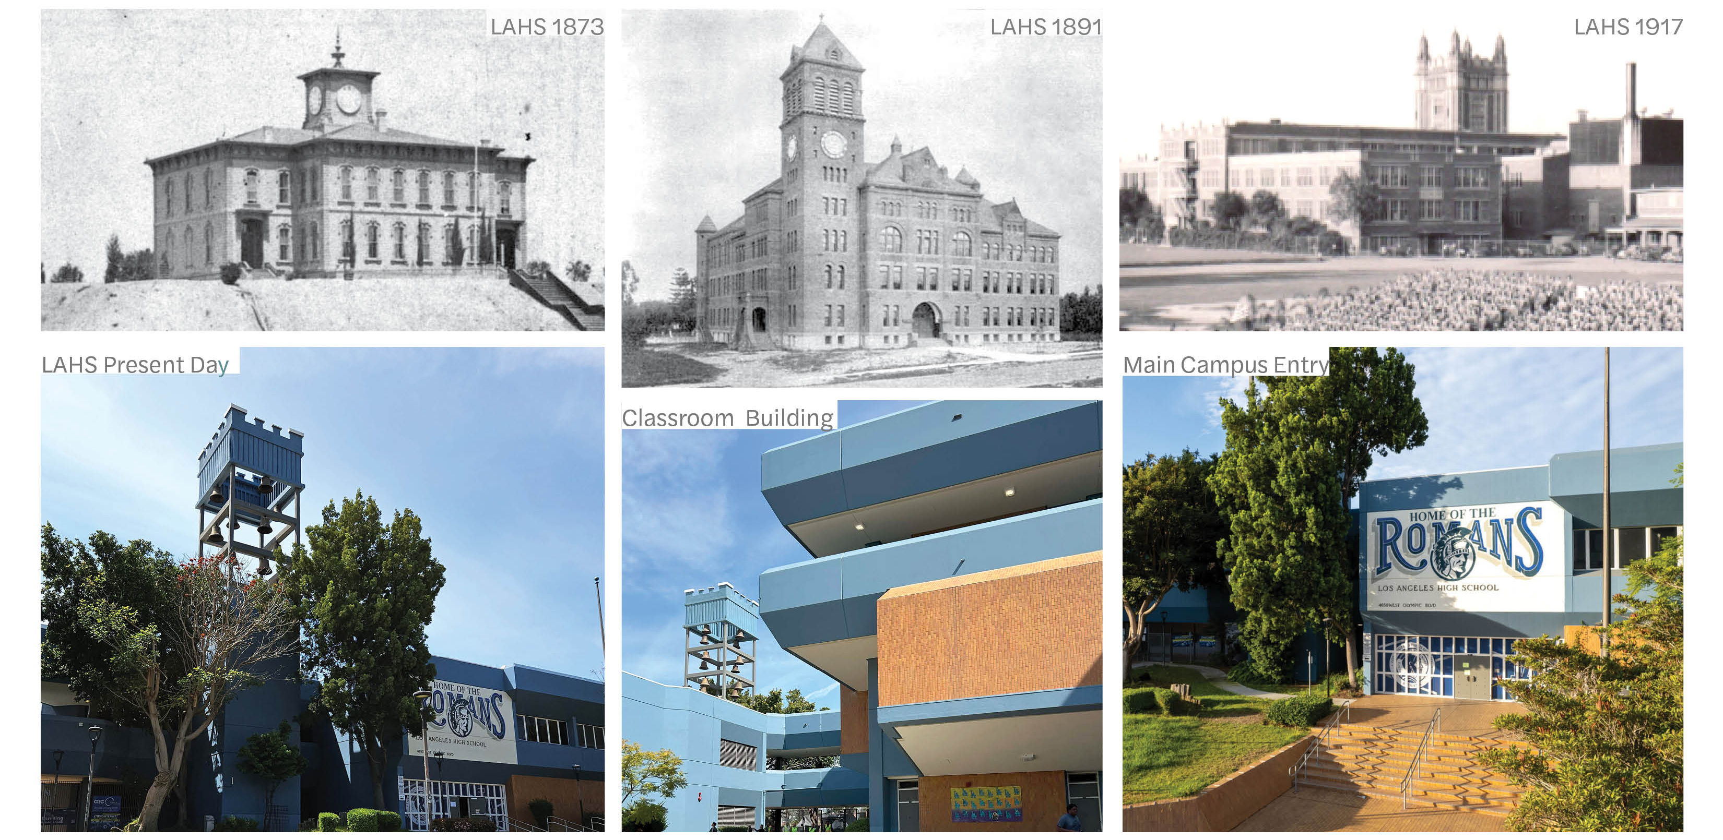
Los Angeles High School

Slide 23
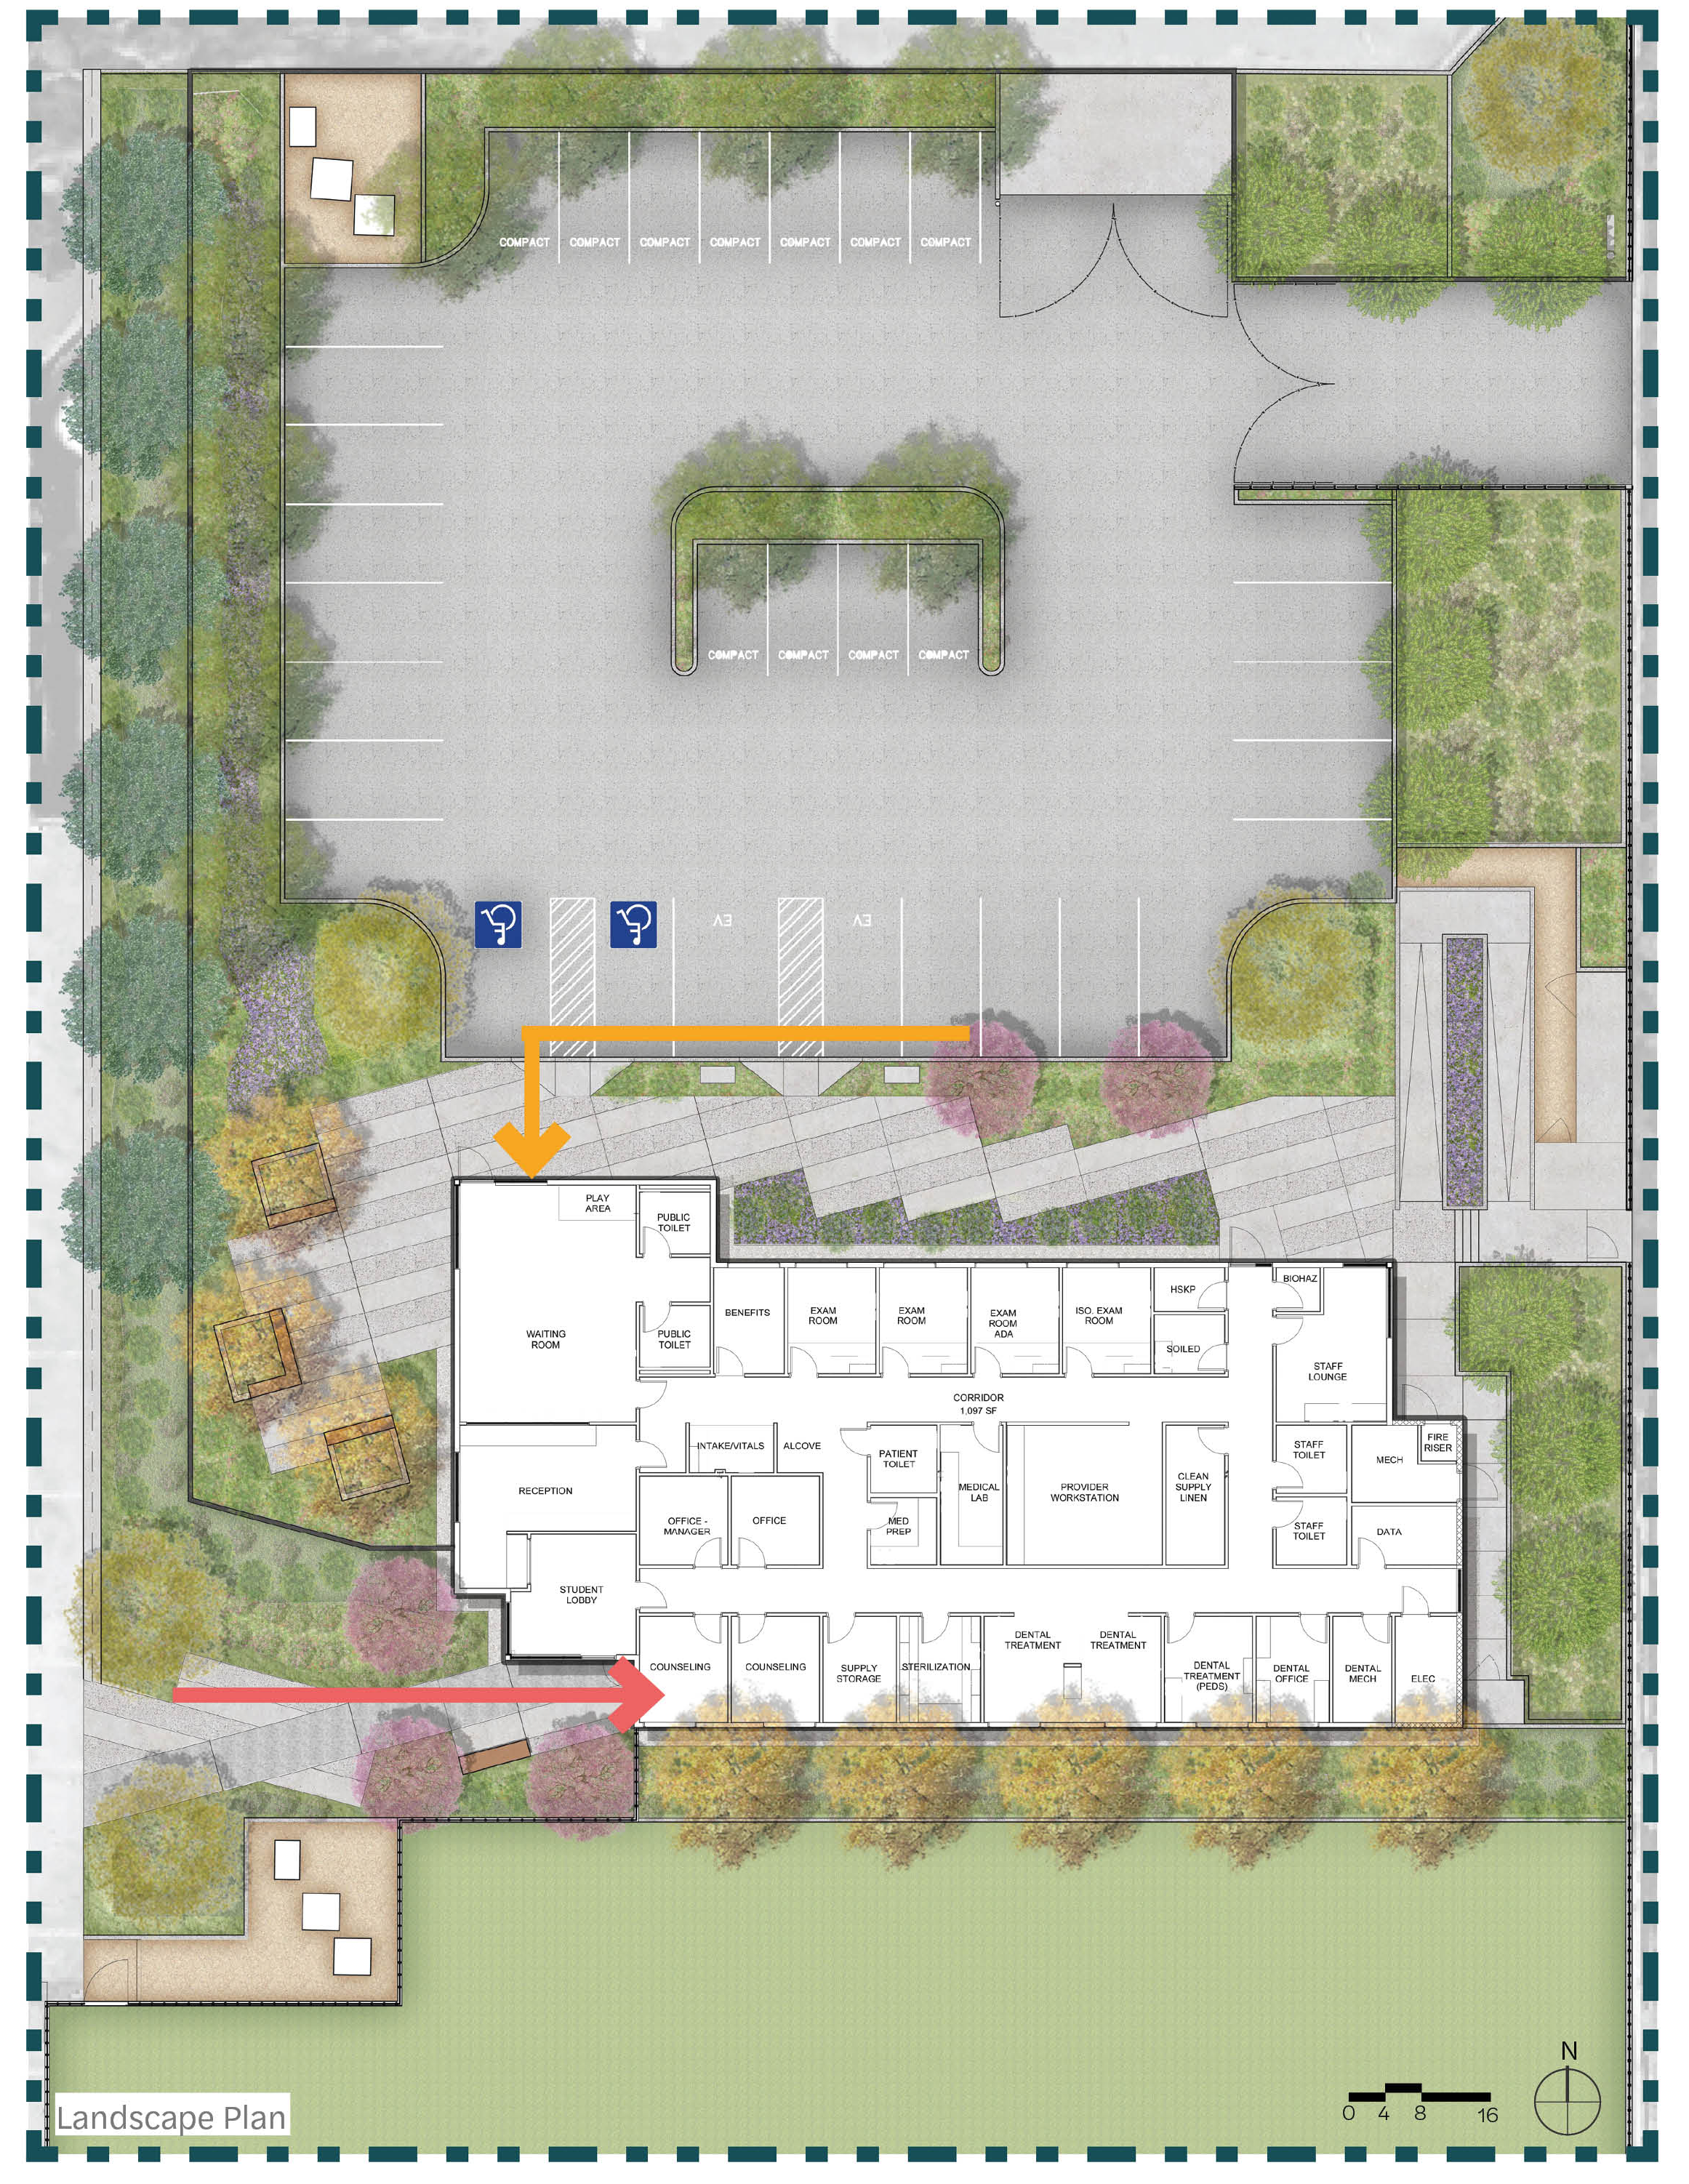
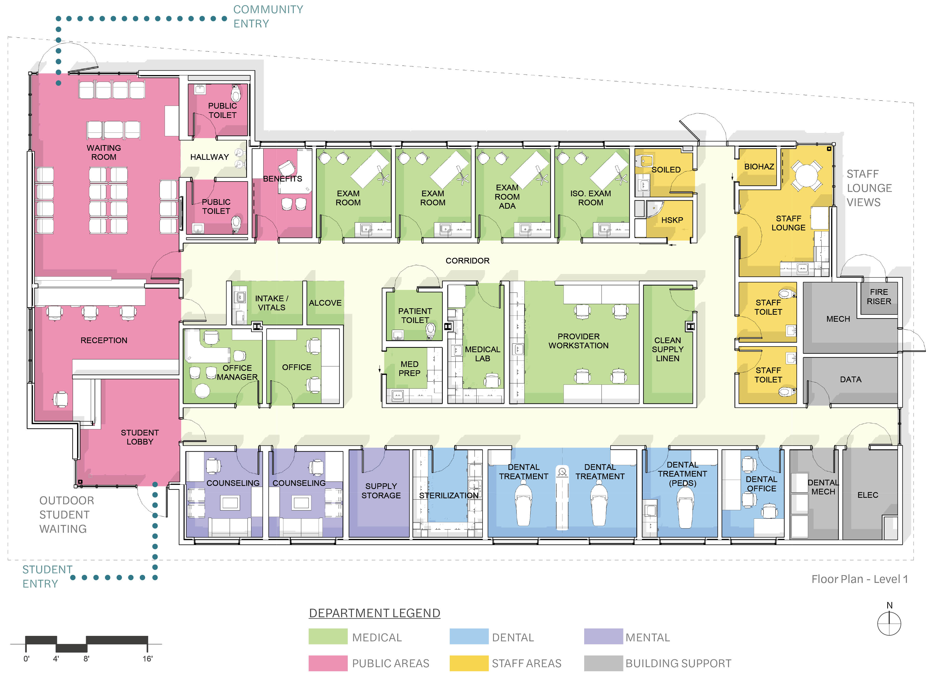
Los Angeles High School

Slide 24
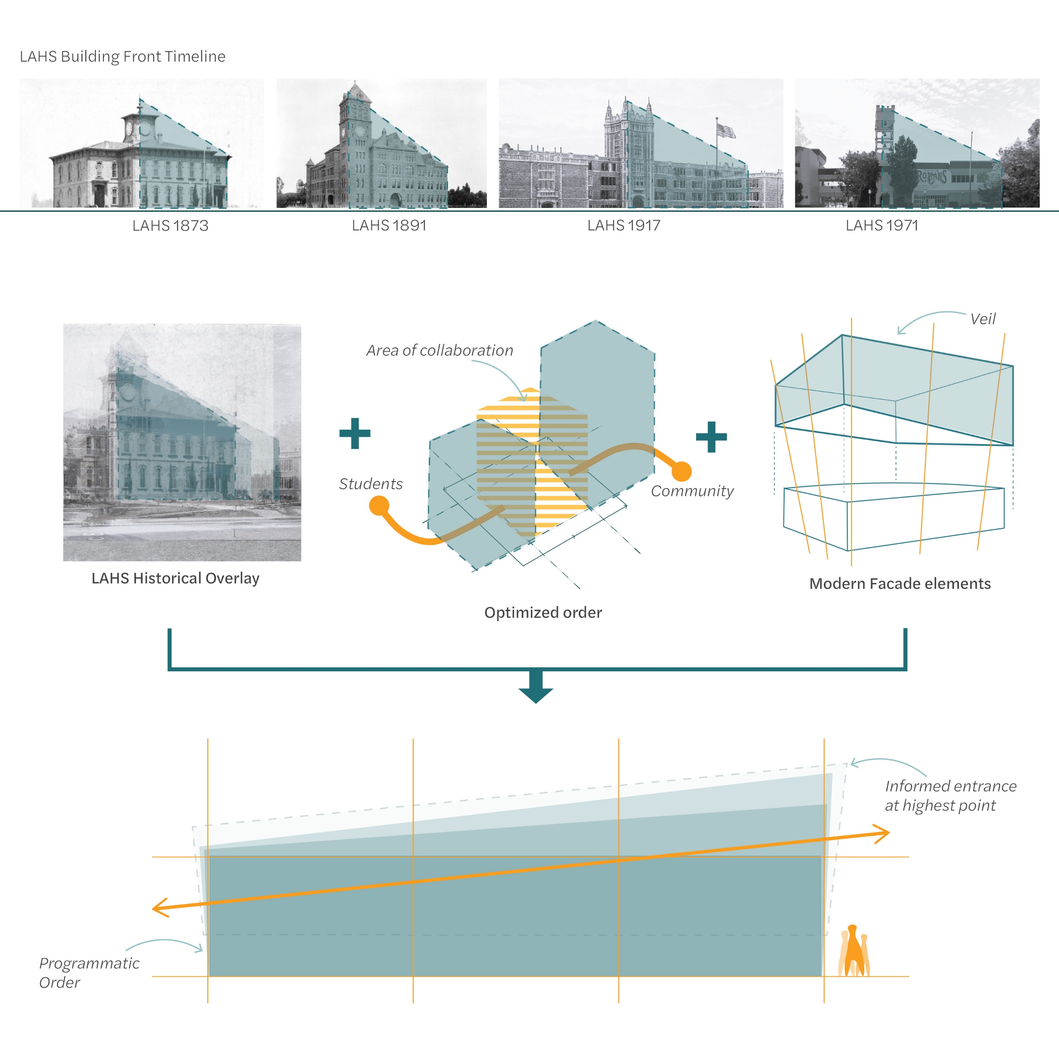
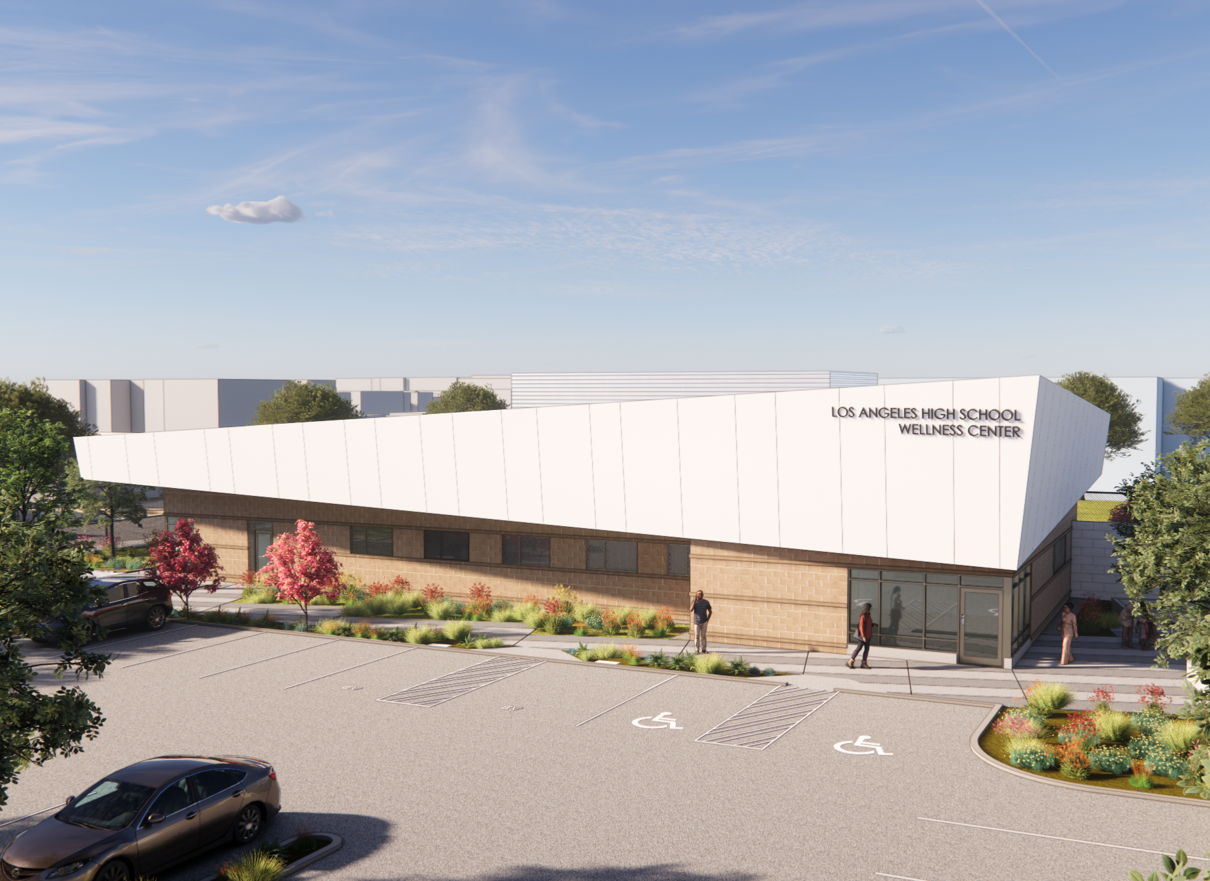
Los Angeles High School

Slide 25

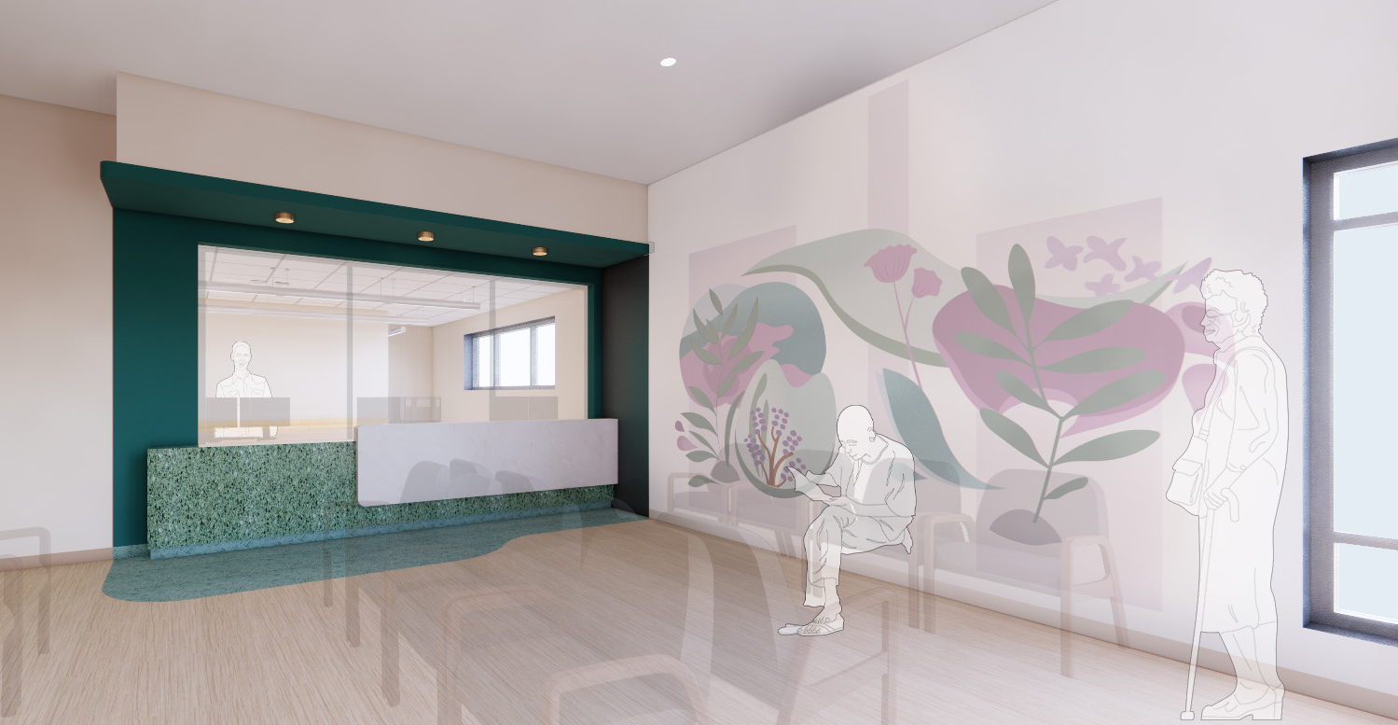
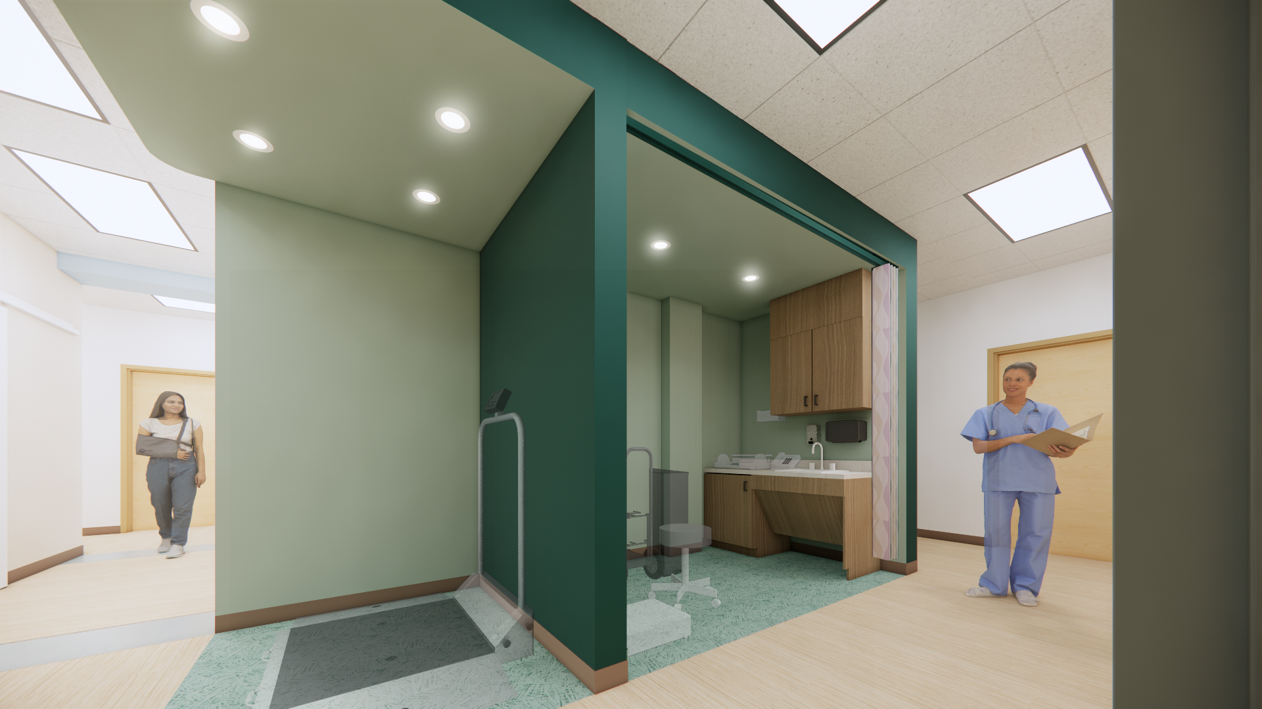
Vibrant Vitality - LAHS

Slide 26
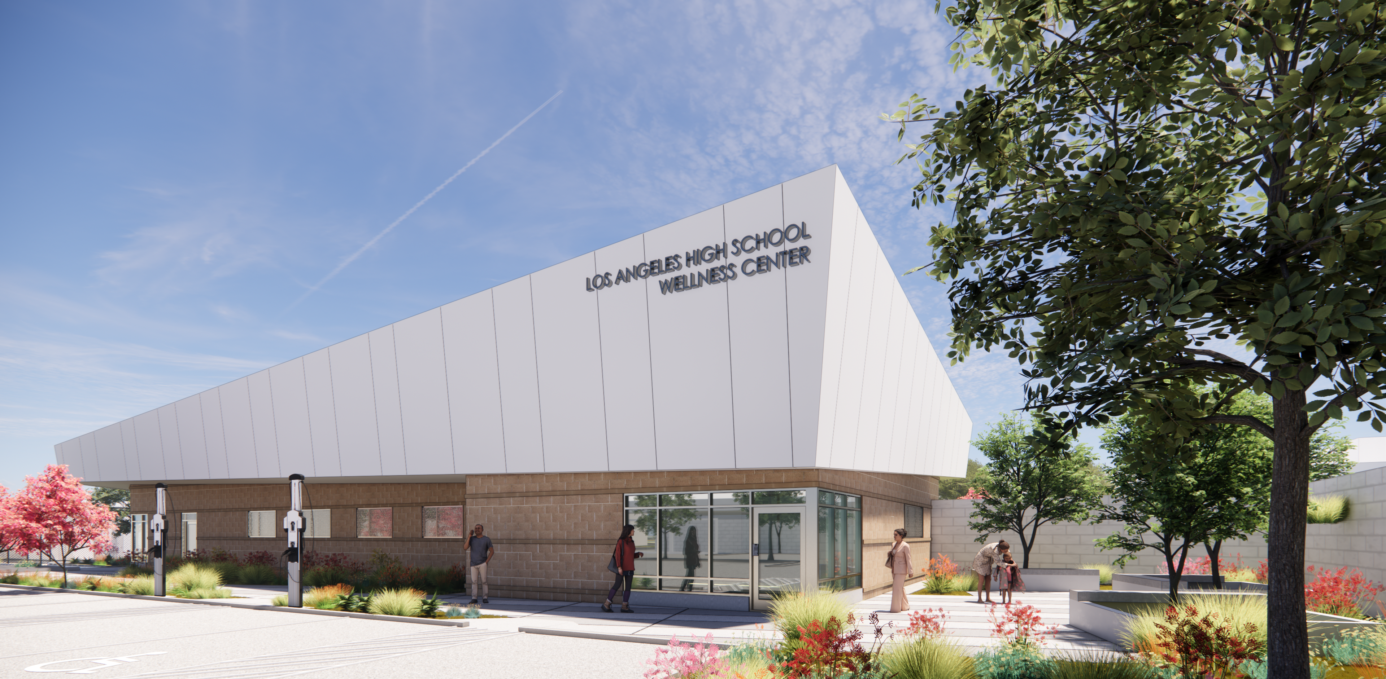
Los Angeles High School

Slide 27
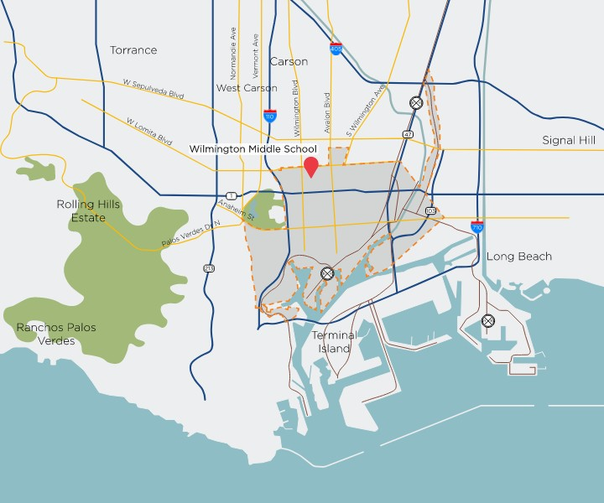
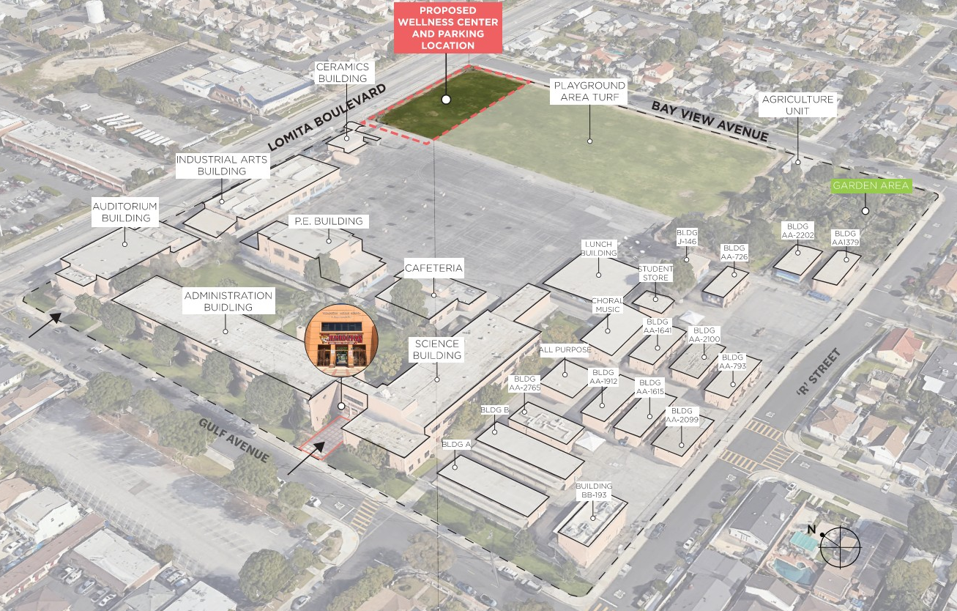
Case Study 2 – Wilmington Middle School

Slide 28



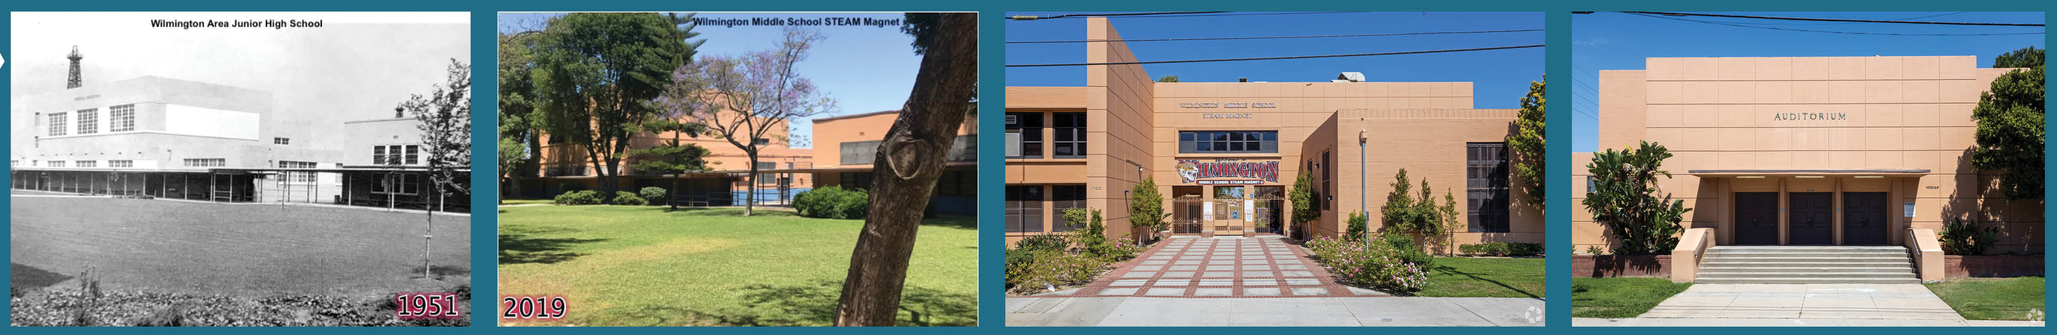
Wilmington Middle School
High School Graduate or Equivalent: 28%
Industrial Hub with major refineries. One of California’s largest oil fields
46% manufacturing + labor employment
Average household size: 6.2

Slide 29
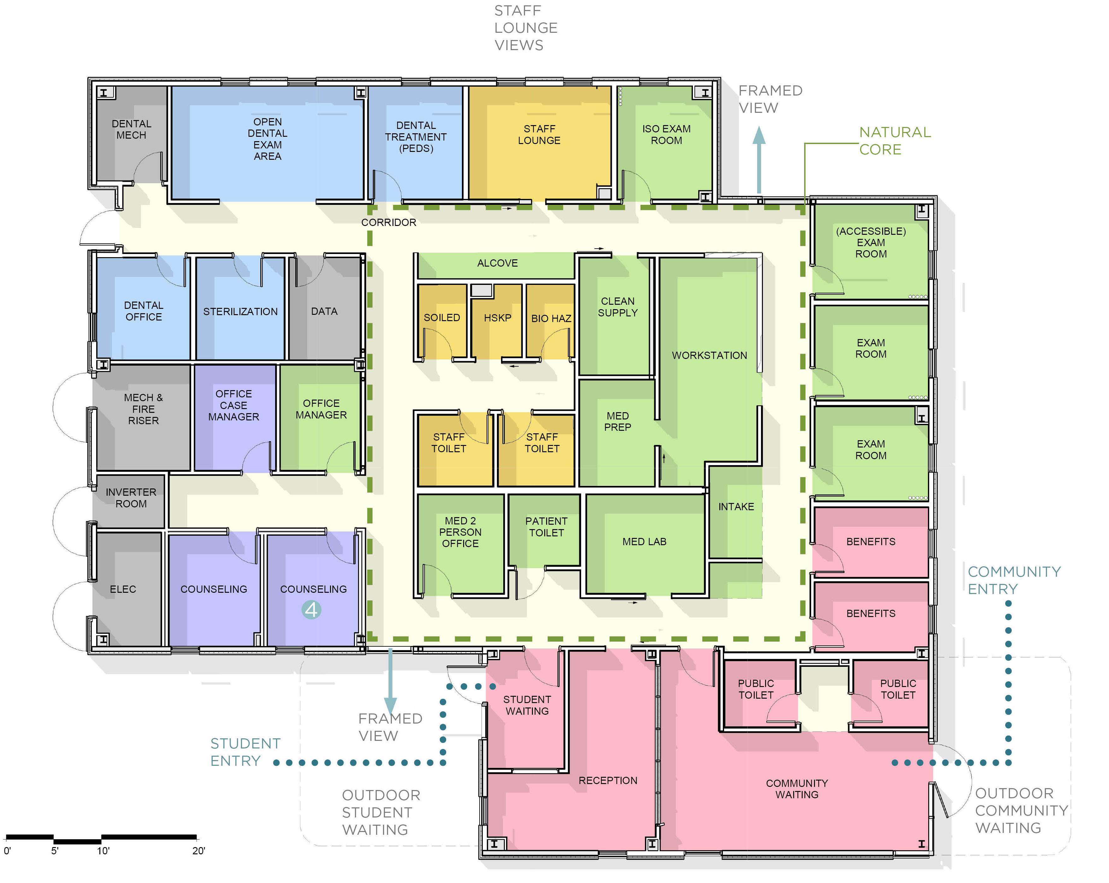
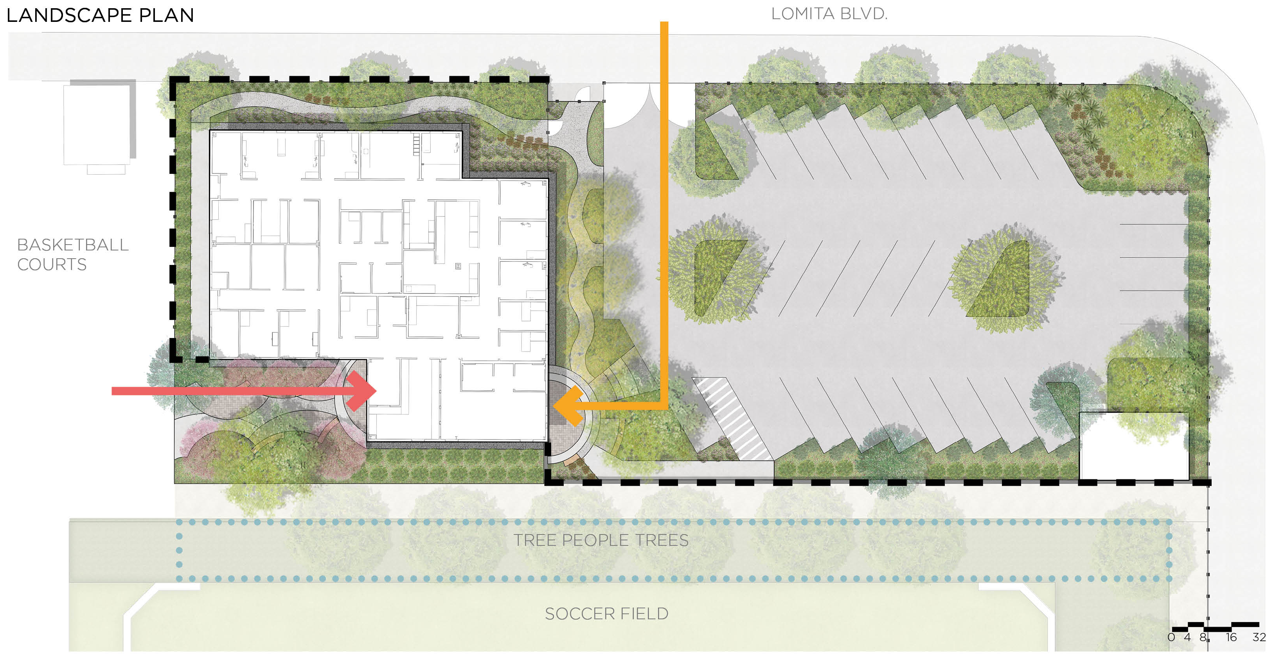
Wilmington Middle School

Slide 30
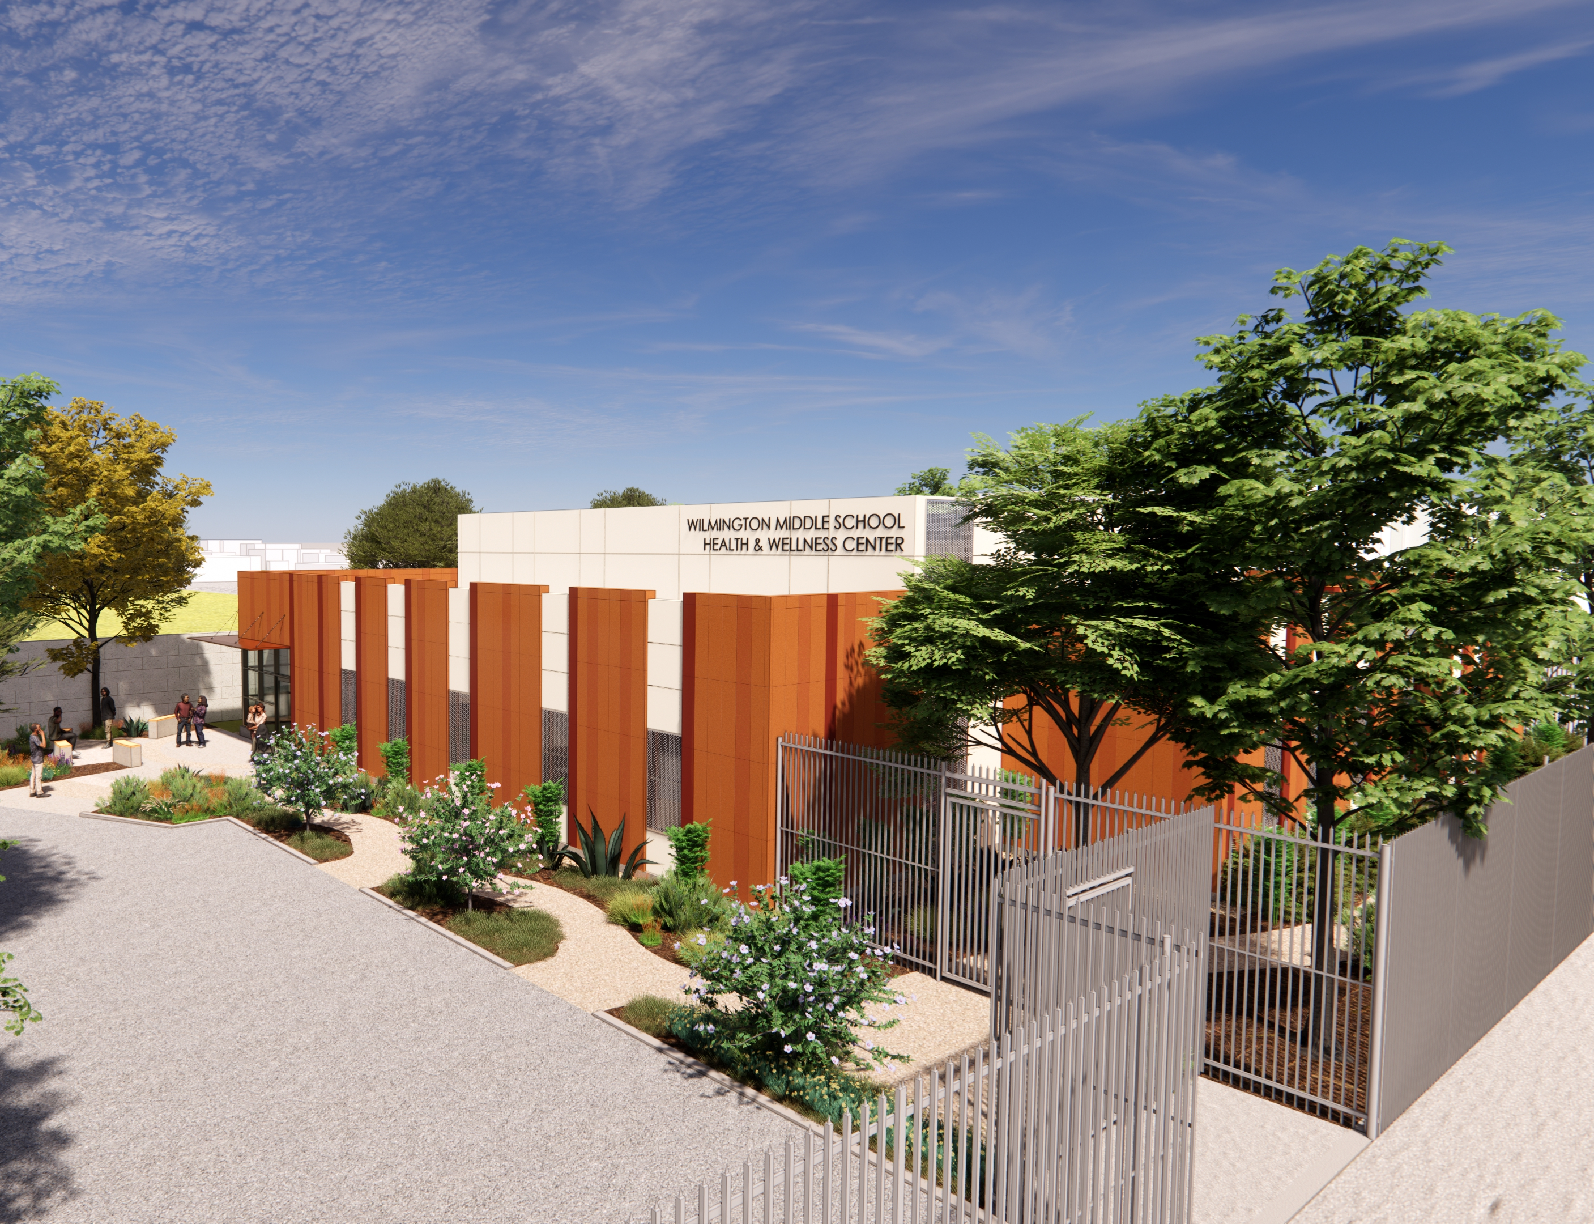
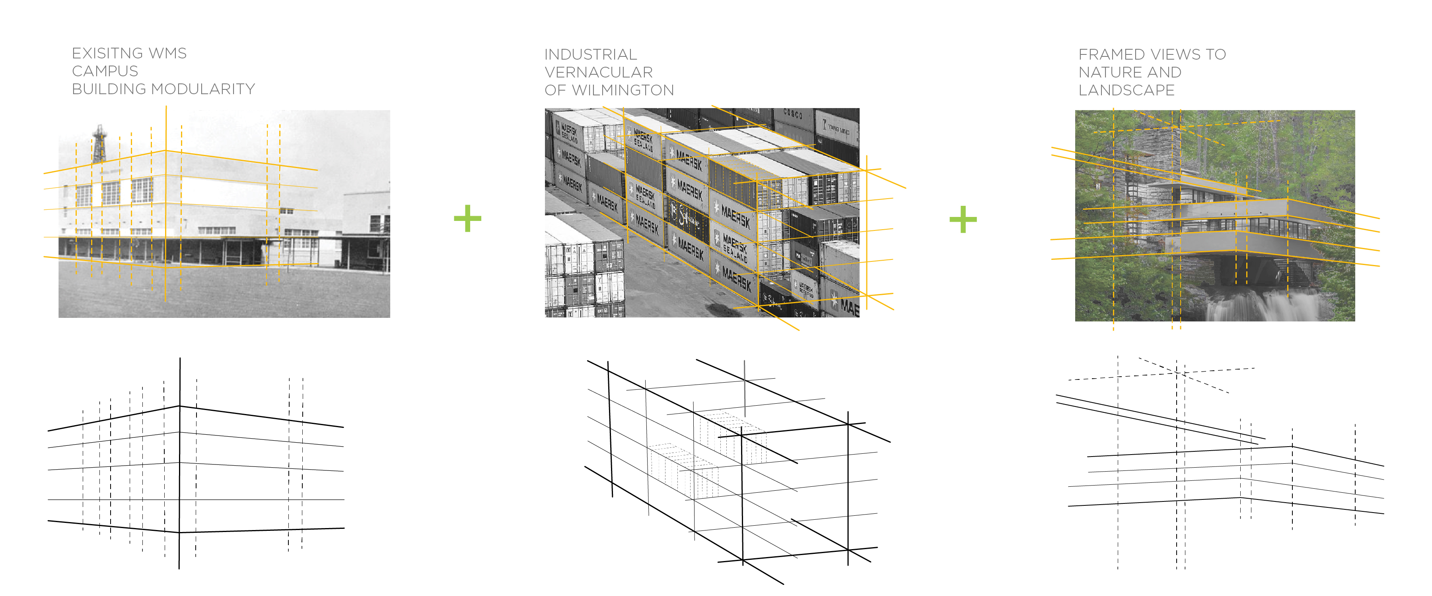
Wilmington Middle School

Slide 31
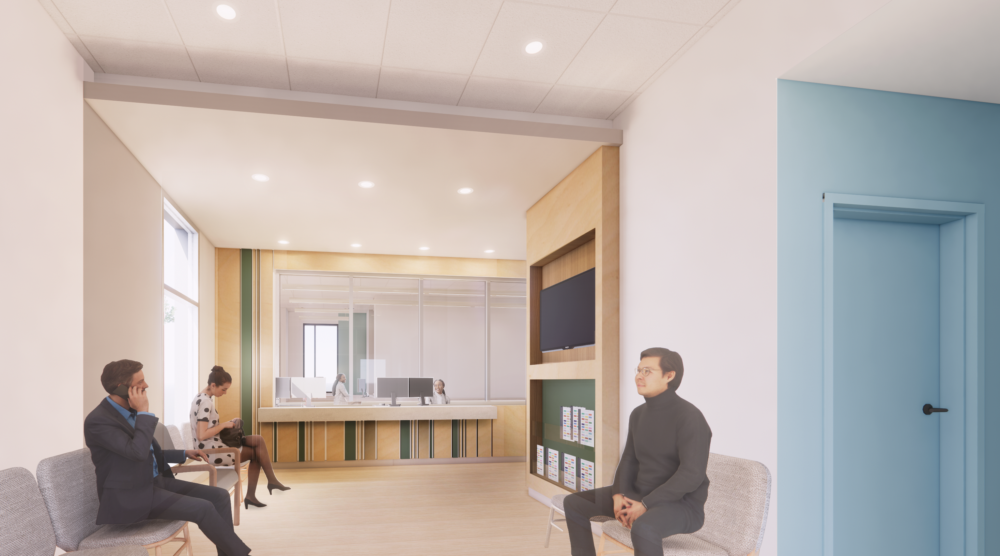
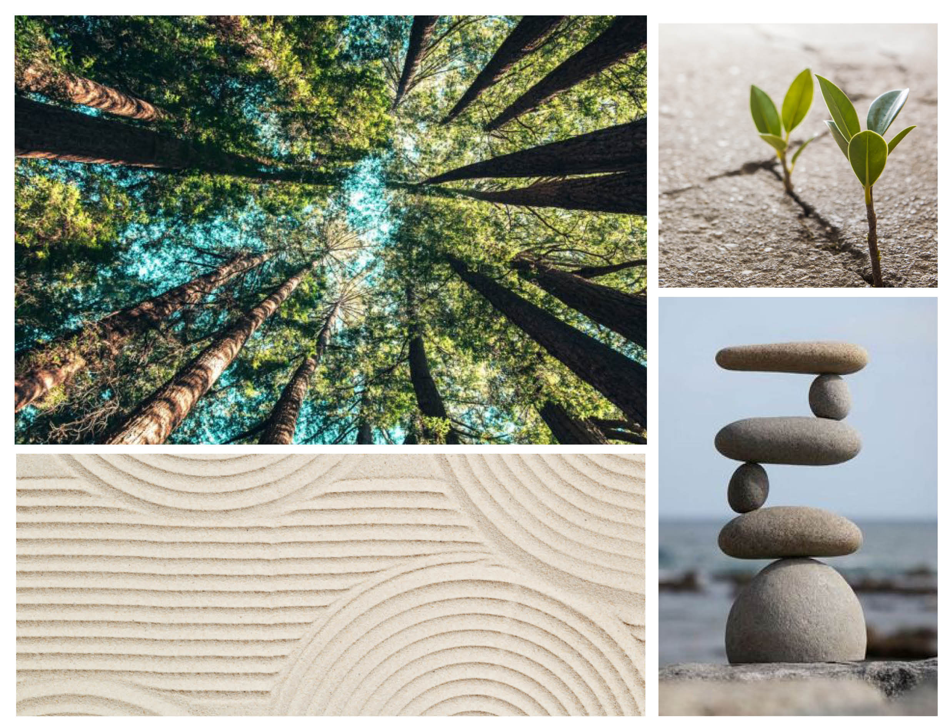
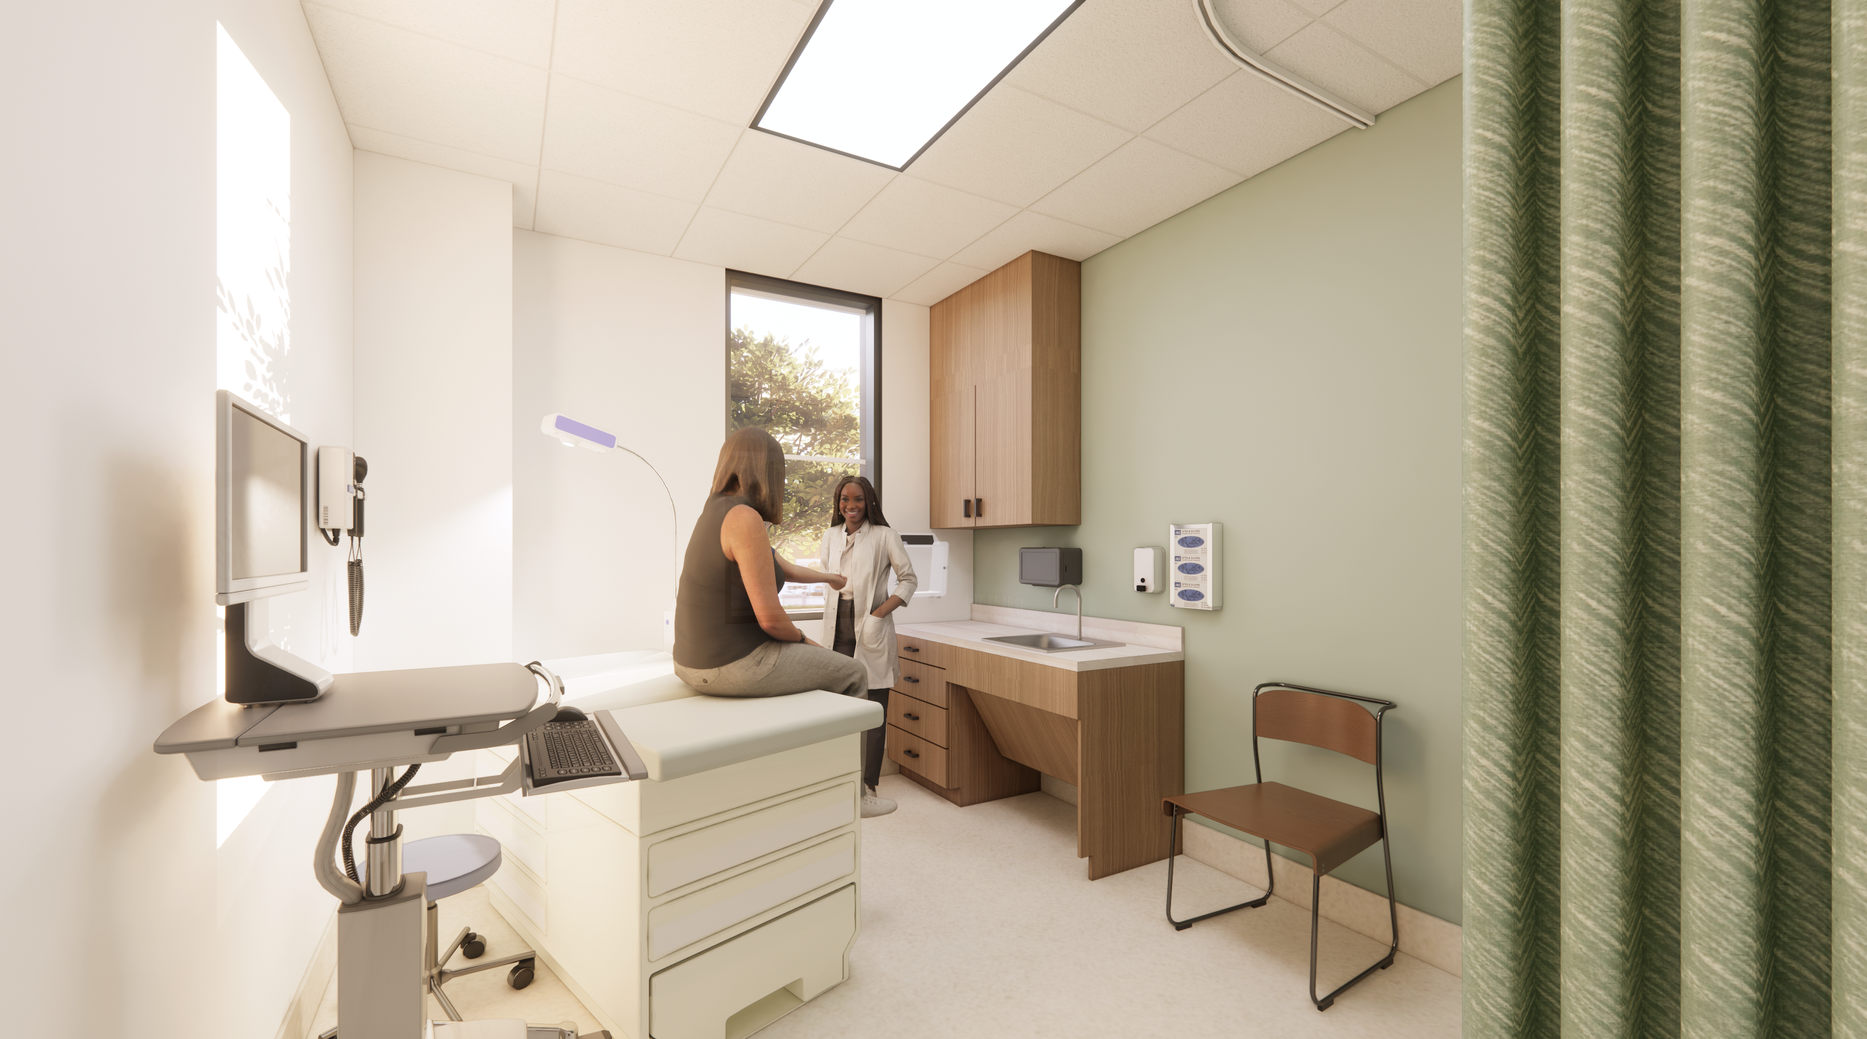
Roots & Rhythm- WMS

Slide 32
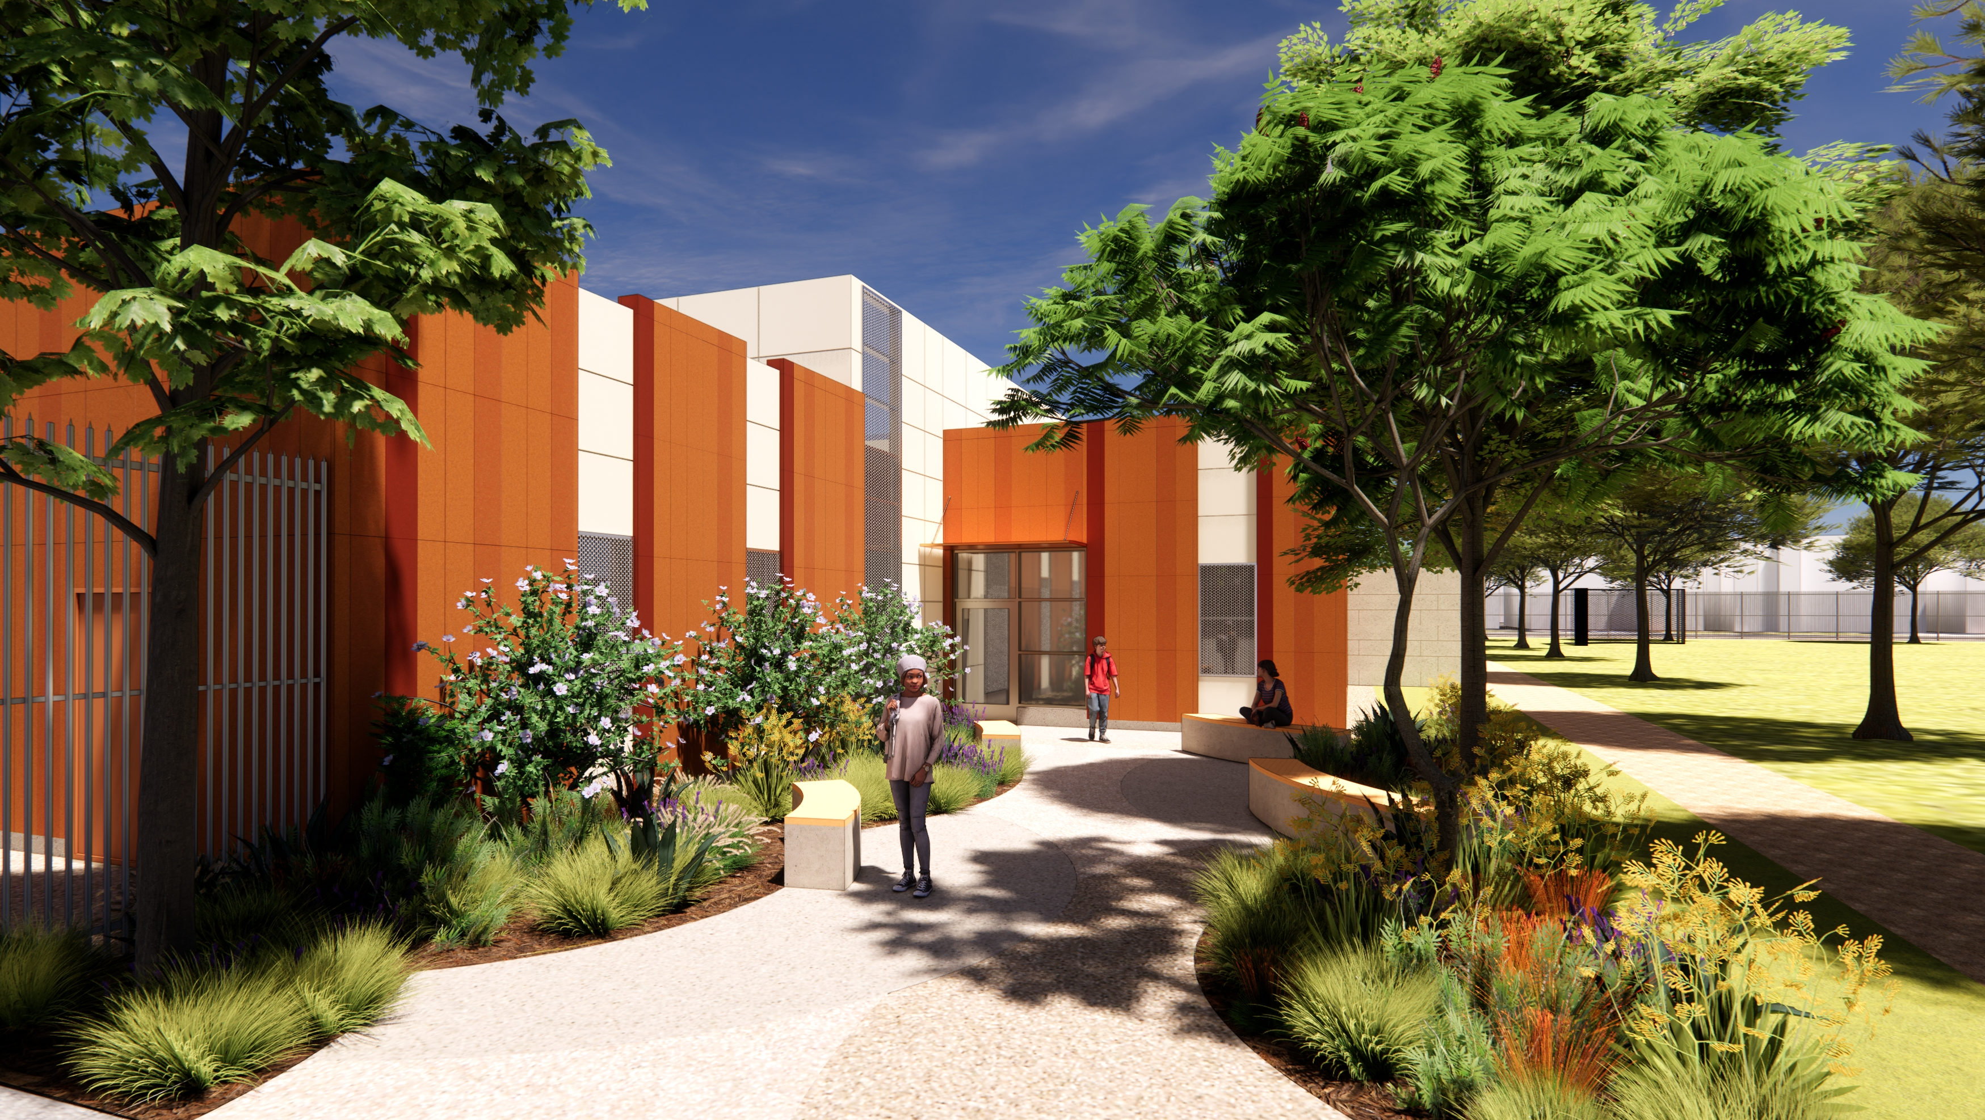
Wilmington Middle School

Slide 33
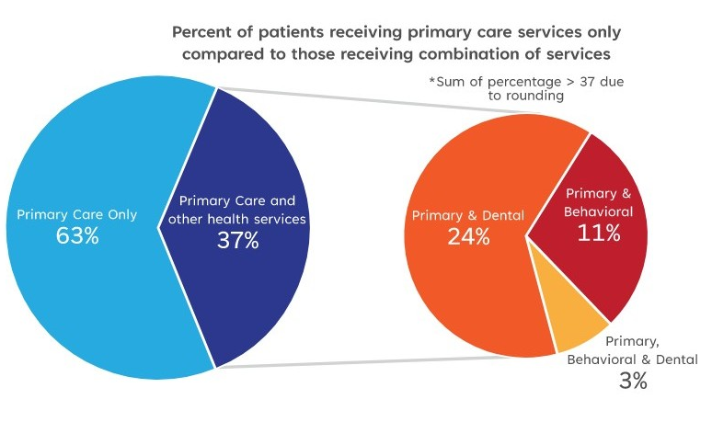
Measuring Impact
In the 2023-24 school year, the District’s 17 Wellness Centers & 3 School-Based Health Centers served up to 54,259 patients
9% increase from 2022-23 school year
Student Age patients ranged between 14-19 years old
7,500 patients visited a school-based health center for behavioral health, a 25% increase from the previous year.
Puffer,M., et al. The Los Angeles Trust of Children’s Health Data xChange Impact Report 2025. Sept 25, 2025.
Notes:
One of our districts has seen up to 400% increase in mental health issues
Ongoing rise in health and mental health issues

Slide 34
Break Out Activity
Prompt: You have seen what is possible- now let’s imagine what student wellness could like in your own community.
4-minute discussion
Instructions:
Turn to a neighbor
Take up to 4 minutes to discuss:
What space or service in your school/district could better support holistic wellness?
What design move would make it feel more inclusive, calming or supportive?

Slide 35

Q
A

Slide 36


Thank You!
#edspaces
Please scan the QR code to provide session feedback.

Slide 37
#edspaces
Thank You!
Please scan the QR code to provide session feedback.
Mobile App - If you have not done so already, please download the mobile app through your device’s app store.
Session Evaluations - Rate Sessions Through the Mobile App Instructions:
Open and load mobile app
In the left sidebar, tap “Schedule”
Locate and select the session you are attending
After opening the individual session page, tap the “Session Survey” link to evaluate the session.

