Slide 1

Get to Know

Slide 2
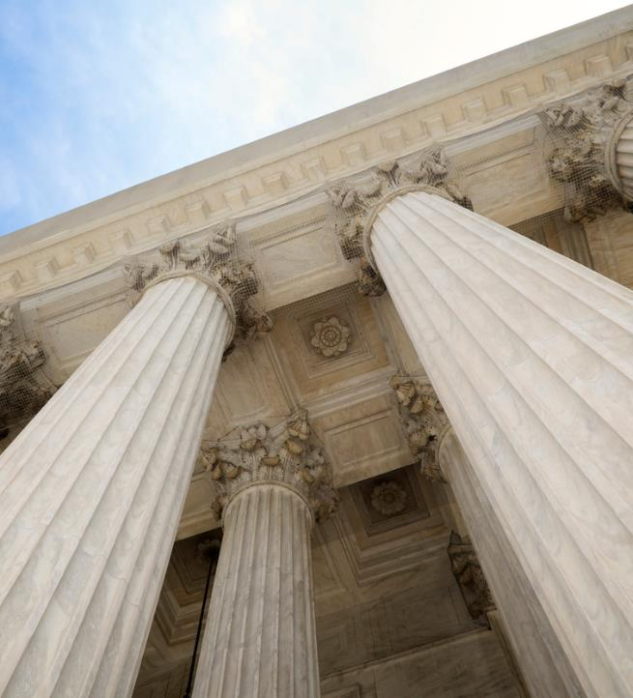

The source of Sourcewell
Unit of government in Minnesota
Legal authority* to establish contracts
Satisfy solicitation process for public sector customers
sourcewell-mn.gov
*M.S. 123A.21
Notes:
Sourcewell is a government agency
M.S. 123A.21
Governed by publicly elected Board of Directors
Sourcewell employees are public employees, same as our members
We are an Alliance between buyers and Suppliers
Serves as a National Municipal Contracting Agency, enabled under the authority of Minnesota State laws and Statutes 123A.21 and M.S.471.59

Slide 3
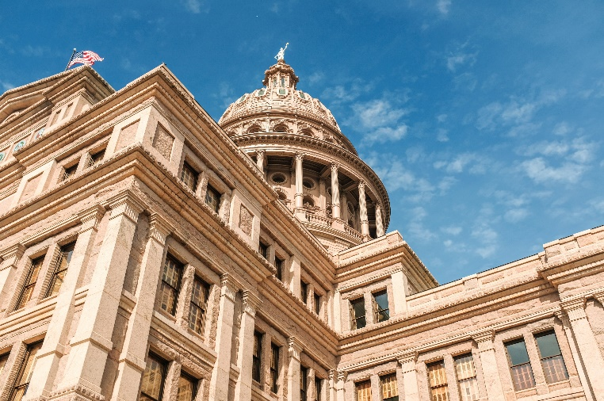



Target Audience: Public Sector Agencies
State and local government
Cities
Counties
States & state agencies
Special & water districts
Native American tribes
Port & transportation authorities
Public and private education
K-12
Special education districts
Charter schools
Higher education/universities
Nonprofits (tax-exempt)
Hospitals & nursing homes
Rural power cooperatives
Housing authorities
Member associations & coops

Slide 4





Procurement Process
Registration
Competitively solicited
Legal
authority
Awarded
contract
Agencies
Suppliers
Works with supplier
A legal contracting pathway between buyers and suppliers.
and procures directly

Slide 5














Sourcewell — depth and breadth
Administrative Services
Construction Contracting
Construction Equipment
Facilities
(MRO)
Fleet and
Related
Food
Grounds and Agriculture
Health and
Science
Insurance
Solutions
Office and Technology
Parks, Recreation, and Athletics
Public Safety
Public Works
Roads and
Airports

Slide 6
What’s In It For Me?

Slide 7

Sourcewell is the bridge to success for all
Why suppliers use Sourcewell
Why agencies use Sourcewell
Agencies can choose you
Sell quality over price
Full catalog
Close business faster
Ability to prioritize high-success opportunities
Ability to choose
100% free to use
900+ competitively solicited contracts
Get what they need, when they need it

Slide 8
Sourcewell by State
Previous two years

Slide 9
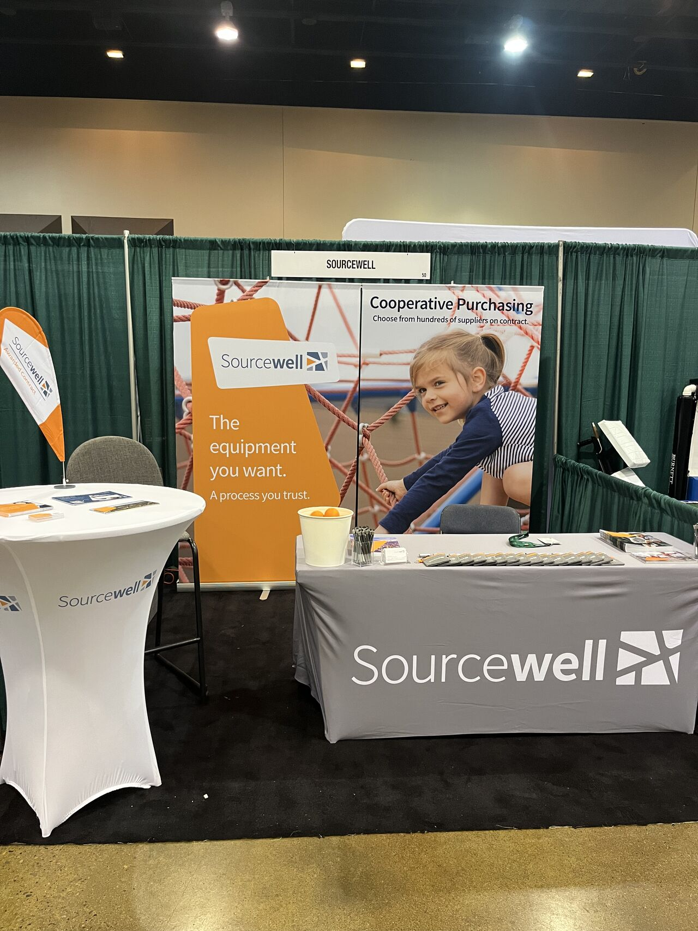
Questions? Visit with us at Booth #1041
Thank you!

