Slide 1
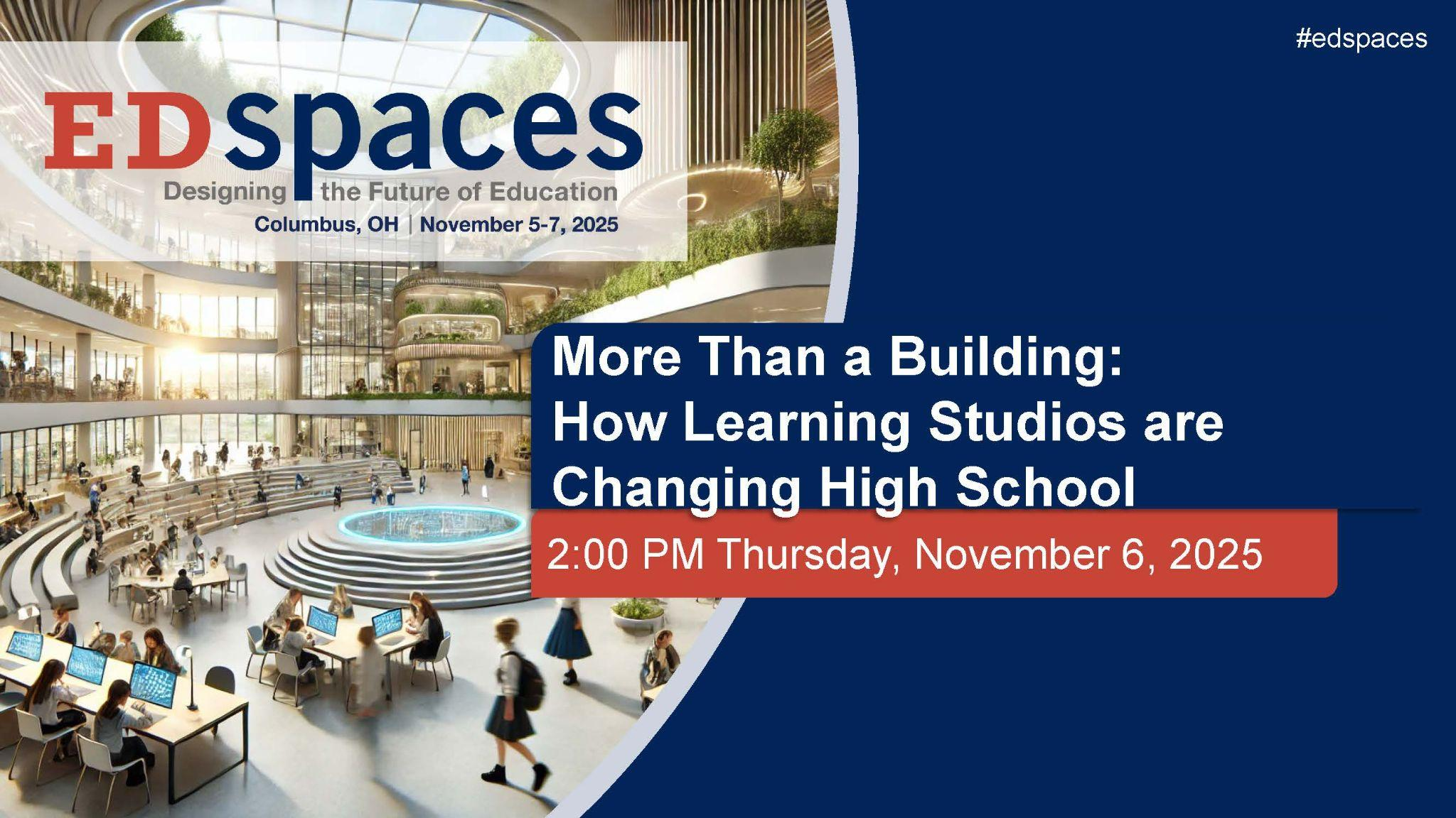

Slide 2
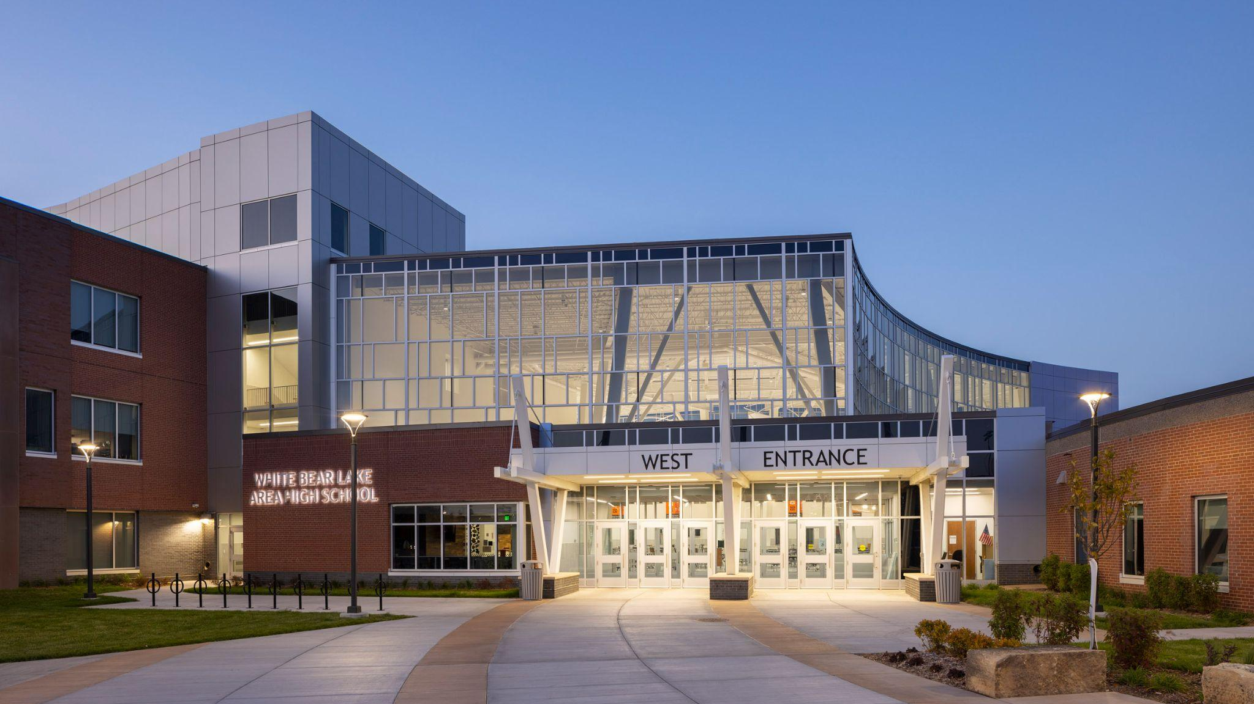
More than a Building:
How Learning Studios are Changing High School

Slide 3

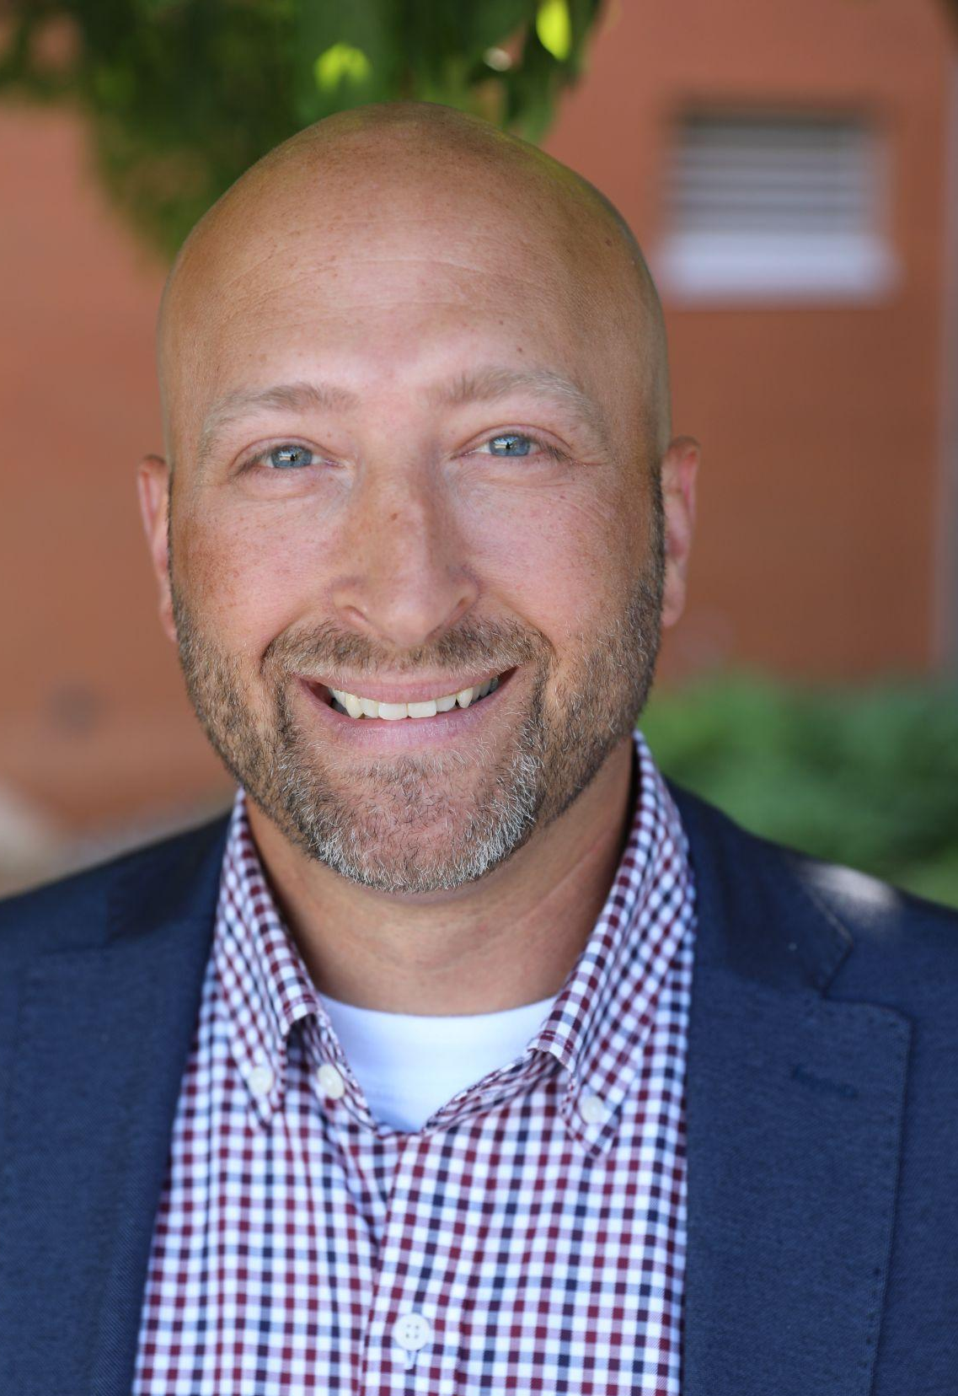



INTRODUCTIONS
Russ Reetz
Principal
White Bear Lake Area High School
Dr. Alison Gillespie
Assistant Superintendent White Bear Lake Area Schools
Matt Young
Associate Principal
White Bear Lake Area High School

Slide 4
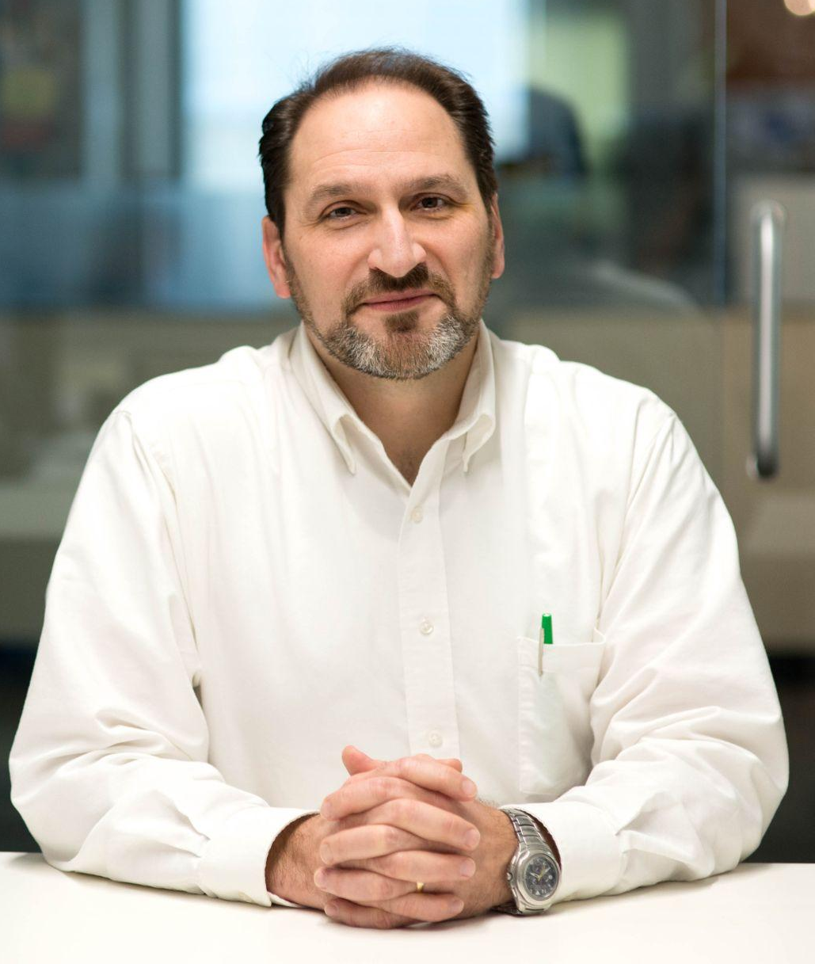


INTRODUCTIONS
Paul Aplikowski
Education Practice Leader
Maria Kennedy
Project Architect
Notes:
I’d like to start with our district stragegic plan

Slide 5


Key Design Ideas & Terms
LEARNING OBJECTIVES
Learning Objective 1 | Understand the Impact of Space on Learning – Explore how intentional design choices in learning studios foster student engagement, collaboration, and a sense of belonging in any school setting.
Learning Objective 2 | Examine the Role of Flexible Furniture and Student Choice – Learn how adaptable furniture and student-driven learning environments enhance ownership, creativity, and personalized learning experiences.
Learning Objective 3 | Analyze the Shift from Traditional Classrooms to Collaborative Studios – Identify key differences between traditional classroom setups and innovative learning studios, and discuss the benefits of increased student dialogue and collaboration.
Learning Objective 4 | Evaluate the Long-Term Impact of Learning Studios on School Culture – Discuss how transforming physical spaces contributes to a more inclusive, connected, and engaging high school experience for students and staff.
Notes:
Paul? Alison?

Slide 6
THE WHOLE BUILDING BECOMES A LEARNING SPACE
Learning is no longer contained to the “Classroom”.
Personalized Learning must support learning throughout a student’s day.
Maximizing the building as a space for learning is essential.
  Student Union
  Flex Areas
  Learning Commons (Media Center)
  Athletic Areas
  Theatre spaces
The design process incorporated this concept whenever possible.
Notes:
Alison

Slide 7
ISD 624
Strategic Plan
Notes:
I’d like to start with our district stragegic plan

Slide 8
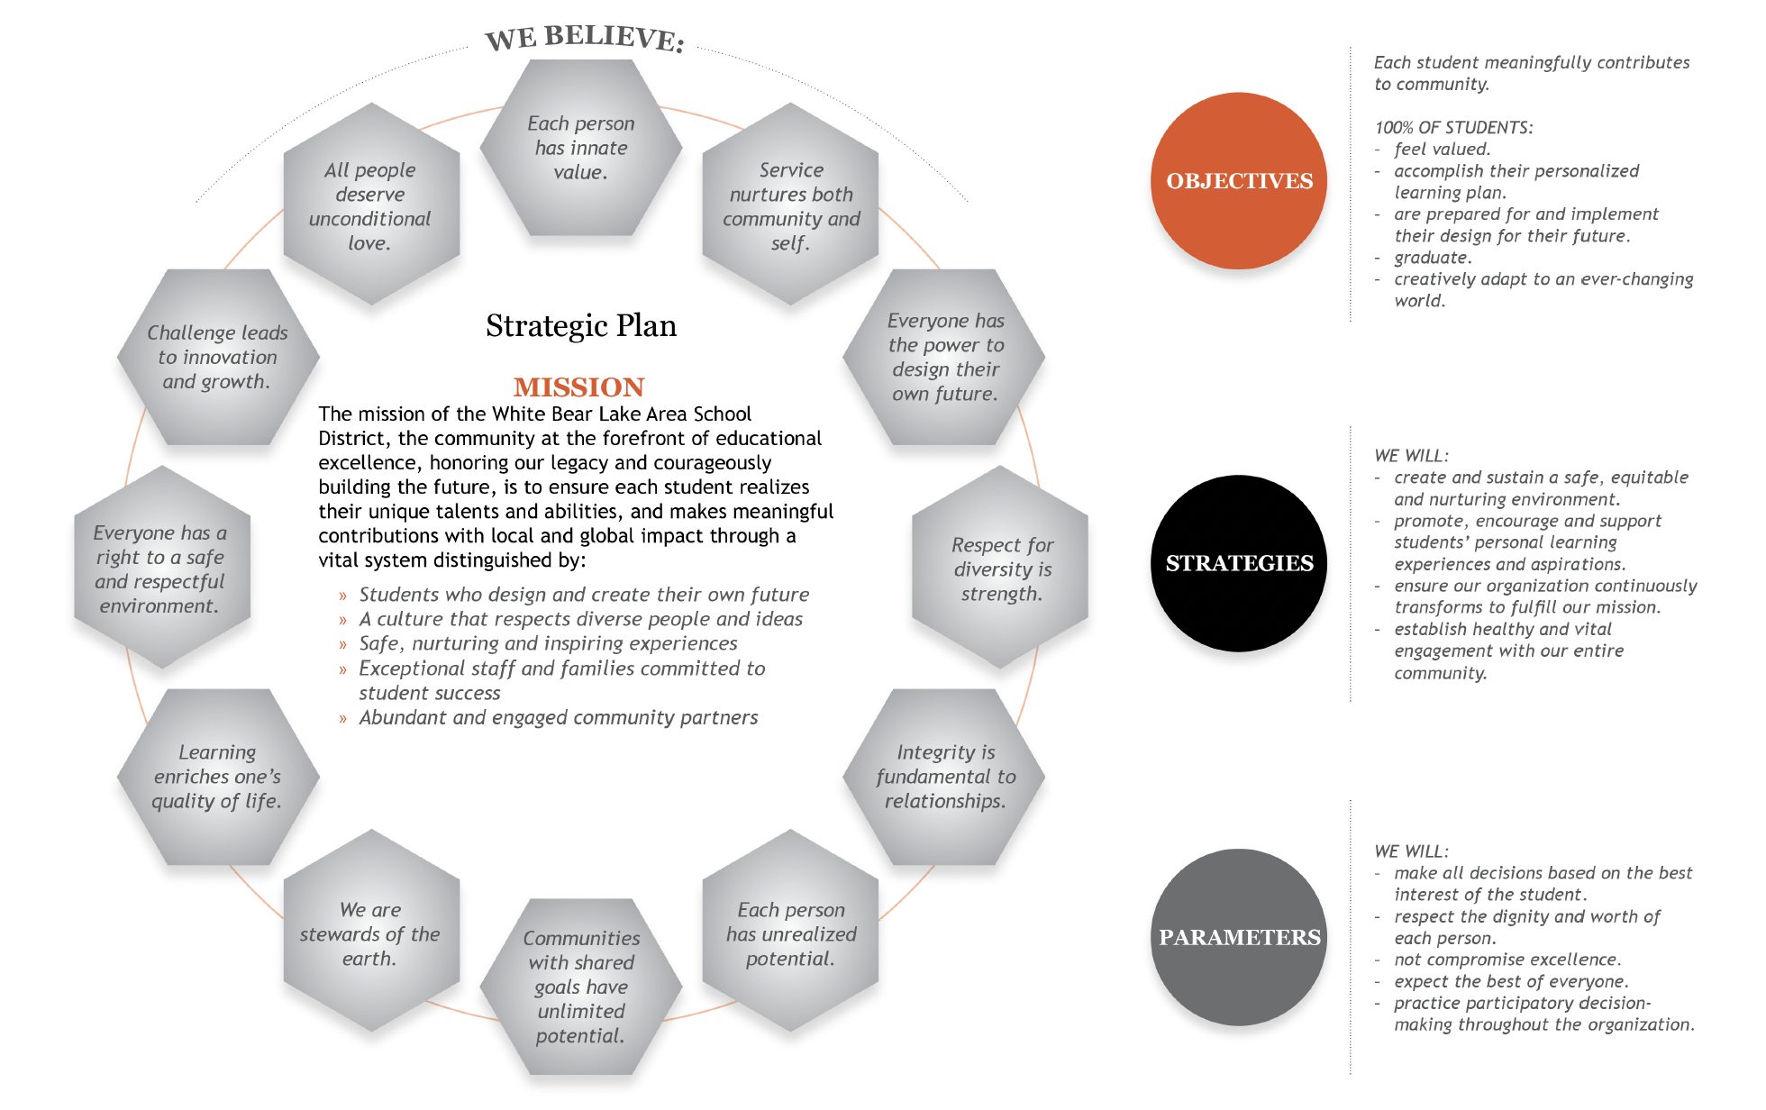
Notes:
The plan includes our mission statement,objectives, strategies and parameters. It is a people centered plan.

Slide 9
OUR MISSION
The mission of the White Bear Lake Area School District, the community at the forefront of educational excellence, honoring our legacy and courageously building the future, is to ensure each student realizes their unique talents and abilities, and makes meaningful contributions with local and global impact through a vital system distinguished by:
Students who design and create their own future
A culture that respects diverse people and ideas
Safe, nurturing and inspiring experiences
Exceptional staff and families committed to student success
Abundant and engaged community partners
Notes:
The mission statement can be broken down into 3 parts. The first part is who we are… a community at the forefront of educational excellence. The 2nd part is what we do, ensure each student realizes their unique talents & contributes to society in meaningful ways, lastly the mission speaks to how we operate.

Slide 10
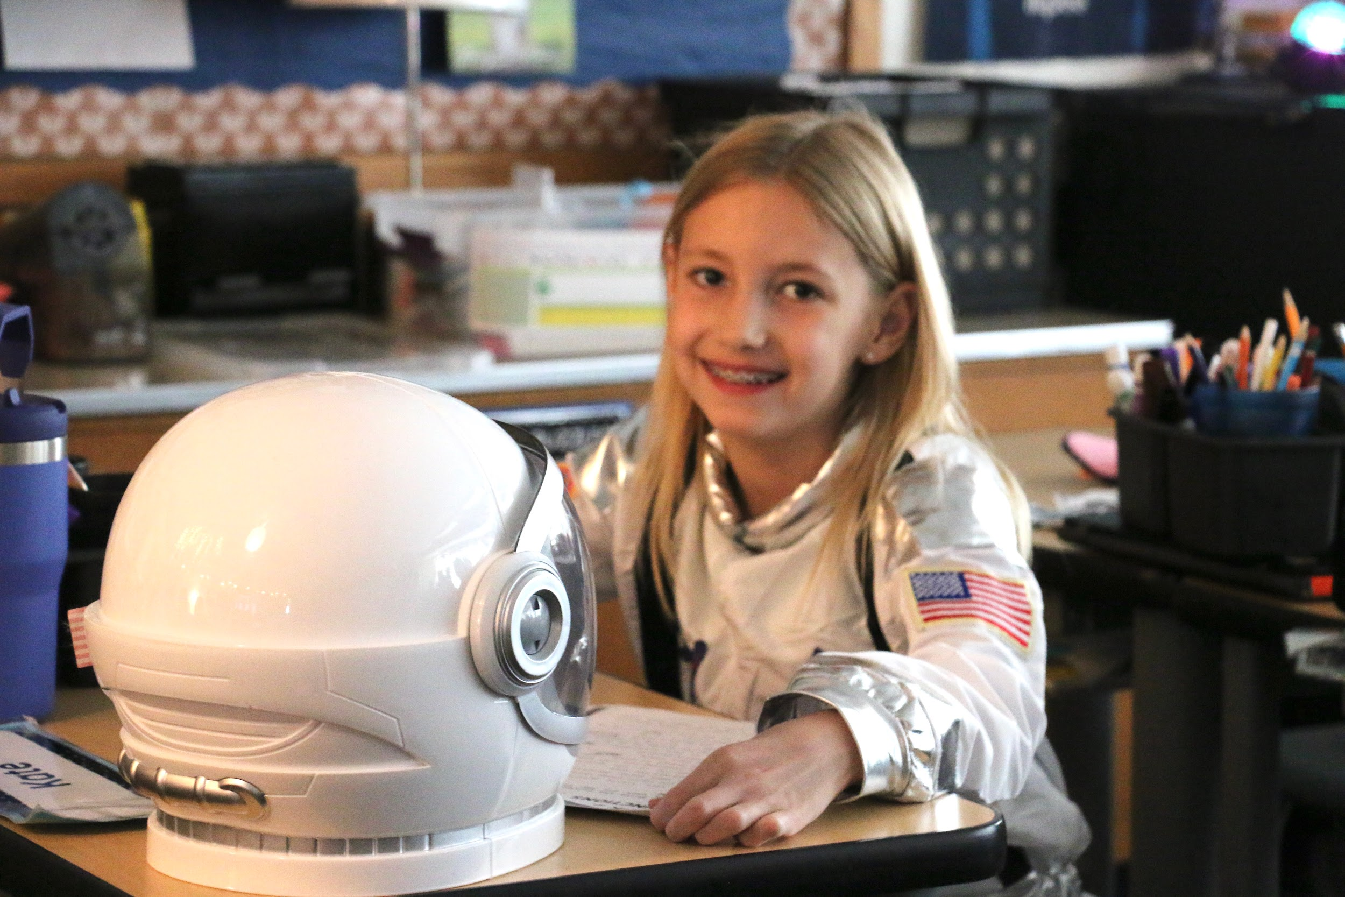
OUR OBJECTIVES
100% of students feel valued.
100% of students accomplish their personalized learning plan.
100% of students are prepared for an implement their design for their future.
100% of students graduate.
100% of students creatively adapt to an ever-changing world.
Each student meaningfully contributes to community.
Notes:
These objectives drive our daily work. They also helped drive our building the future plan. The district beliefs and objectives grounded us during the design phase. We now seem them come alive in our new spaces.

Slide 11
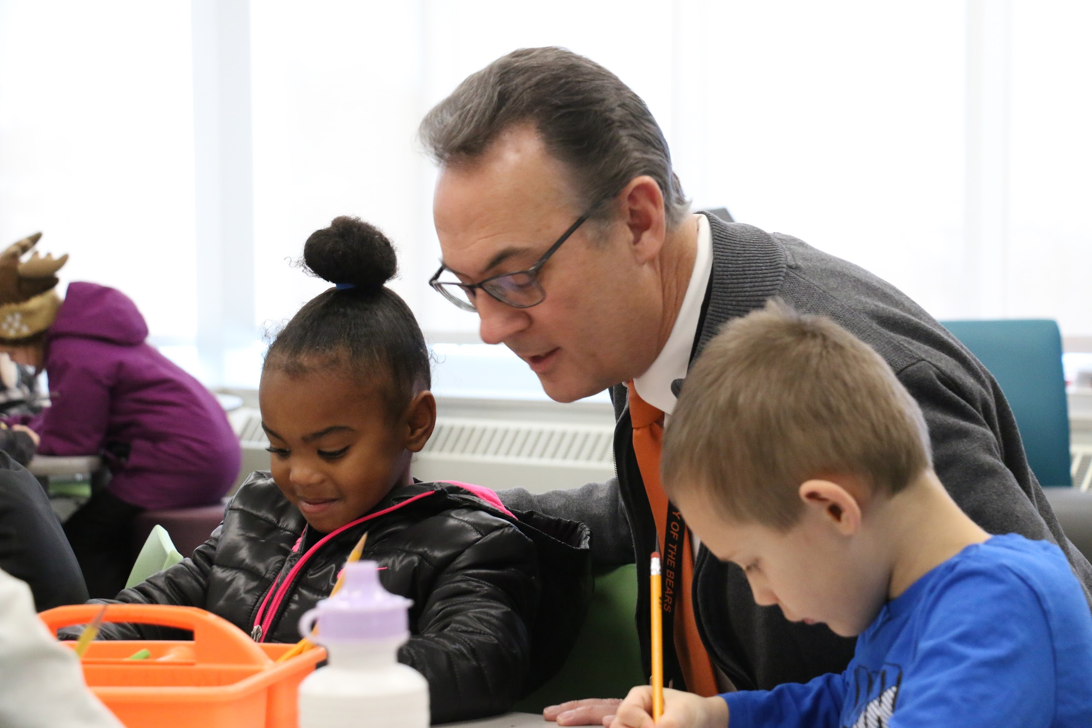
STRATEGIES
We will create and sustain a safe, equitable and nurturing environment.
We will promote, encourage and support students' personal learning experiences and aspirations.
We will ensure our organization continuously transforms to fulfill our mission.
We will establish healthy and vital engagement with our entire community.
Notes:
The believe statements can be summarized into 3 words… belonging, agency and efficacy for and of learning.

Slide 12
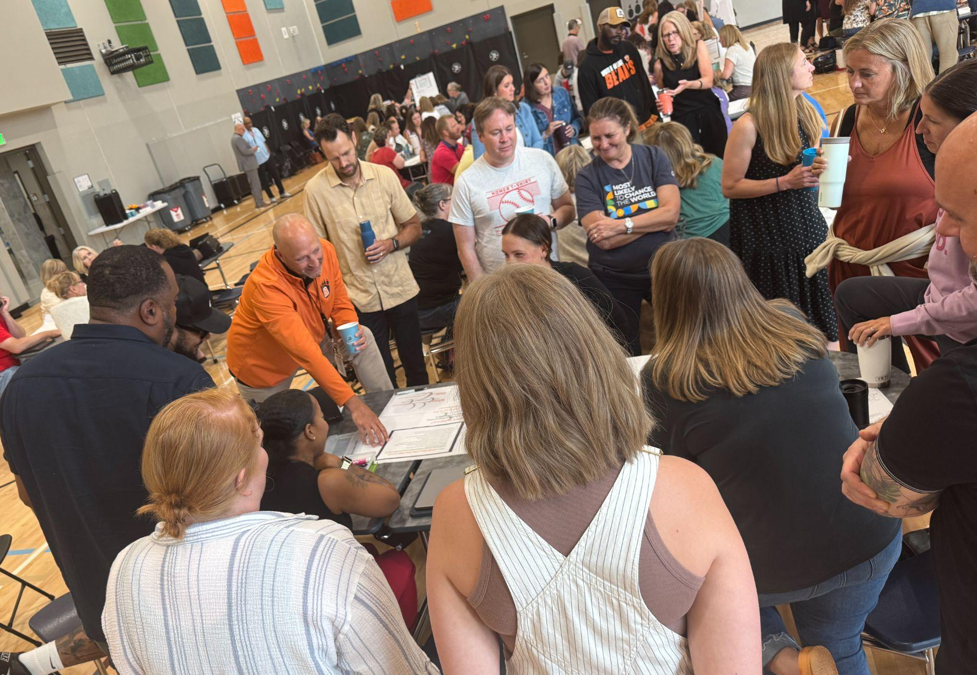
PARAMETERS
We will:
  Make all decisions based on the best interest of the student.
  Respect the dignity and worth of each person.
  Not compromise excellence.
  Expect the best of everyone.
  Practice participatory decision-making throughout the whole organization.
Notes:
Student-centered decision making, respect and excellence as non-negotables, and shared leadership coupled with collective responsibility

Slide 13
2015
creation of strategic plan
2018
wold hired
summer
2018
assessing district needs
nov - mar 2018
facilities long range planning
nov
2019
student & staff input
spring
2019
district called for an election
dec
2019
future of learning
committee began
summer
2019
design envisioning
aug
2019
student agency
visioning
2021
2024
construction
nov
2019
election
success
2024
occupation
PLAN
ASSESS
VISION
DESIGN
IMPLEMENT
Notes:
Alison
Design process - community/stakeholder involvement

Slide 14
PLANNING PROCESS OVERVIEW
Group Name: | Participants: | Goals / Responsibilities: | Timeline:
School Board | School Board Members |  | Ongoing
District Facilities Committee: | Select Administration | Set District Standards Review direction of design & budget Recommendations to Board | Ongoing: Monthly meetings
Future of Learning Committee: | Stakeholders from District and buildings | Set District-wide vision for all projects Develop educational specifications for facilities and instructional practices | 4 initial meetings; ongoing
Core Planning Groups: (project) | Select Community Site Based Administration Select Staff District Administration | Design decisions Establish priorities Guide/direct design Recommendations to Facilities Committee | 2-3 months (6-8 meetings and tours)
Site Based Planning Groups: (user groups) | Site based administration Select stakeholders in schools Community stakeholders | Gather detailed input for specific spaces | 2-3 months 1-2 meetings, each site
Notes:
Alison

Slide 15
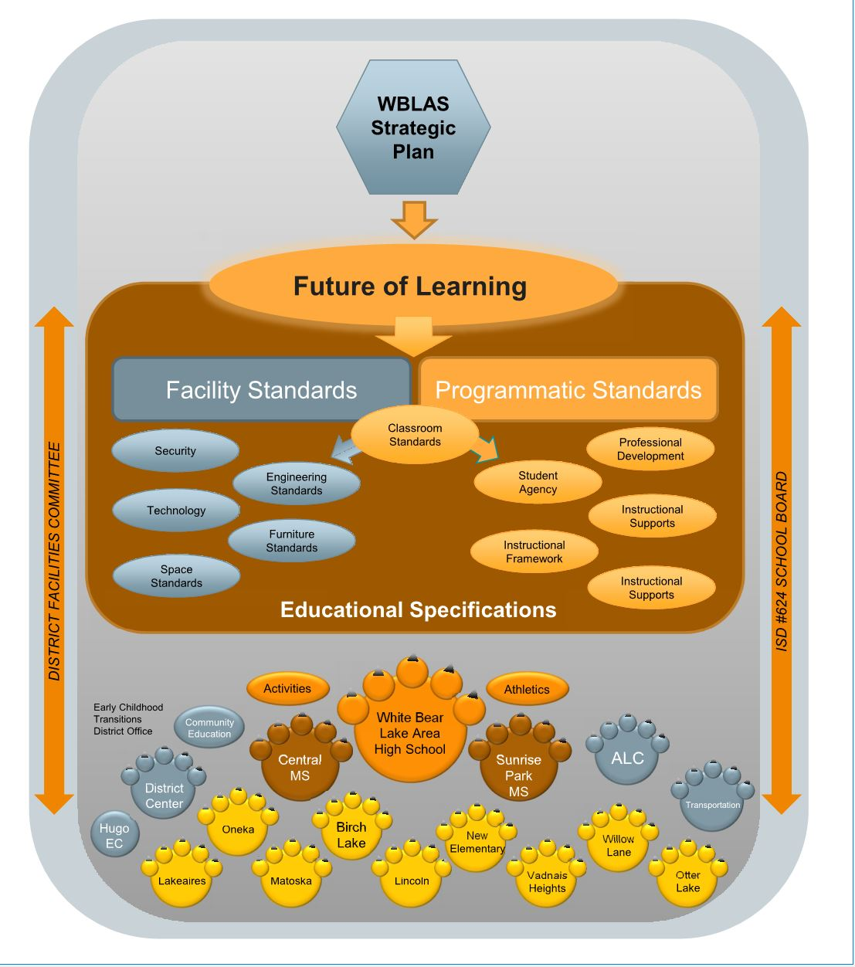
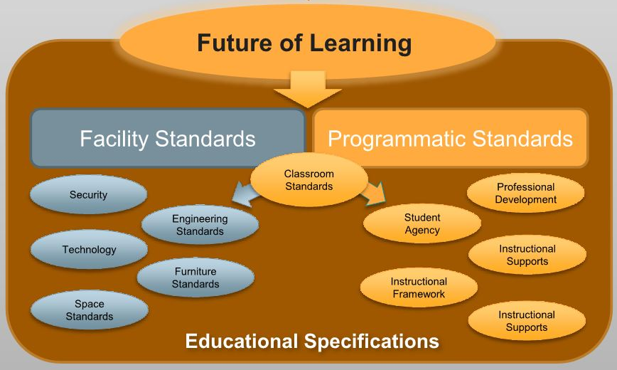
DESIGN PROCESS
Notes:
Design process - community/stakeholder involvement

Slide 16
Facility Design Process
Notes:
Maria Wold - WHY we do what we do (inclusive participatory design), hopeful outcomes of that, investment in this is important for total project success
Define in partnership with the District the degree of change that this project

Slide 17
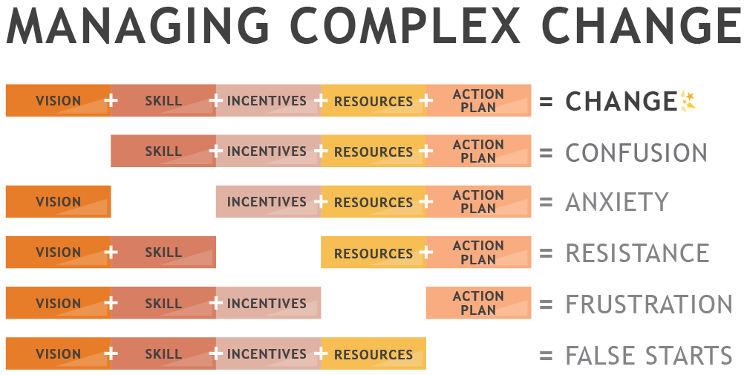
DESIGN PROCESS - ALIGNMENT WITH DISTRICT VISION
Source: The Managing Complex Change model was copyrighted by Dr. Mary Lippitt, founder and president of Enterprise Management, Ltd., in 1987.
Notes:
Wold Slide - Maria - What is needed to achieve successful change?
Got on the same page with the District about this BEFORE Core Group
Adapated Core Group to meet those District goals and vision

Slide 18
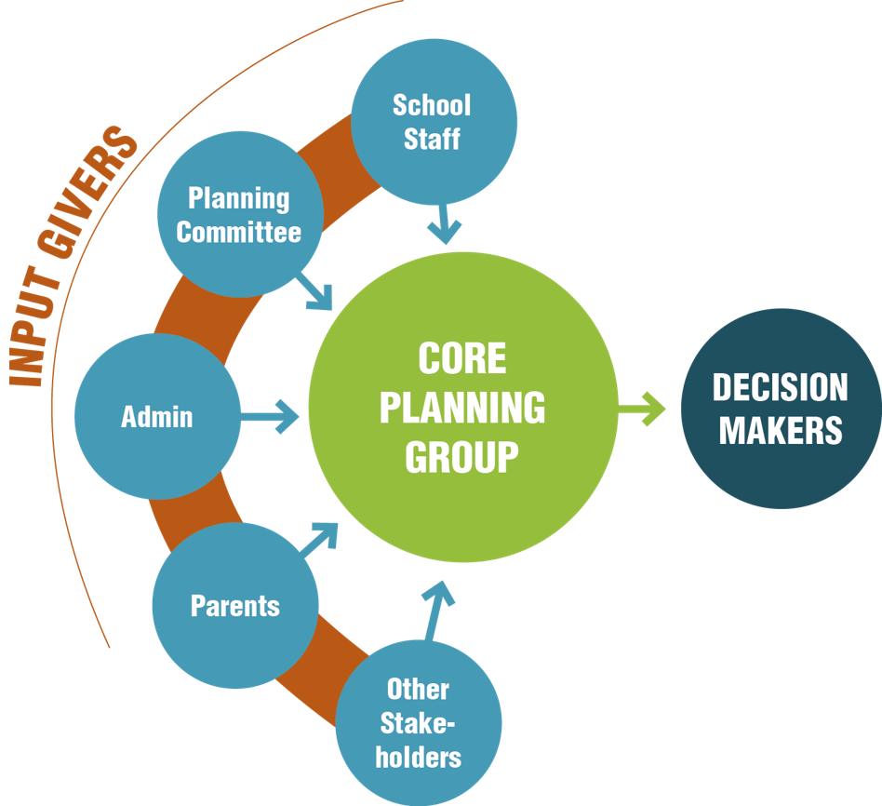
DESIGN PROCESS - INPUT GATHERING
Build ownership around design and educational philosophy
Core Planning Group
  Tours (Common Language)
  Consensus on Criteria and Guiding Principles
  Establish spatial relationships
  Develop Building Diagram
  Renderings / Visuals
  Final Schematic Design
Notes:
Wold Slide - Maria
Collaborate with stakeholders and gather input
TO build ownership and help people visualize themselves in the space
Alignment with educational philosophy

Slide 19
PROJECT DESIGN PRINCIPLES
The design will be future-ready and forward thinking, and adapt to the changing needs of the community over time.
The building will serve as a destination and genuine source of pride for learners, staff and the community.
The building will be an inclusive place where learners can explore their evolving interests and develop a sense of community. Learning studios should be organized to create a “small-school feel” within the high school.
The building and programming will actively support student agency while providing guidance and support in their educational journey.
The design will foster interpersonal relationships and support social and emotional learning.
Notes:
Maria
Values and statements of intent developed with CPG, key ones are highlighted here

Slide 20
KEY DESIGN IDEAS & TERMS
Teaching & Learning on
Display
Transformational
Adaptable
Student Agency
“Small School Feel”
Collaborative Environments
Sense of Community
Forward Thinking
Engaging
Notes:
Maria
Key Terms that broadly define / describe project intent
Notes:
Animation have them come up (not as one large block) sprinkle
lOOK INTO TIMING

Slide 21
KEY DESIGN IDEAS & TERMS
THE UNION
EDUCATIONAL TEAM
LEARNING STUDIO
LEARNING COMMONS
Central gathering area of the high school which creates a sense of community for dining and gathering. Constitutes the major organizing space of the high school with connections to all major elements.
A team of up to 12 staff grouped around learning objectives with the intent of fostering collaboration who share a meeting space.
A collection of learning spaces grouped together to enhance collaboration, innovation, and student agency.
A specialized learning studio focused on media resources, technology access, and collaborative spaces as a resource to all learners.
Notes:
Maria
Concepts that became the building blocks of the architecture and the educational success.
Union - central
Educational Team - evaluated and defined the size of staff groups that would allow for collaboration, flexibility, and the small-school feel.
Through this process, landed on the learning studio
Learning COmmons was reinvented as well.

Slide 22
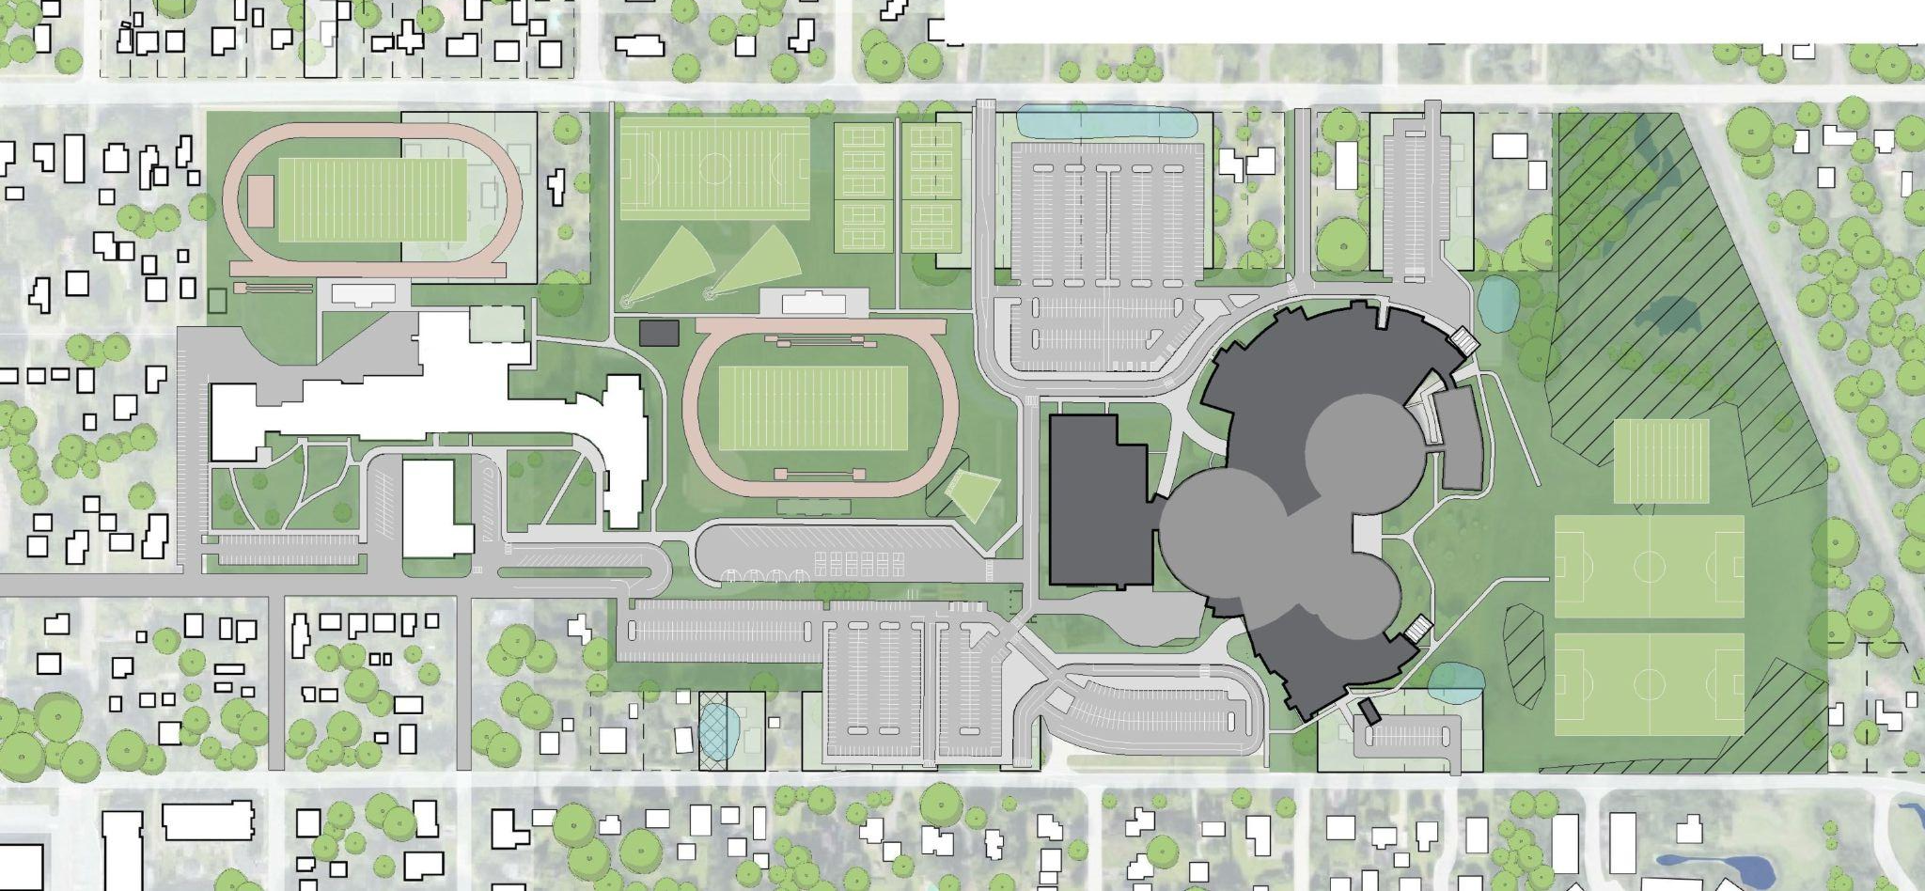
OVERALL SITE PLAN
MIDDLE SCHOOL
WHITE BEAR LAKE AREA HIGH SCHOOL
N
Notes:
MARIA
Site planning process and noting the intention to reinvest in this existing site and community infrastructure and making these amenities work in an urban environment / dense. Downtown, easy access.
List amenities verbally
Include the union

Slide 23
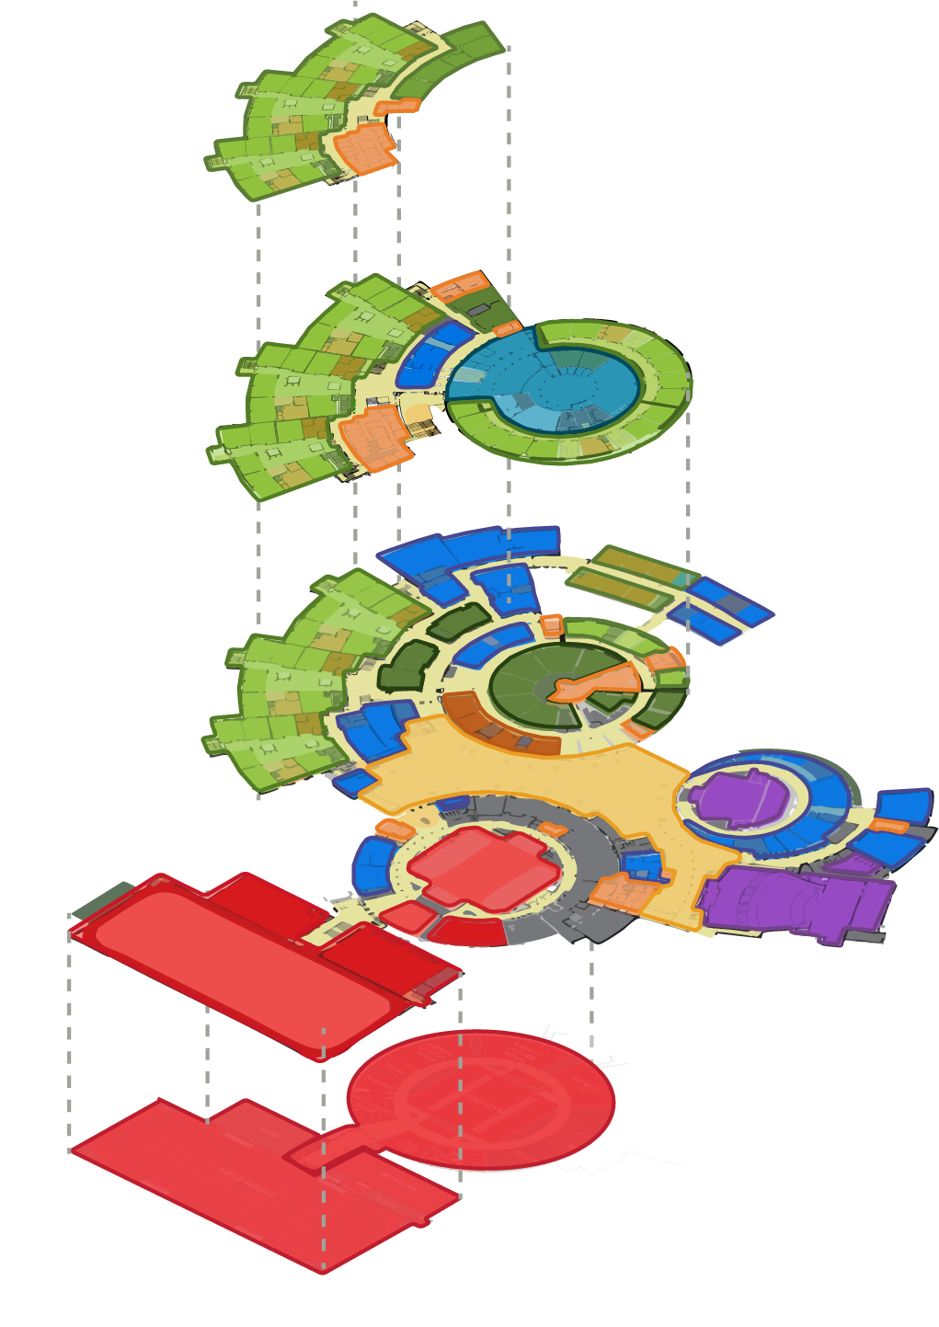
BUILDING LAYOUT
Third Level
Second Level
Main Level
Lower Level
Notes:
Paul
Include the union
Notes: animate to come in all at once
Add swoopy arrow - follow sidewalk
Create outline around whole building (black)
Maybe change writing to black // contrast

Slide 24
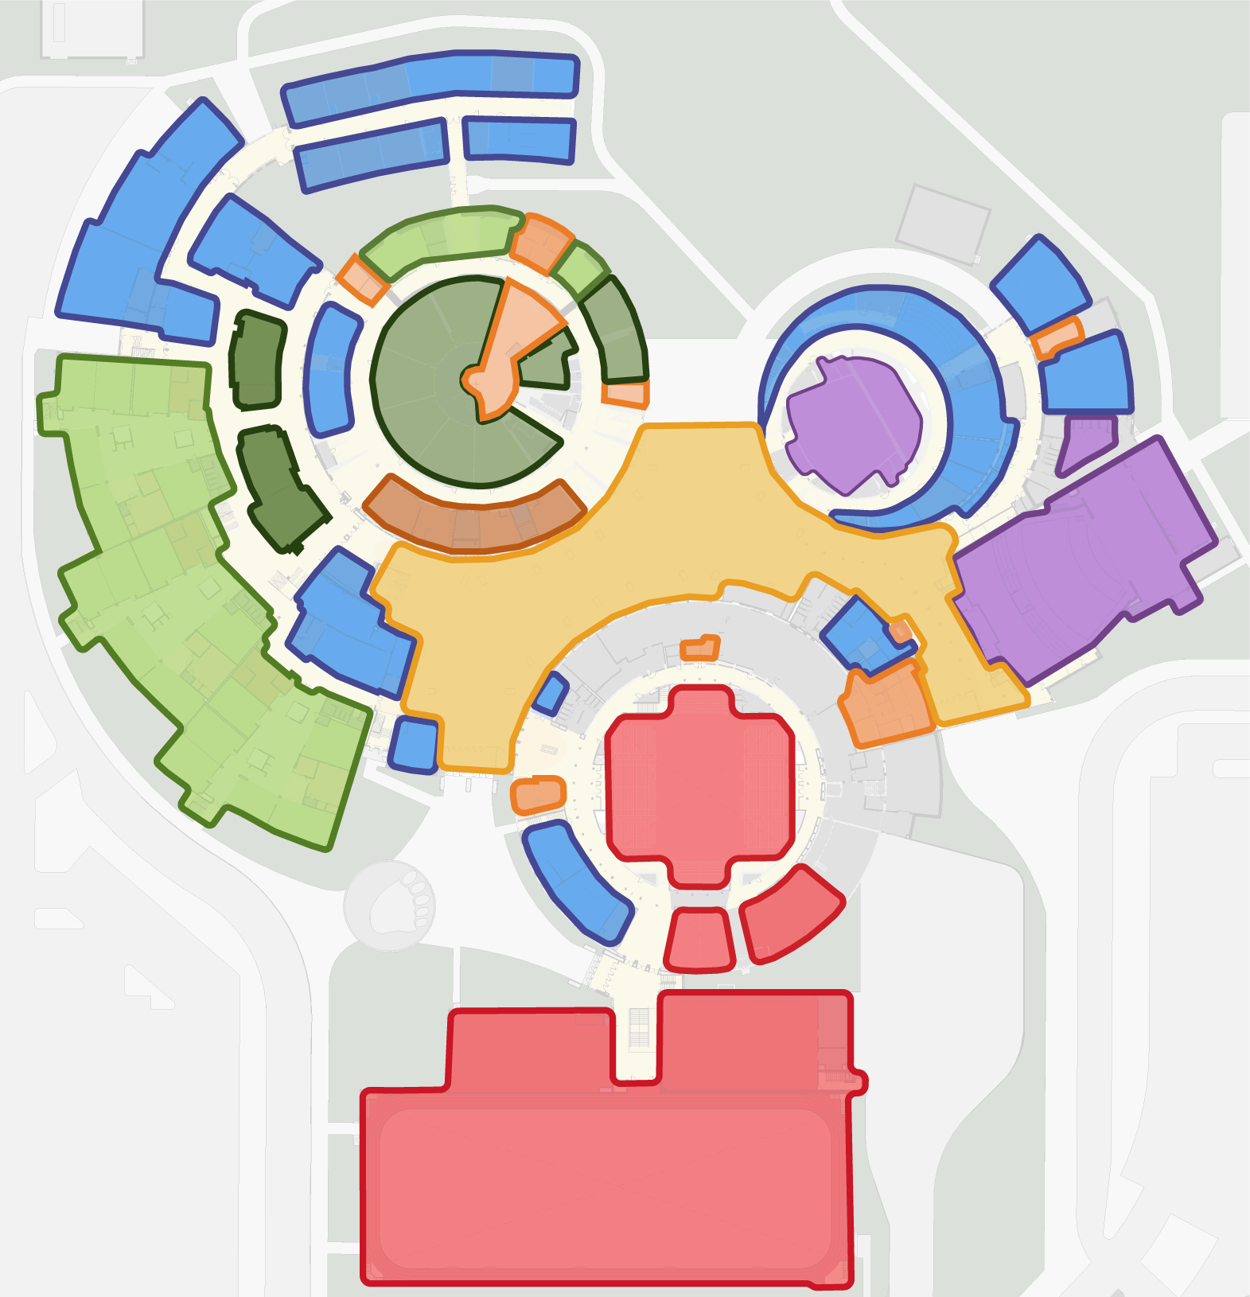
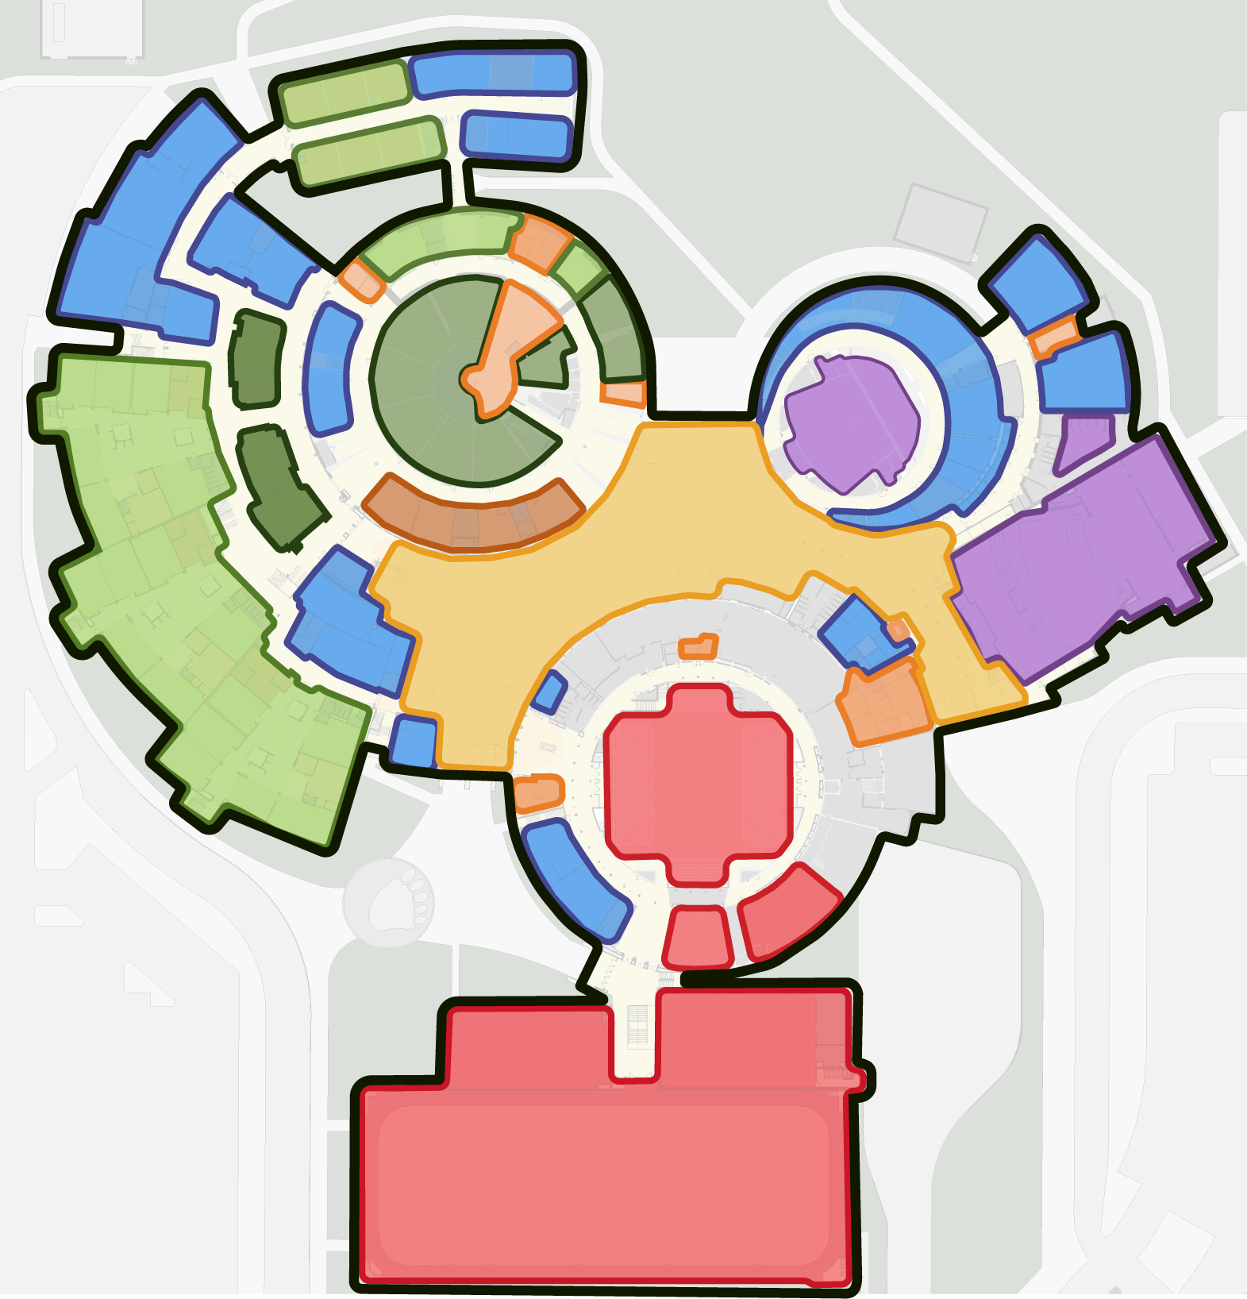

BUILDING LAYOUT
NEW AUDITORIUM
LEARNING COMMONS (ABOVE)
PATHWAYS CLASSROOMS
THE UNION
3-STORY LEARNING STUDIOS
MAIN ENTRY
RENOVATED MAIN GYM
STUDENT ENTRY
ATHLETICS ENTRY
FIELD HOUSE
Notes:
Paul
Include the union
Notes: animate to come in all at once
Add swoopy arrow - follow sidewalk
Create outline around whole building (black)
Maybe change writing to black // contrast
SOLID BLACK ARROW
Leave entrances on the photo // n o transition

Slide 25
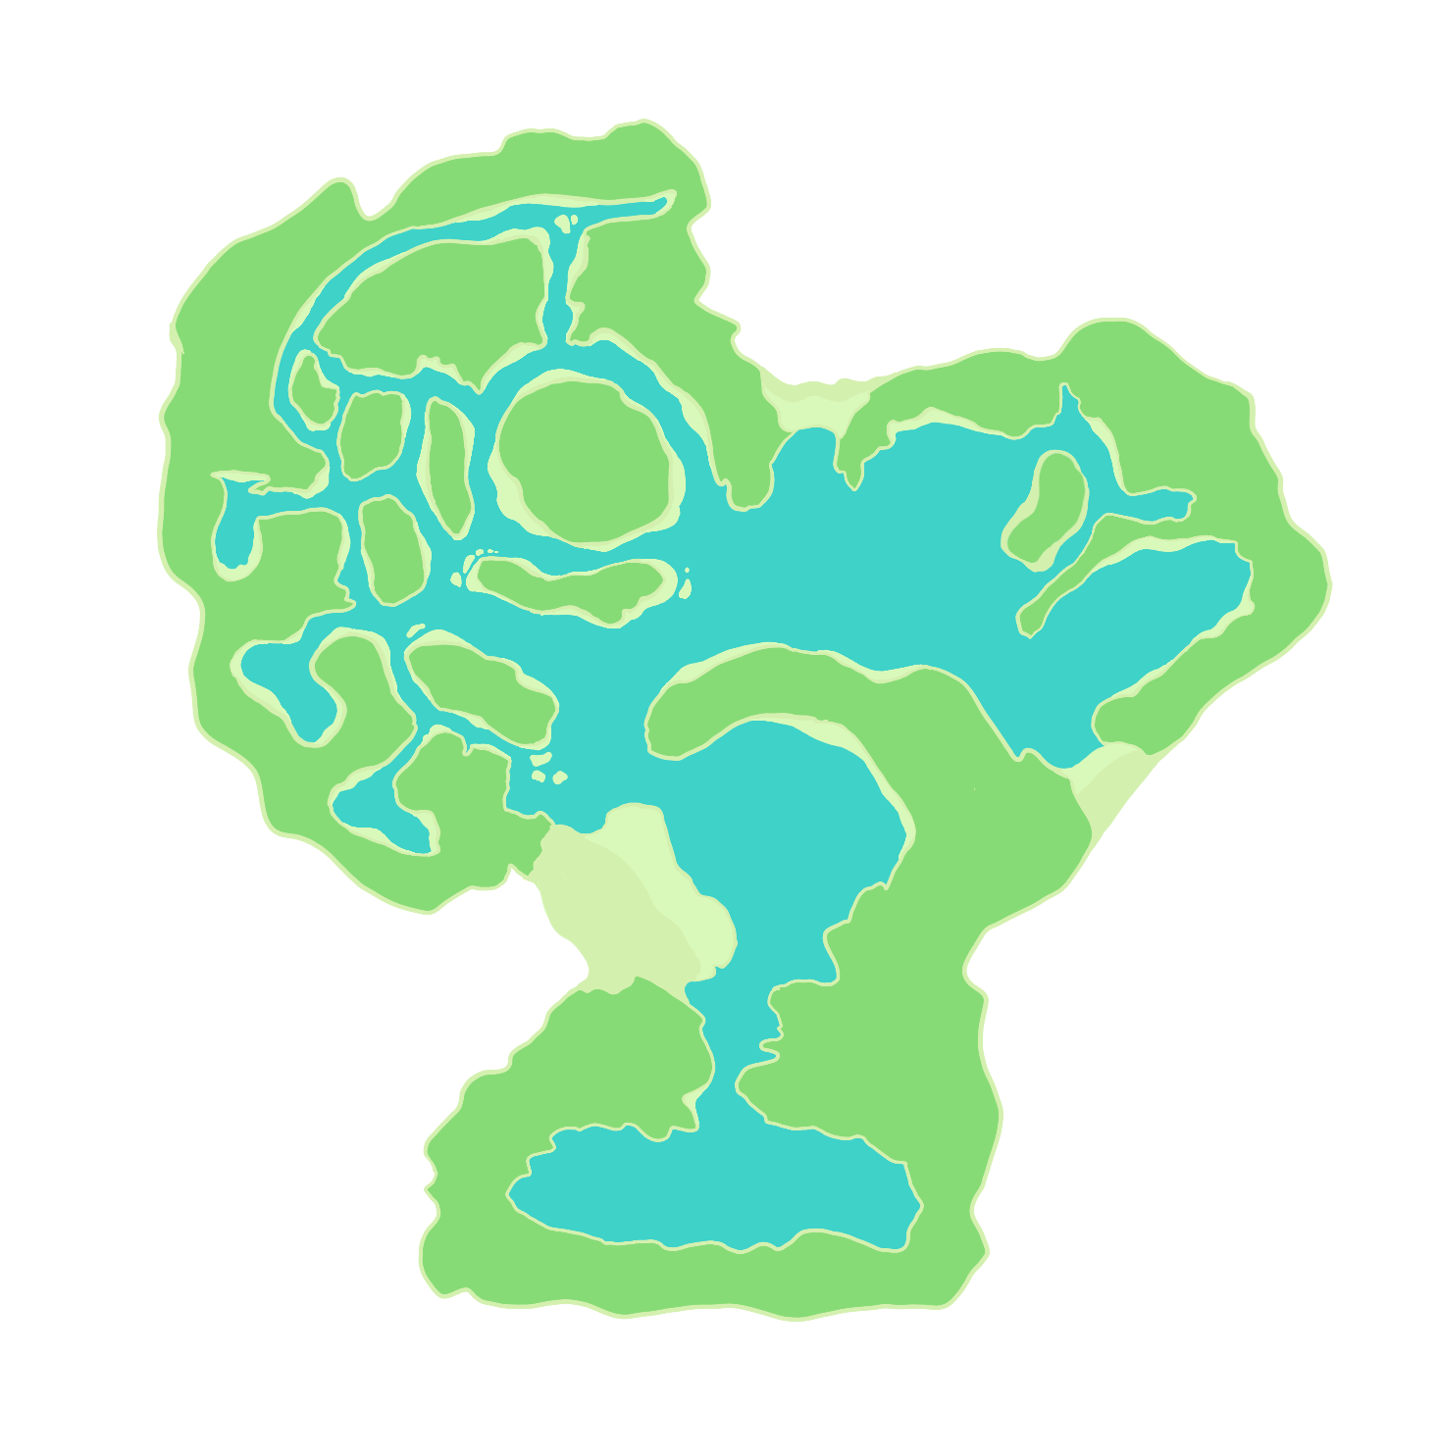



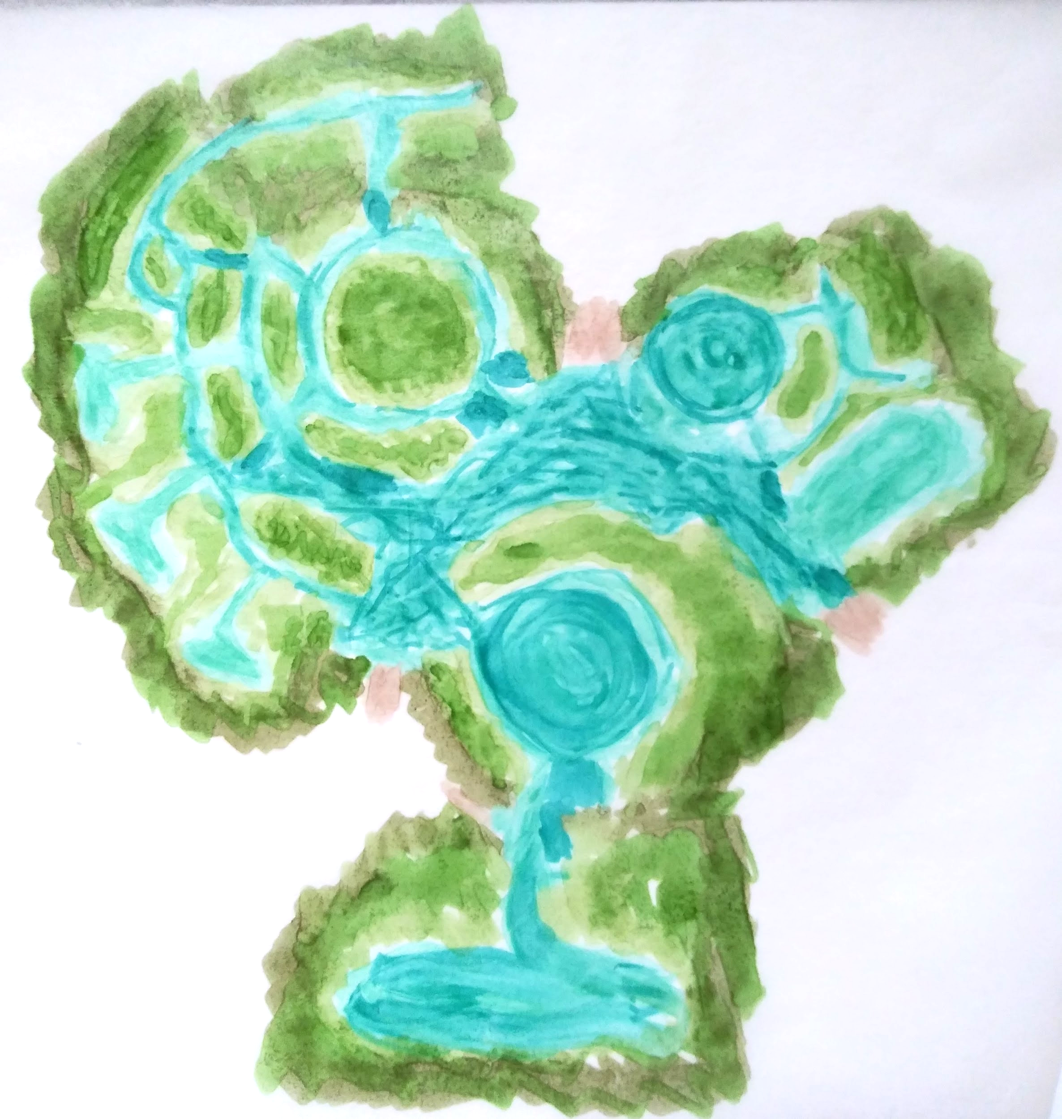



DESIGN CONCEPT & INSPIRATION
ISLANDS
OPEN WATER
COVEE
BAY
Notes:
Anchor ideas present in design, tie to strategic plan Paul

Slide 26
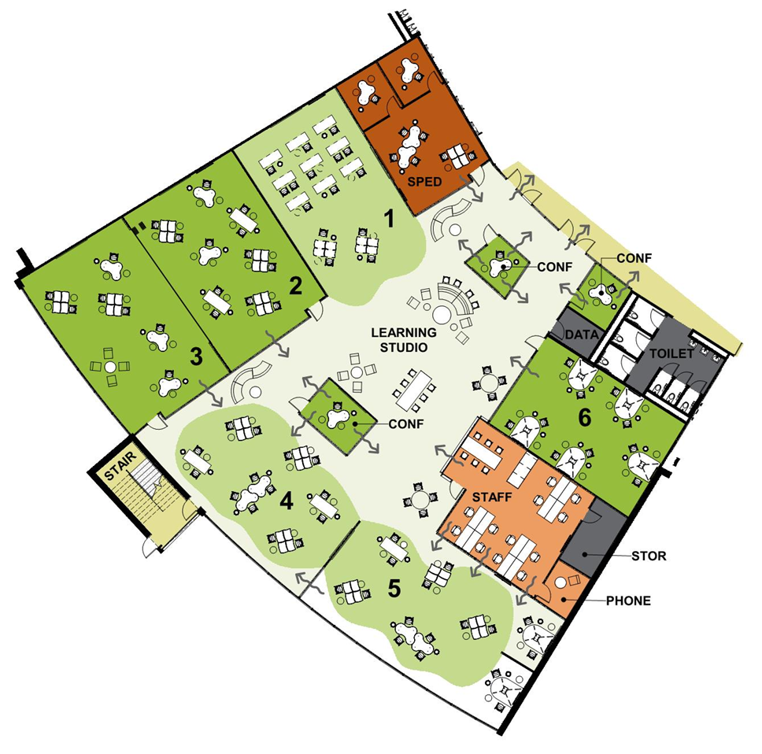
LEARNING STUDIO MODEL
Home base for staff and students
Small-school feel + community
6 capacity classrooms
Integrated Student Services space
Flexible spaces support student agency and differentiated learning
Dedicated professional Staff Office
Variety of spaces:
  Conference rooms
  Individual work
  Small group
  Collaborative porch
Notes:
Paul

Slide 27
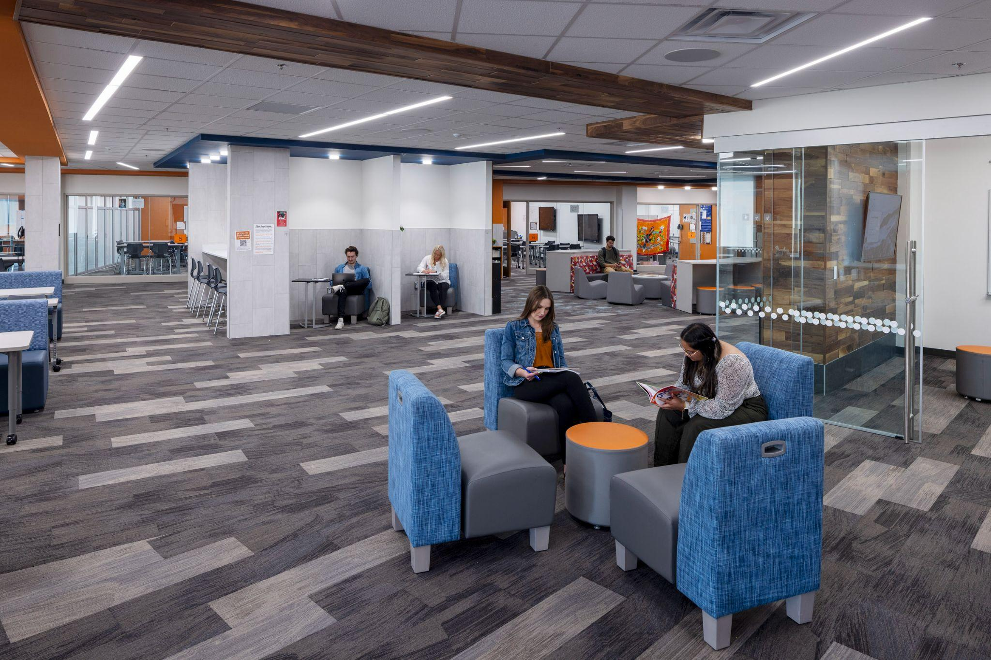
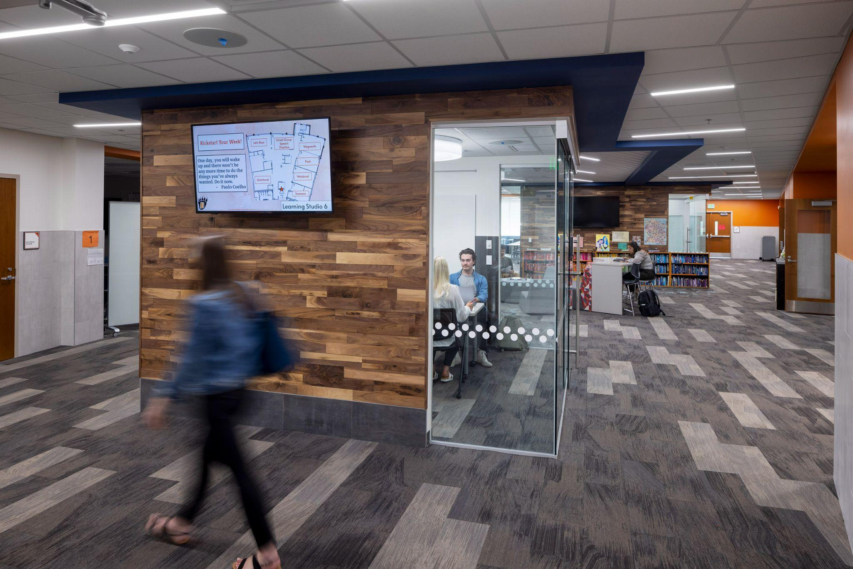
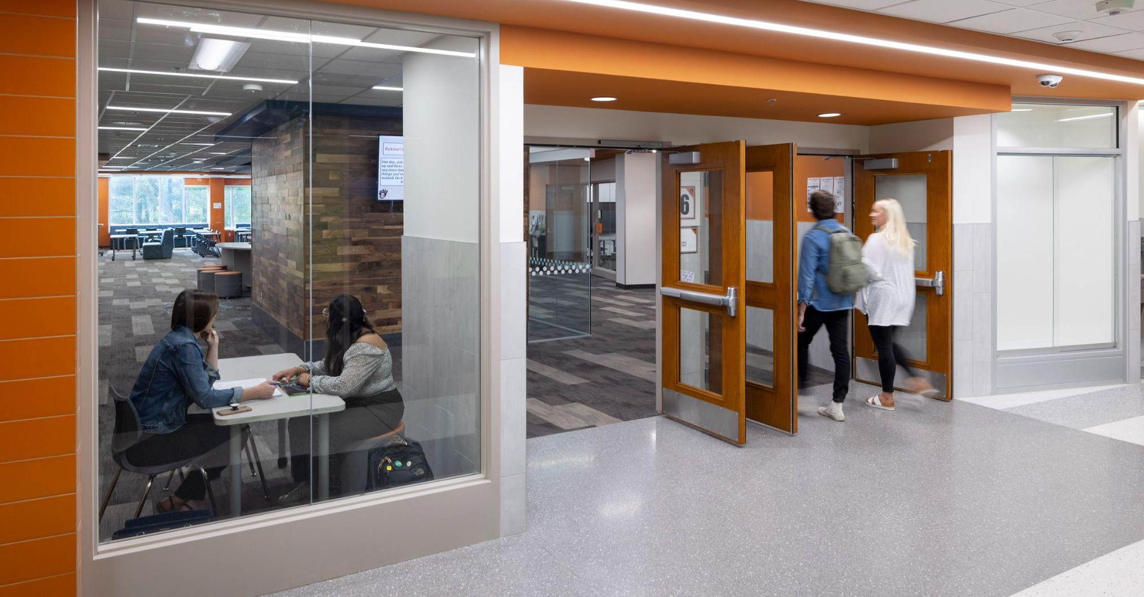
LEARNING STUDIO
Notes:
Paul

Slide 28
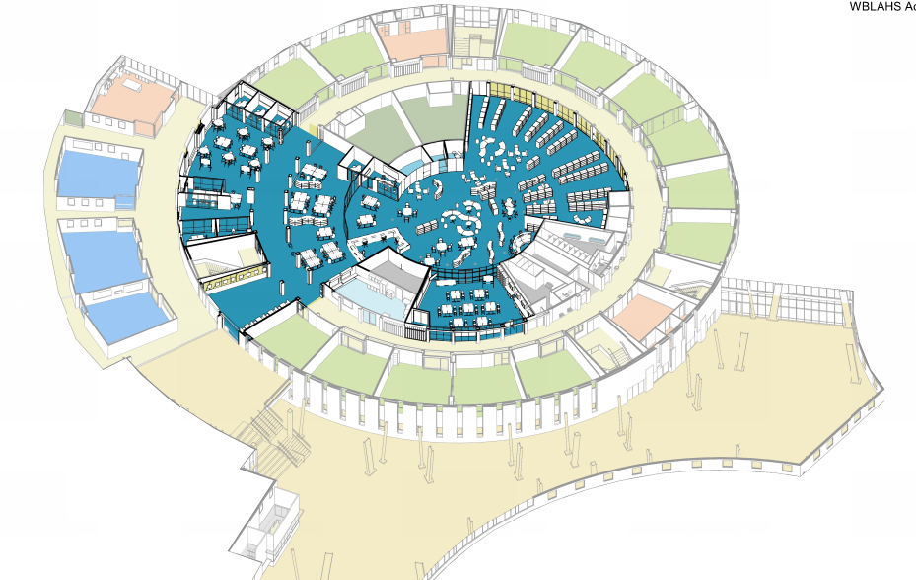
LEARNING COMMONS
Learning Commons
-Central hub, connecting floors and new and existing building
-Transparency and glass open to Learning Studios
-Maker Space + Broadcast Studio
-Tech Hub
-60-person presentation area
-Resources like Tutoring and Office of Equity
Existing Learning Studios
To Learning Studios
Pathways
Tech Hub
The Union
Makerspace
Notes:
MARIA - Highlight the Tech Hub
Notes:
Add circle to lines
Change to lighter orange color
Change to bullets

Slide 29
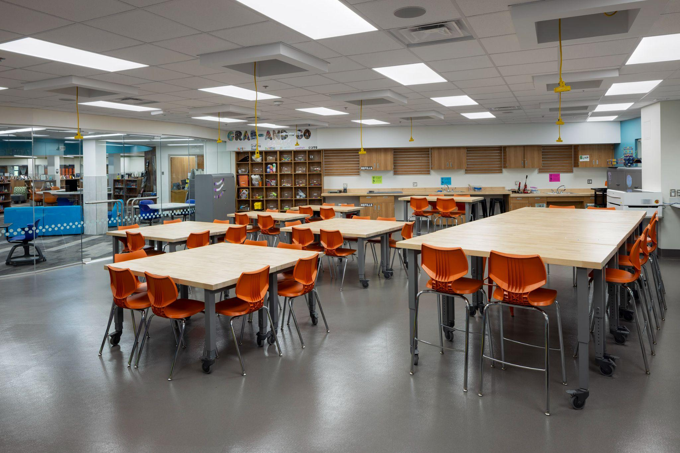
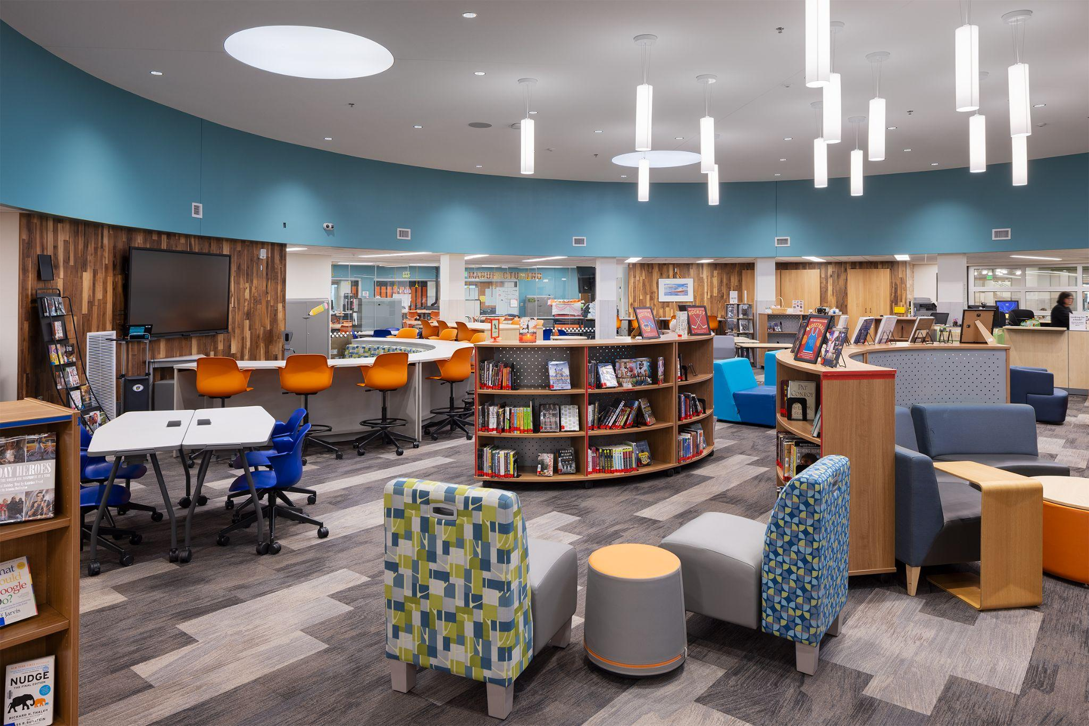
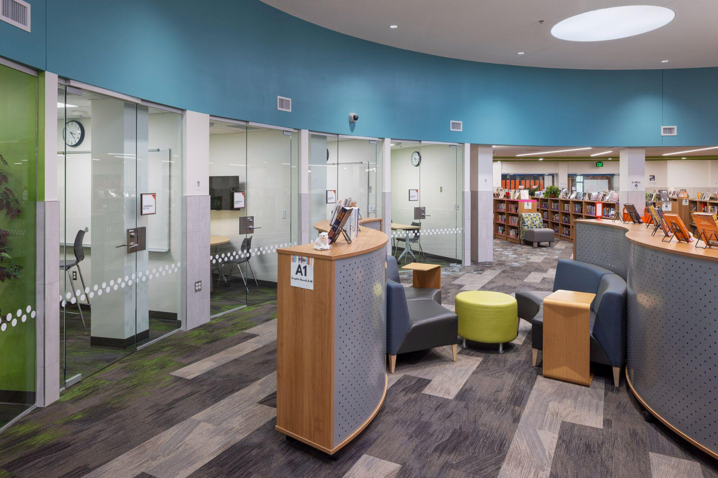
LEARNING COMMONS
Notes:
Maria

Slide 30
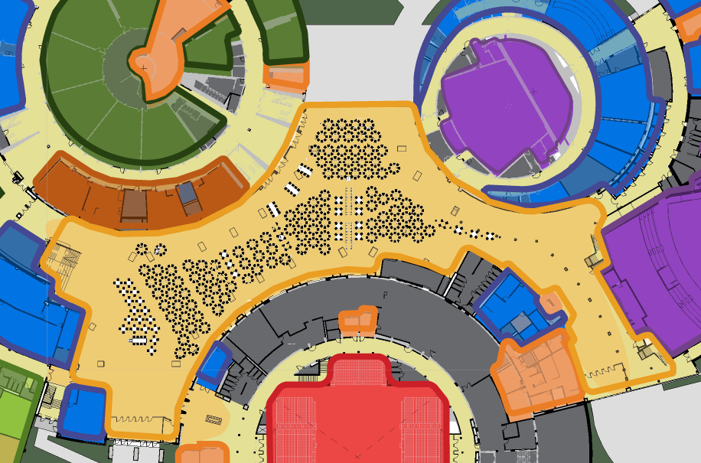
THE UNION
MAIN ENTRY
STUDENT ENTRY
Notes:
Maria
Updating with some FFE
Notes:
Maria to send photo - possibly remove sections

Slide 31
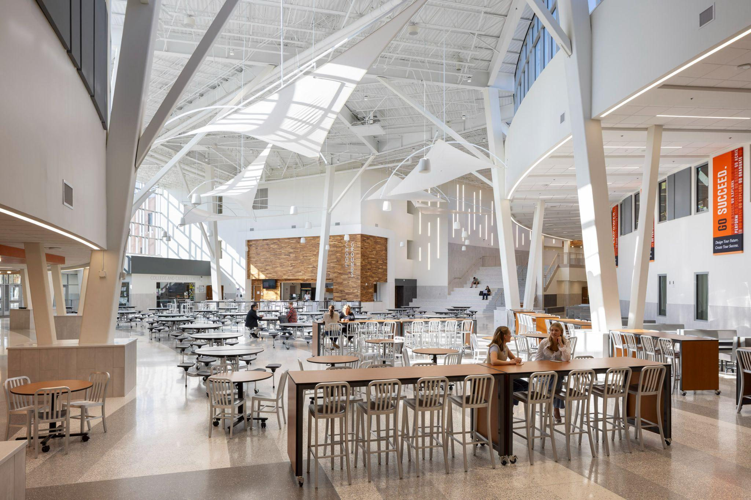
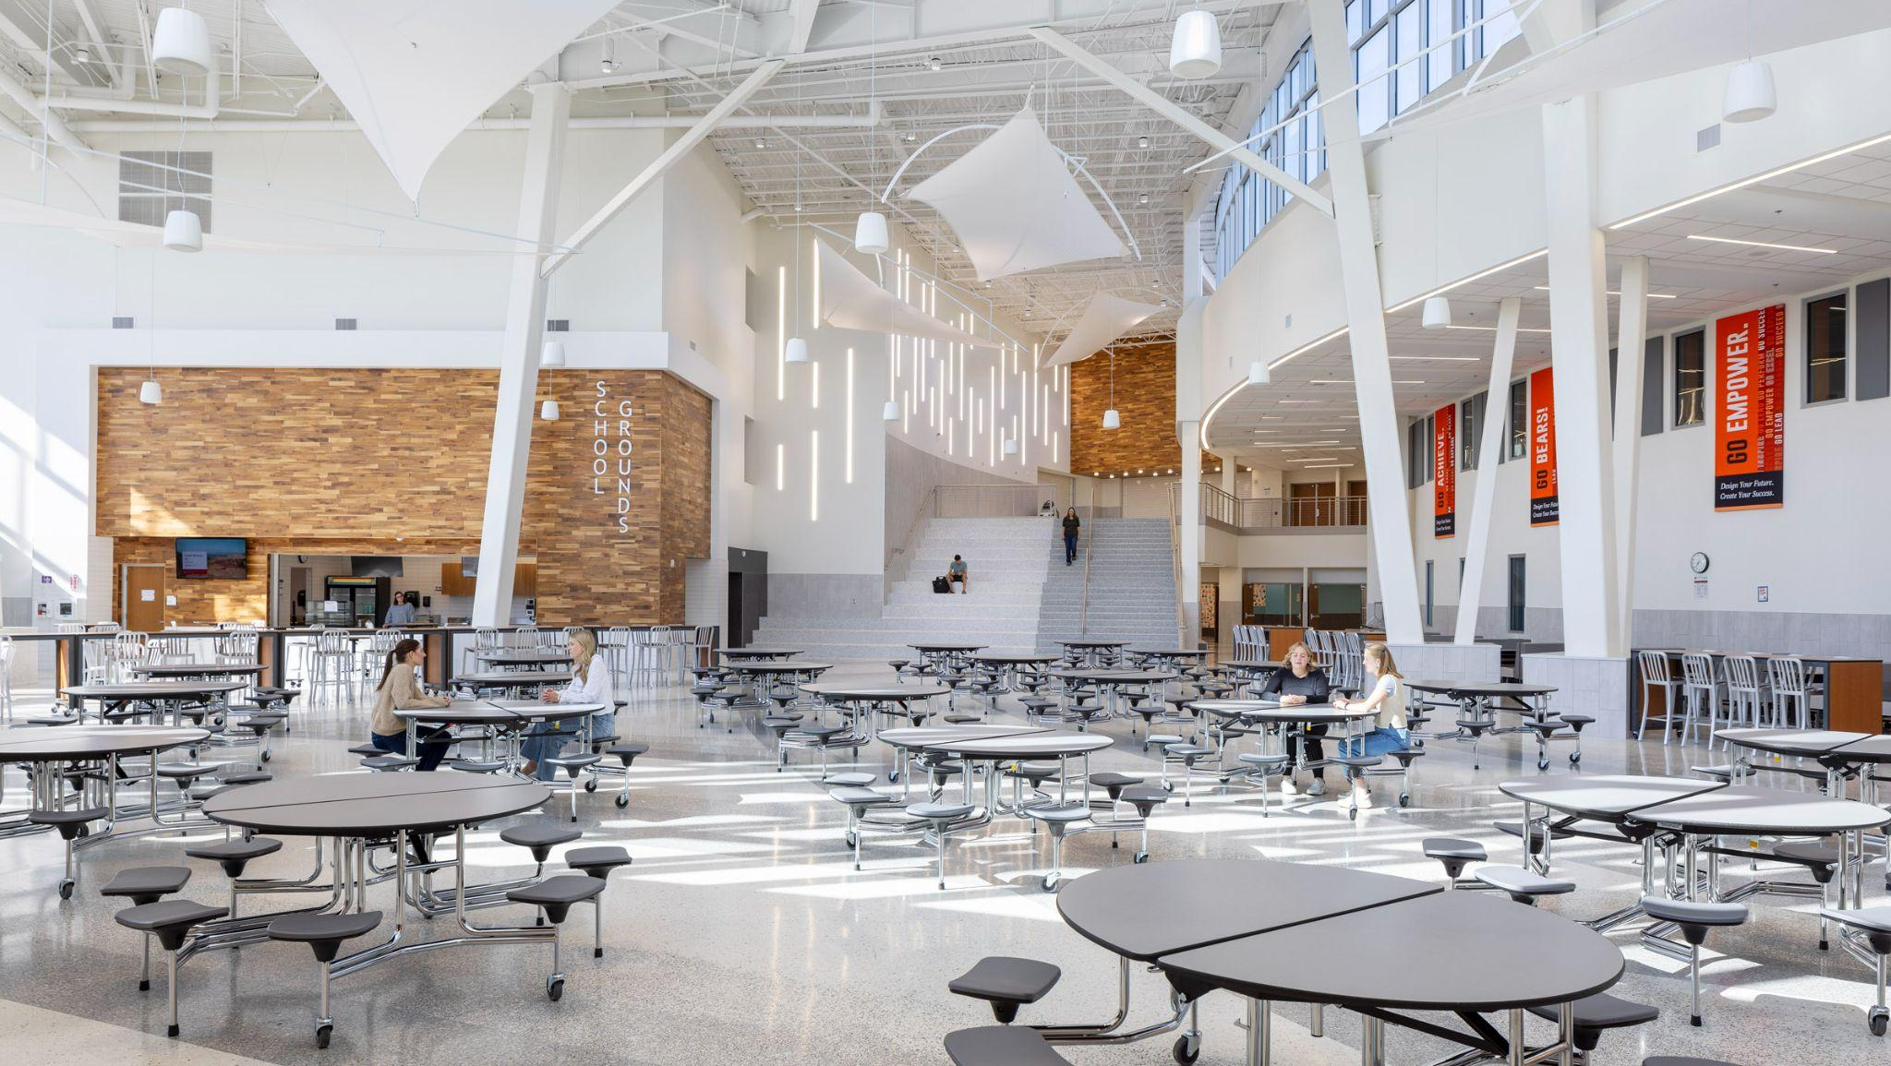
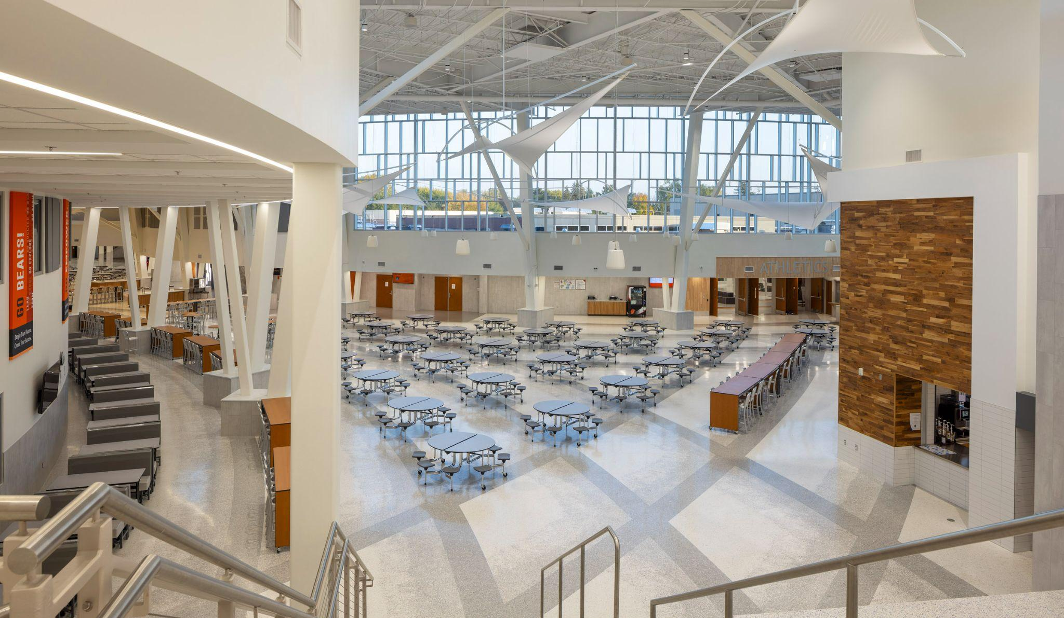
THE UNION
Notes:
Maria

Slide 32
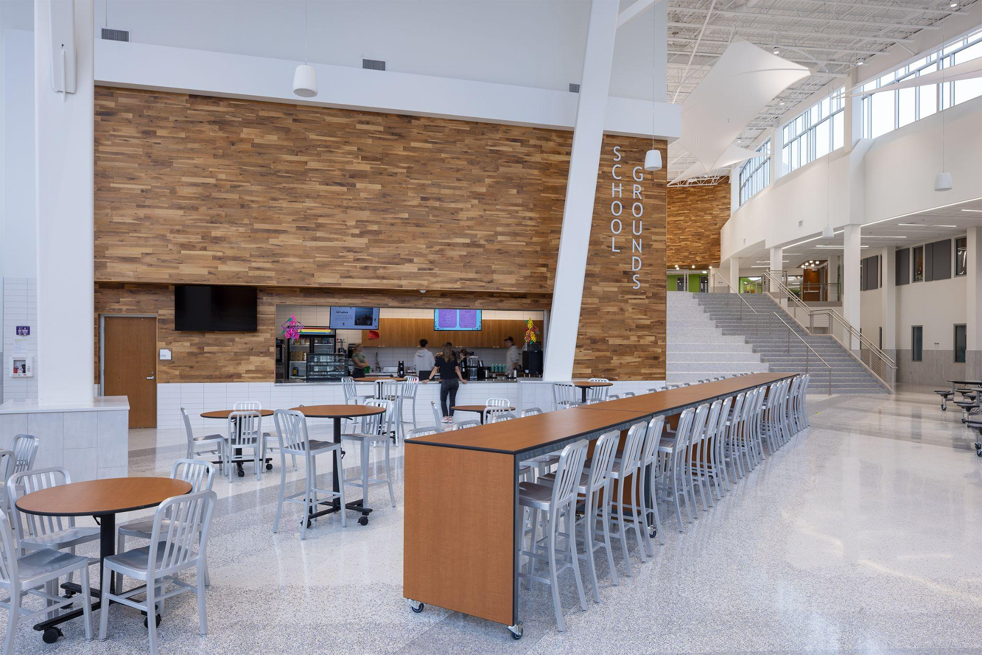
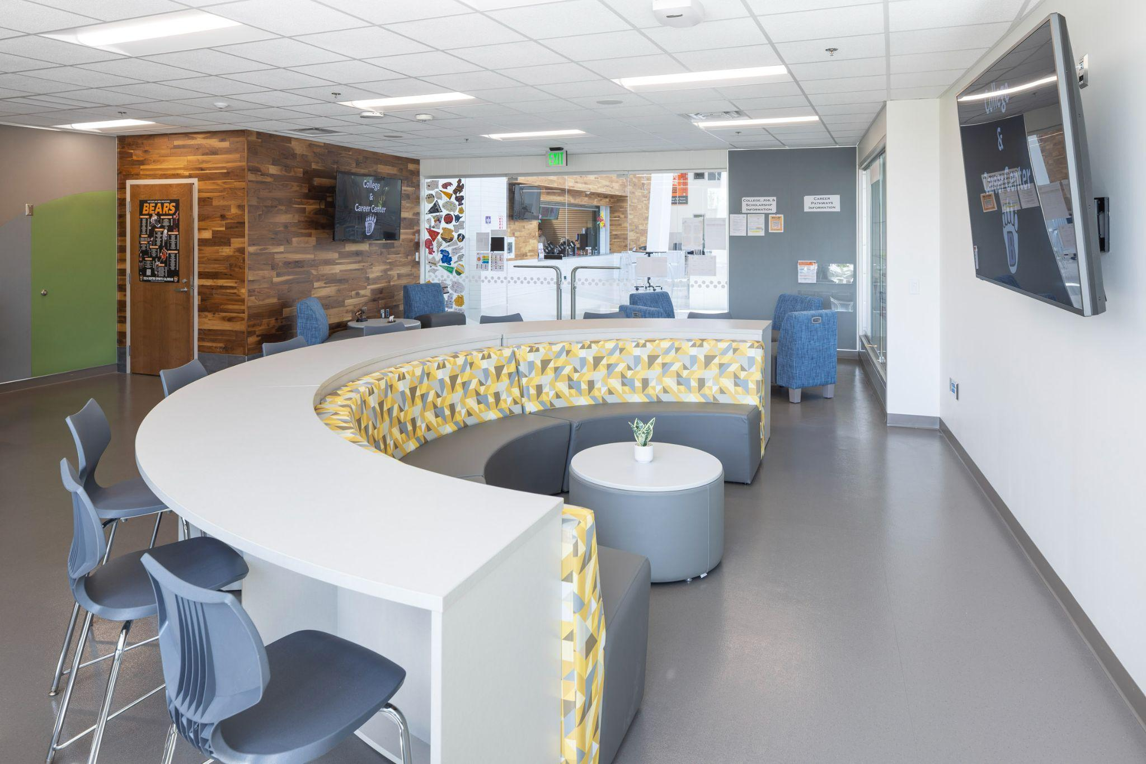
THE UNION
Notes:
Photos of coffee shop and college and career center - Maria

Slide 33
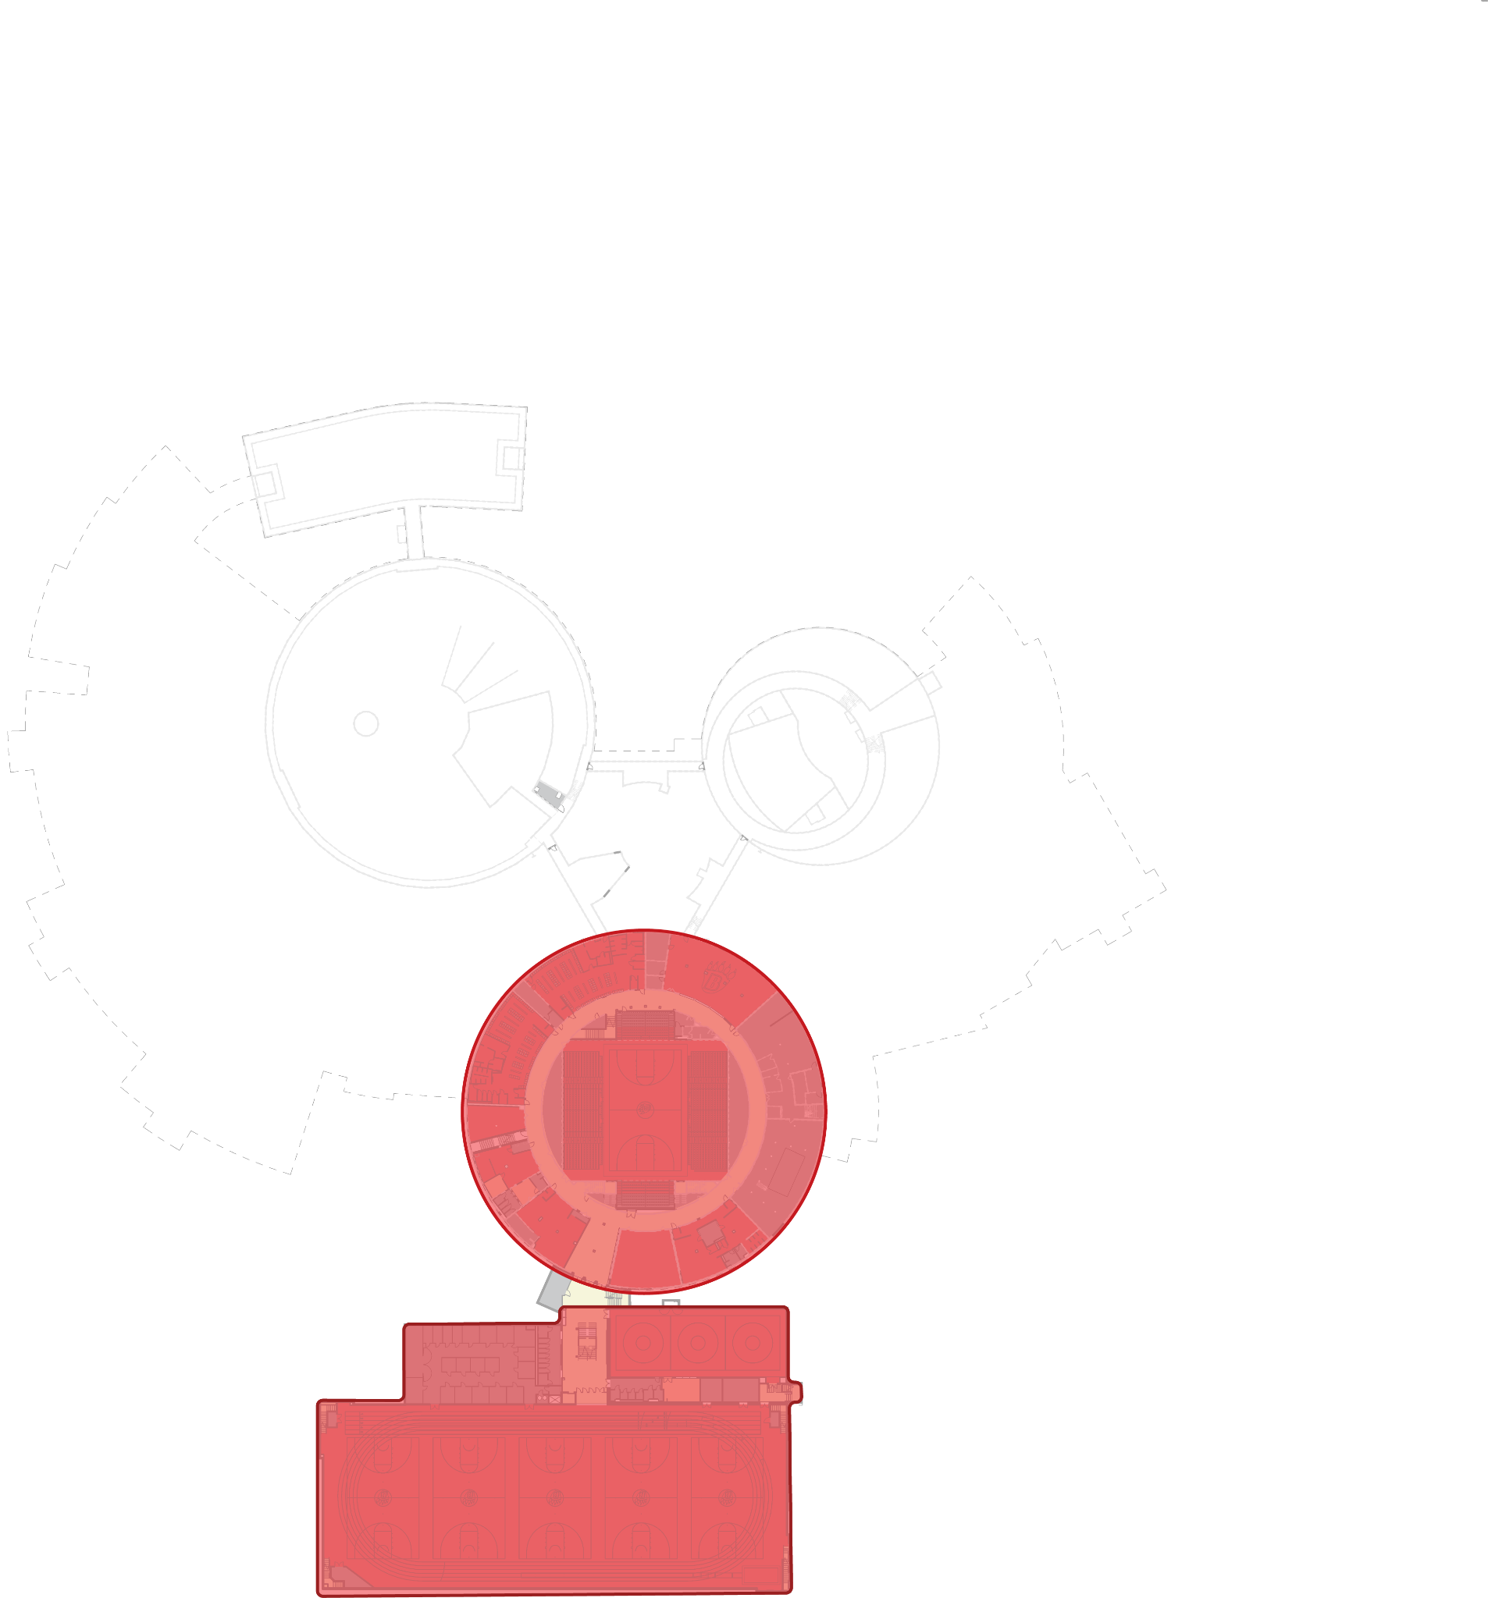

FIELD HOUSE
ATHLETICS ENTRY (ABOVE)
WRESTLING
STORAGE
2-LEVEL FIELD HOUSE
Notes:
Paul
May be getting updated version of photo to update

Slide 34
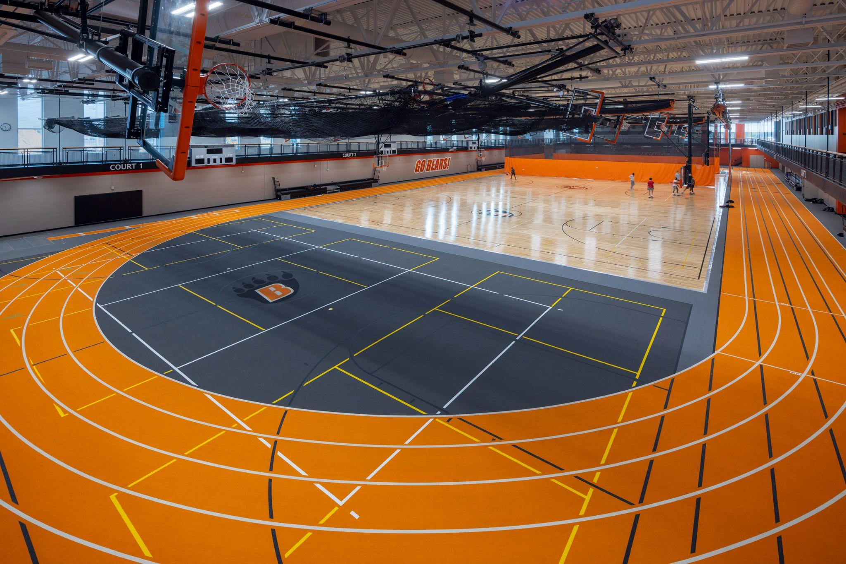
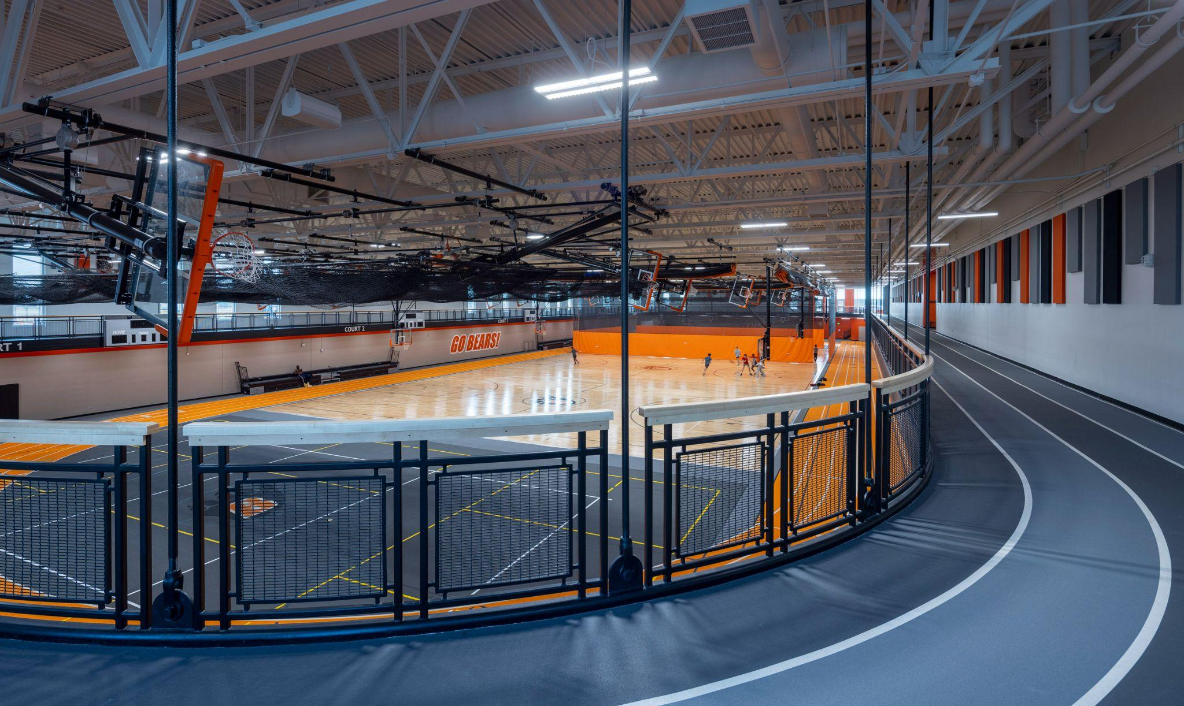
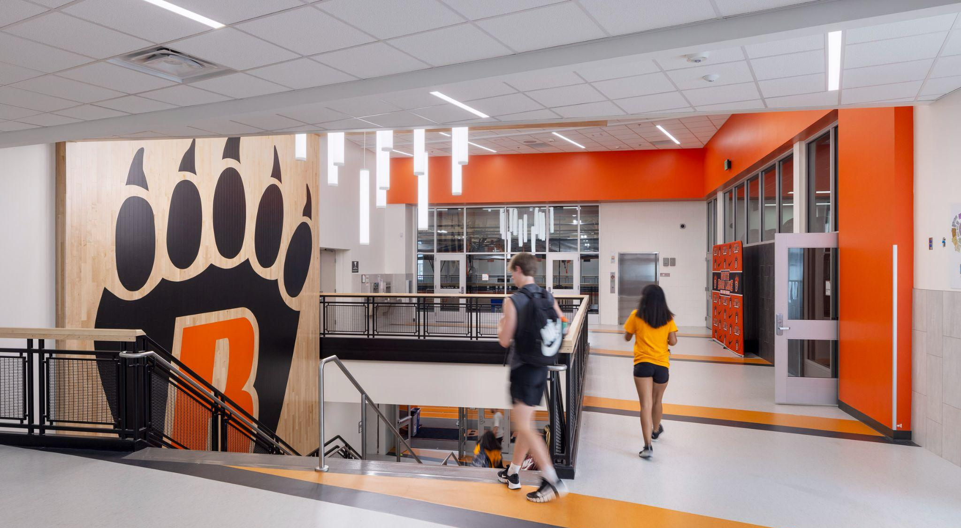
FIELD HOUSE
Notes:
Paul

Slide 35
ISD 624
Strategic Plan
Notes:
Russ Opens

Slide 36
The mission of White Bear Lake Area High School, the safe and vibrant community that aspires for greatness, is to ensure each student sets sail on their own course to personal and intellectual excellence. Together, our school is committed to a culture of welcoming, belonging, and leading.

Slide 37
3 QUESTIONS / 4 CORE VALUES
We want all students to be able to answer yes to these Three Essential Questions:
Do I belong here?
Is this meaningful?
Can I do this?
We believe in providing the conditions for students to develop their ROAR…
Relationships
Ownership
Awareness
Respect
Notes:
Russ

Slide 38
“DO I BELONG HERE?”
Notes:
Russ

Slide 39
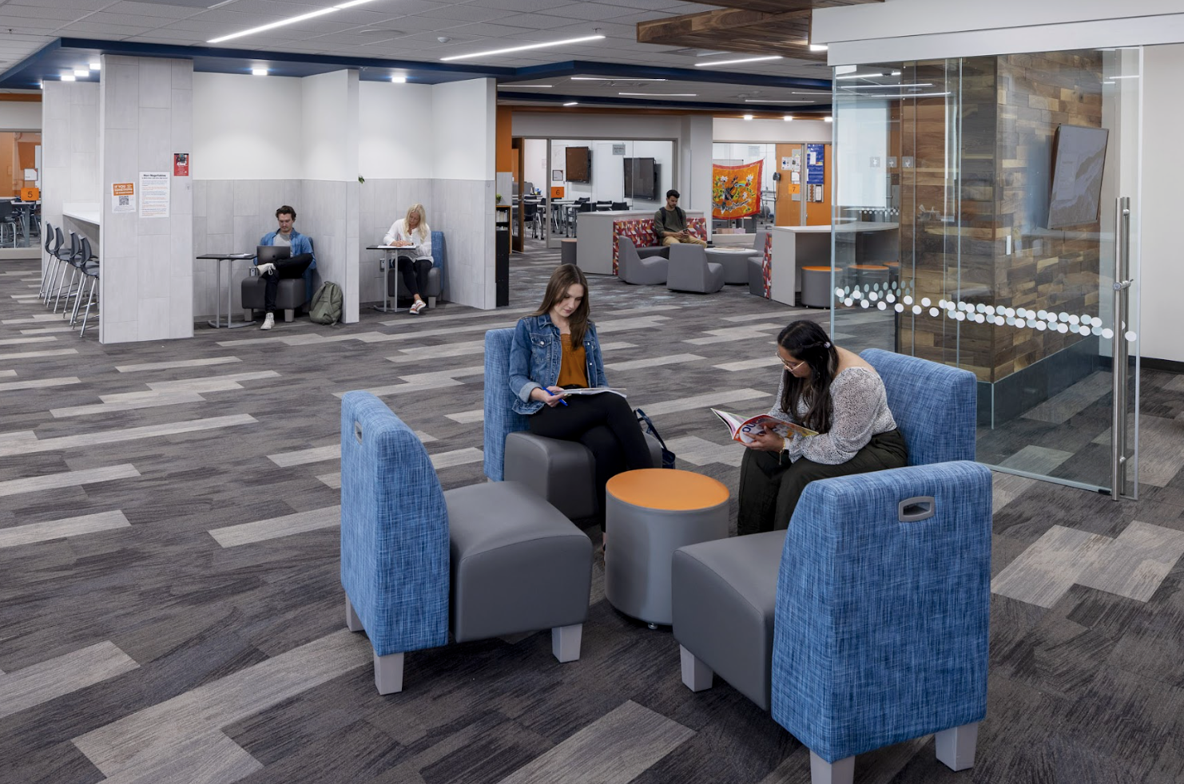
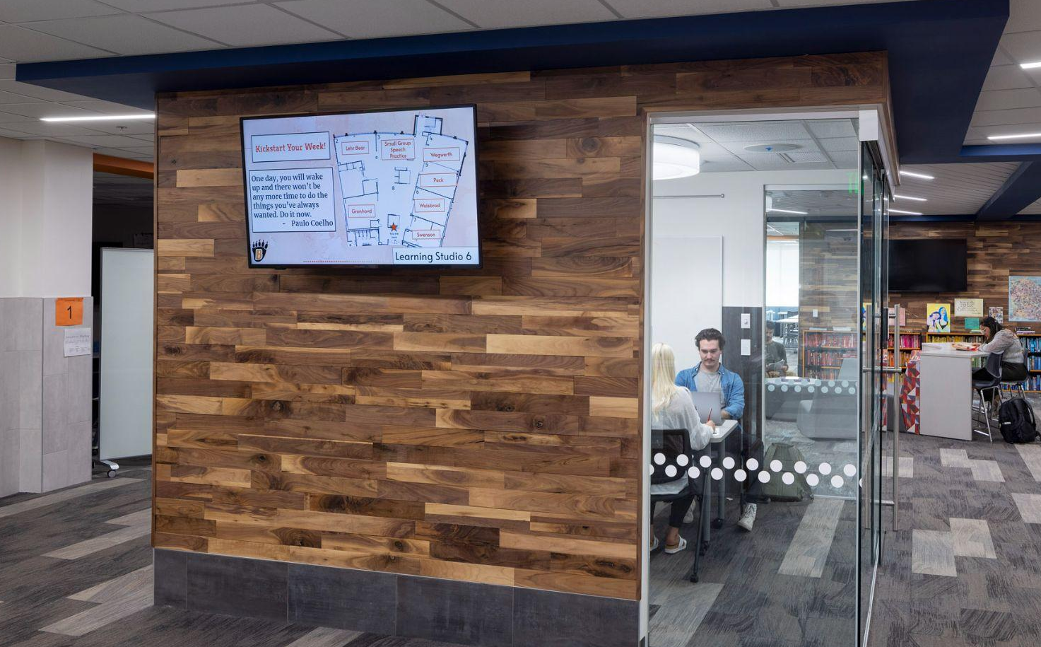
DESIGN & “DO I BELONG HERE?”
Flexible furniture supports educational needs and creation of norms among studios
Student choice and agency
Beyond the seating chart
Notes:
District to add a photo of students using flexible furniture
Russ/Matt - each studio has created their own norms, allows student choice and incredible flexibility, not worrying about the seating chart. How you take attendance in that setting.

Slide 40
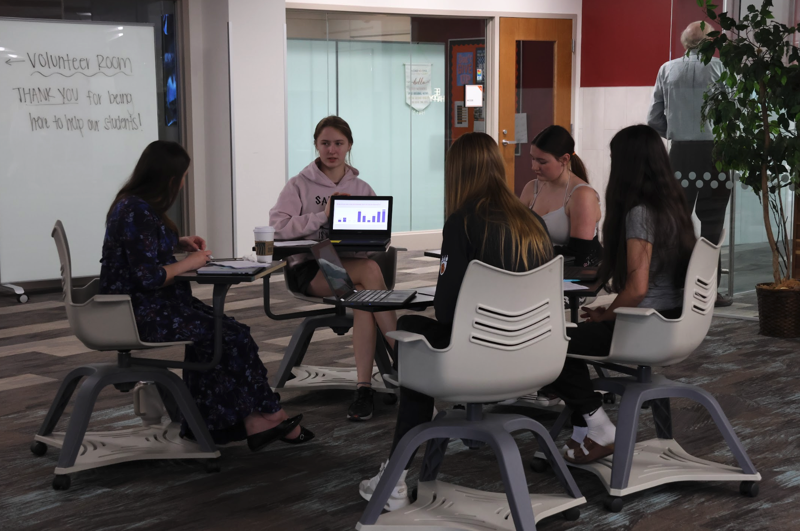
DESIGN & “DO I BELONG HERE?”
Design Strategy 1 - Learning Studios
A “school-within-a-school”
Team-based environments
Makes a large building feel small
Creates a sense of community and ownership
Notes:
Russ

Slide 41
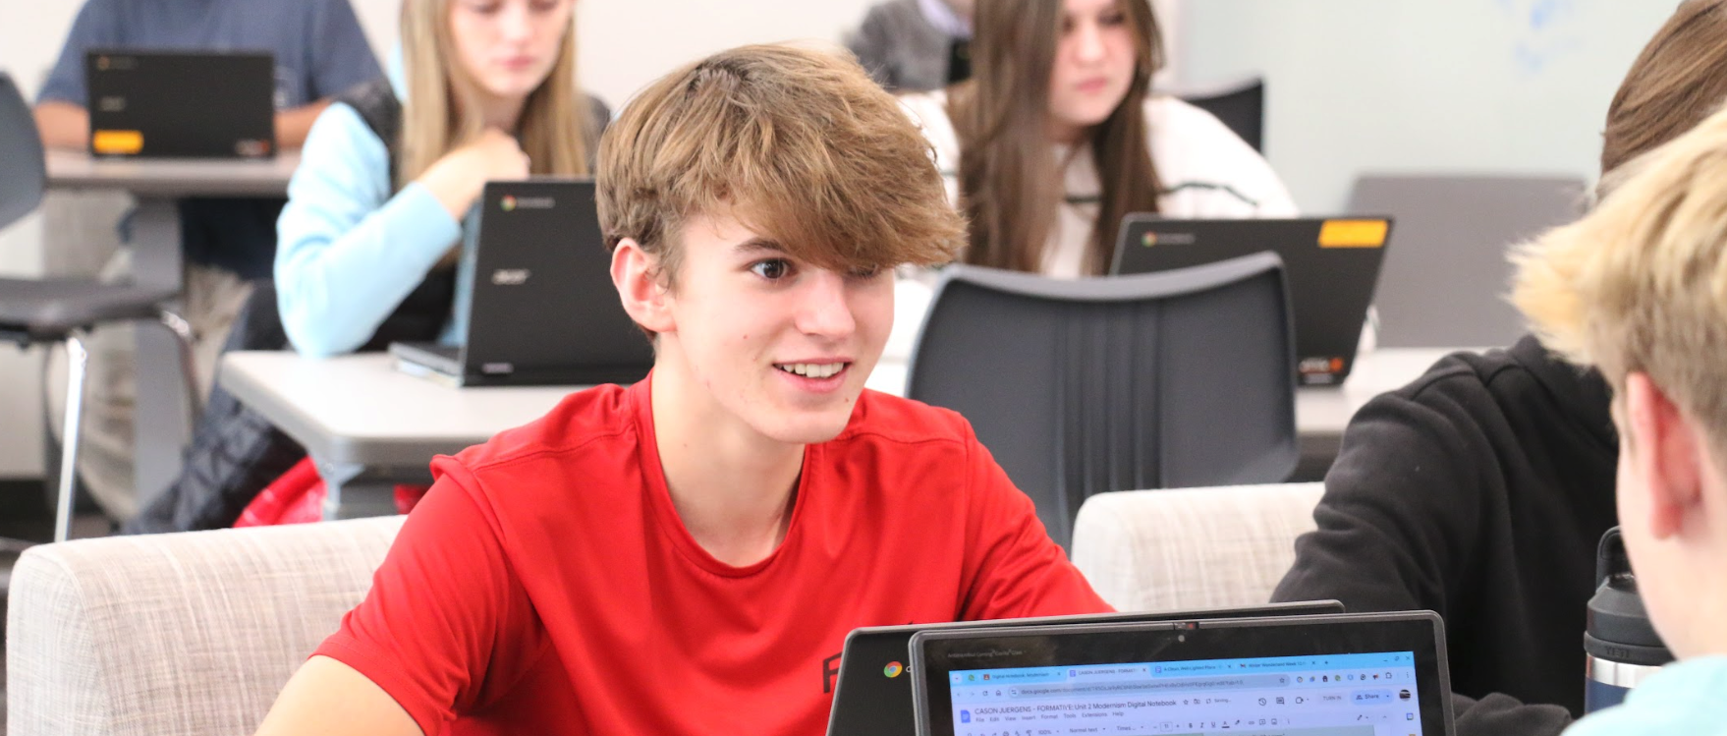
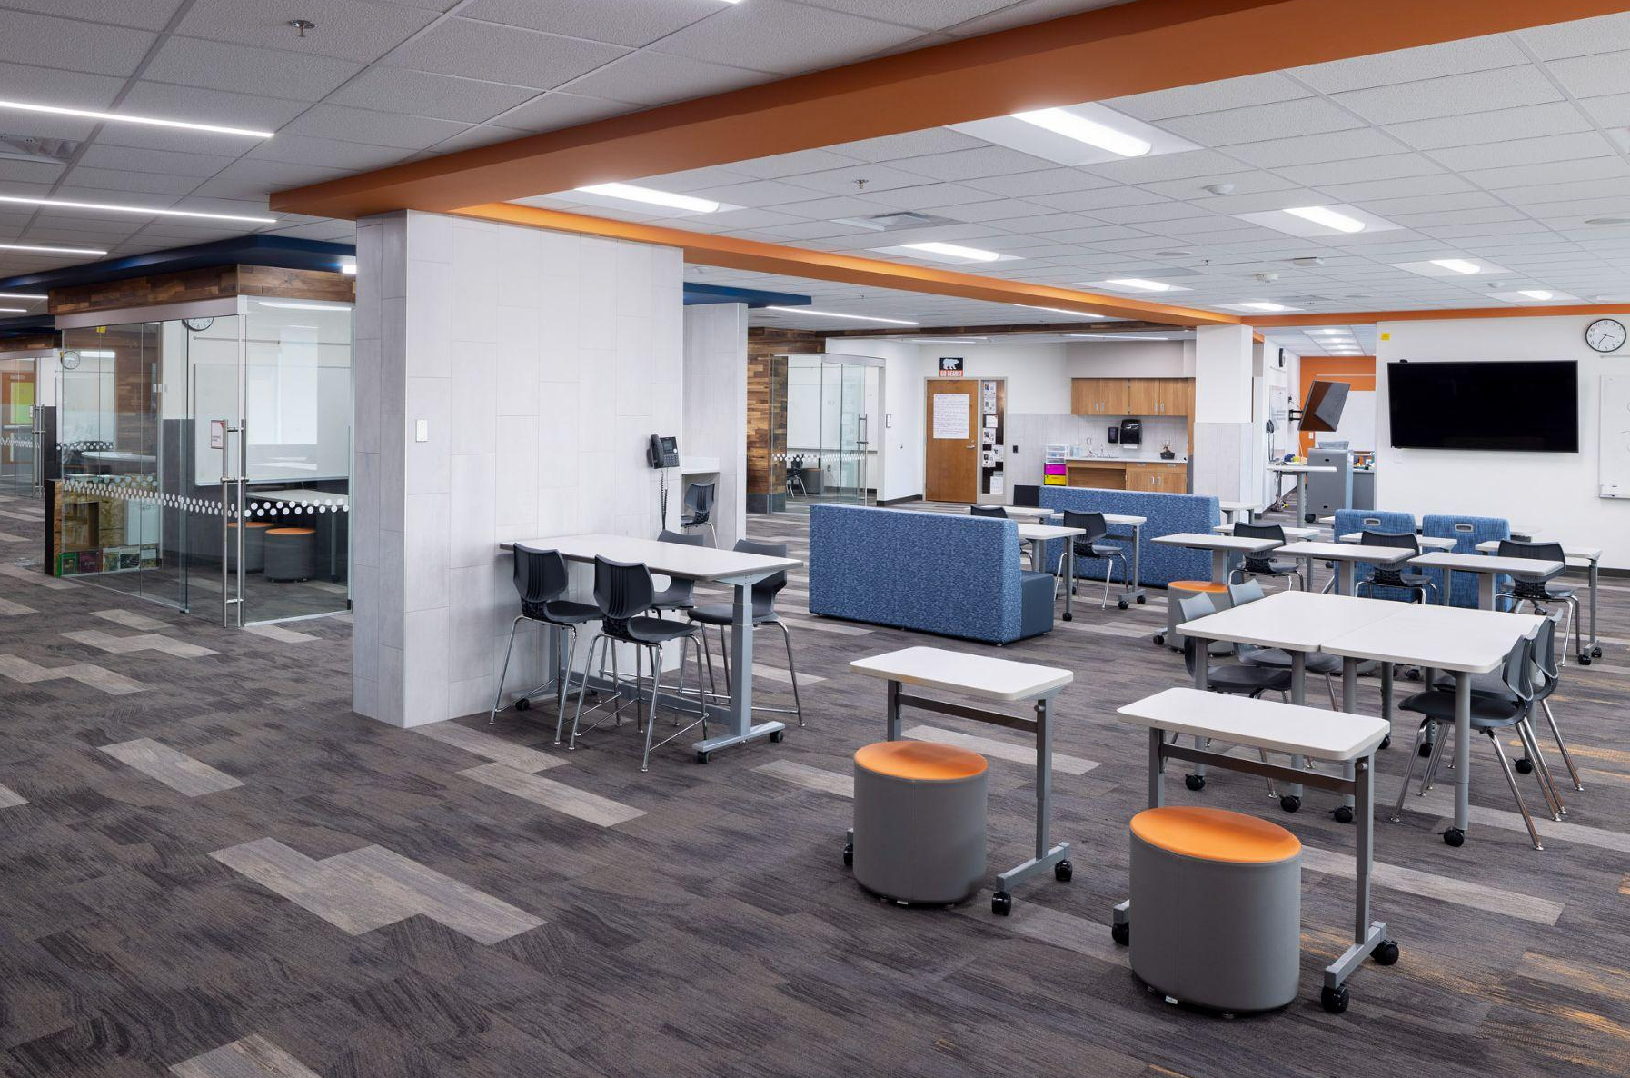
DESIGN & “DO I BELONG HERE?”
Design Strategy 3 - Inclusive & Student Centered-Spaces
Accessibility for varying abilities and personal preferences
Large and small group collaborative spaces
Flexible seating
Learning & Achievement on display
Privacy Restrooms
Happy & Proud
Notes:
Russ/Matt
Somewhere in this section speak to the student input gathered / survey asking questions about sense of belonging

Slide 42
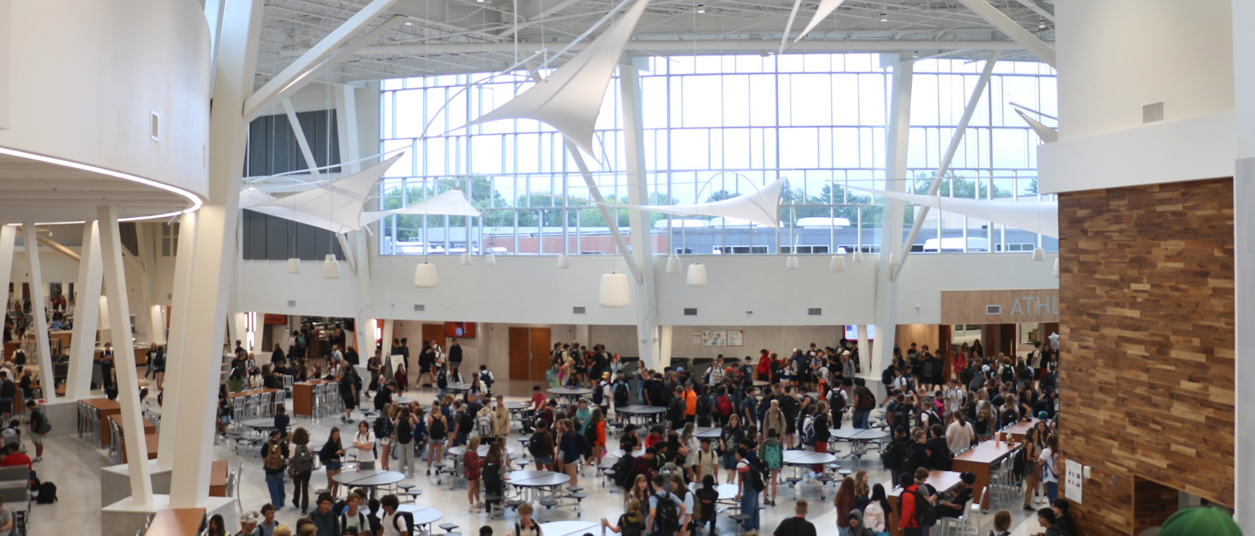
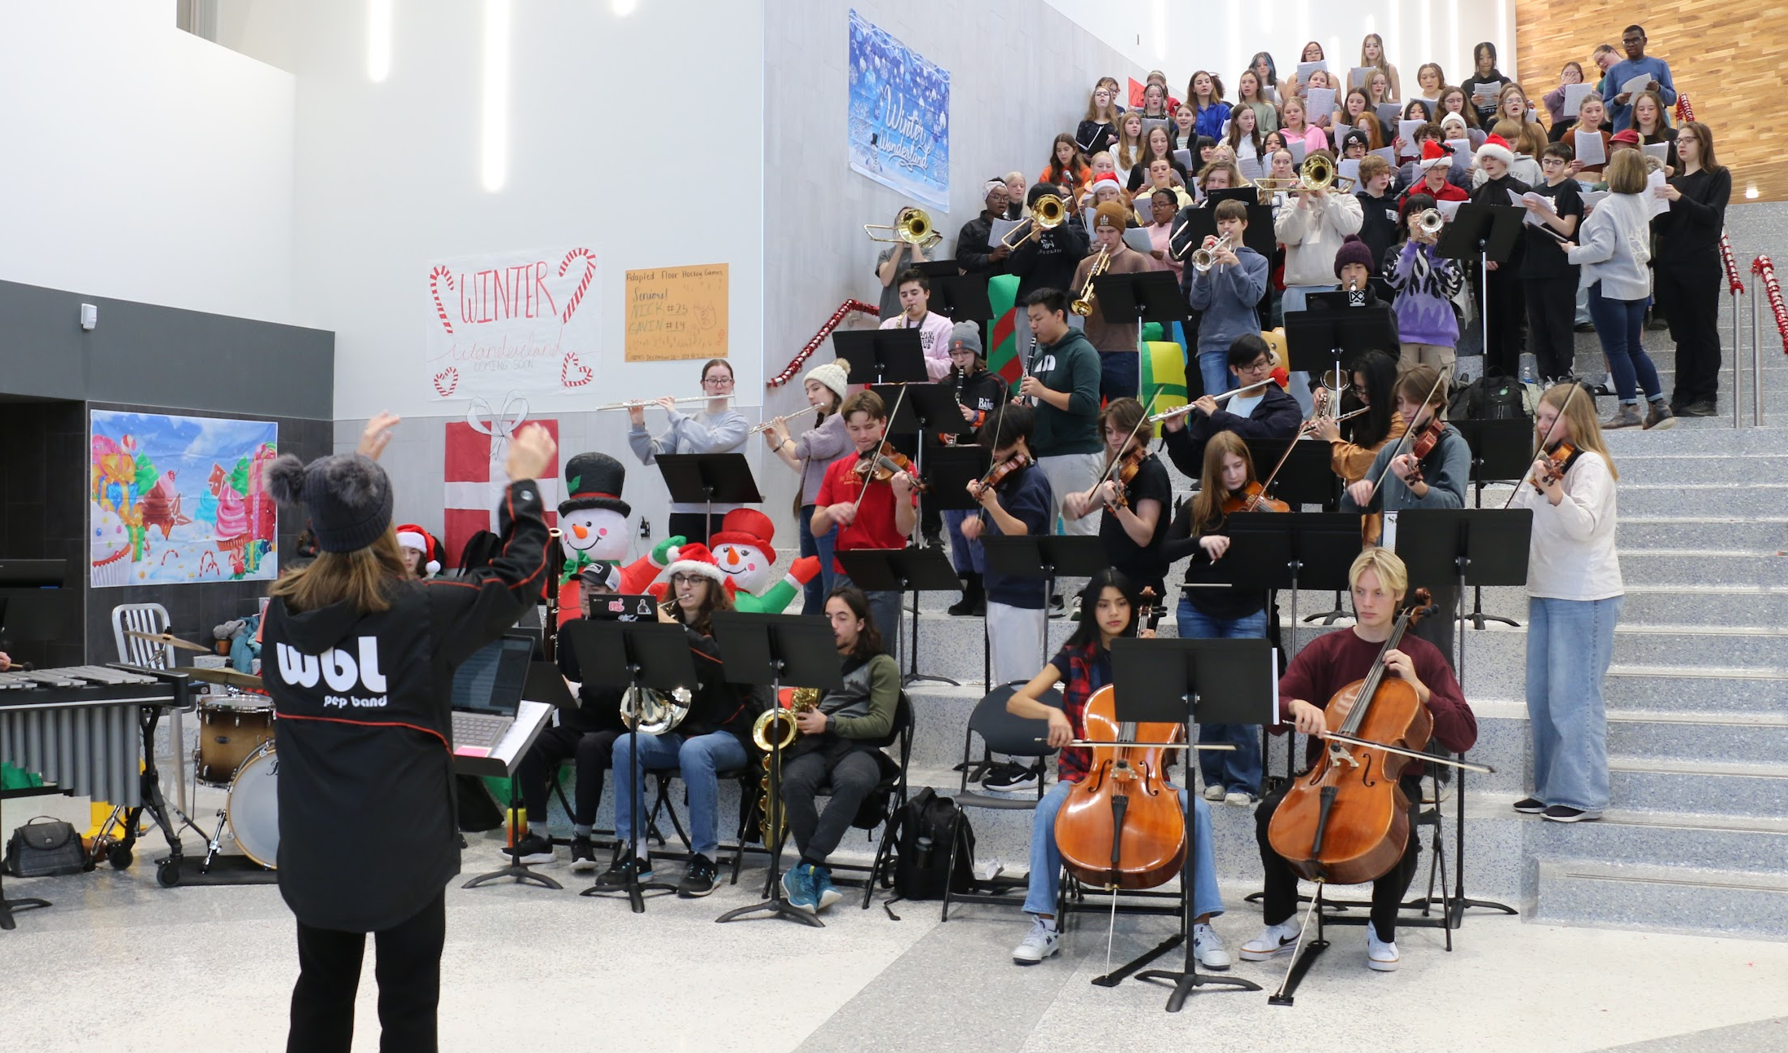
DESIGN & “DO I BELONG HERE?”
Design Strategy 2 - The Union
The central backbone
Serves as a social hub, collaboration space, meeting/event space…and cafeteria
A unified identity - “White Bear Nation”
Natural light, open sightlines, & constant activity - far from an institutional feel
Notes:
Russ

Slide 43
“IS THIS MEANINGFUL?”
Notes:
Matt - Meaning making and making what the learn and do meaningful to them now and in the future.

Slide 44
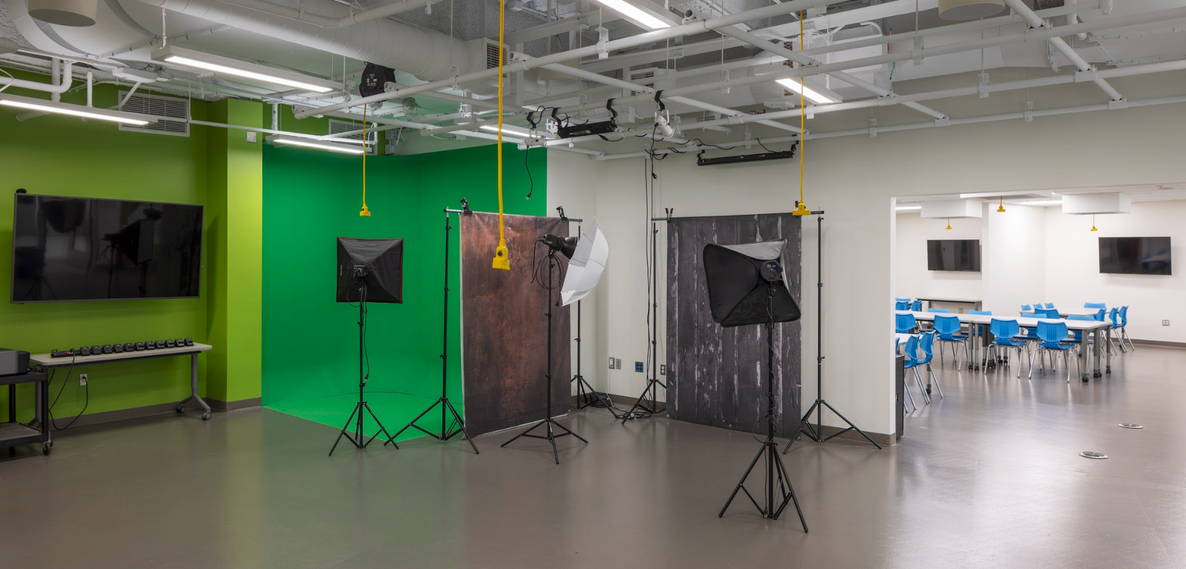
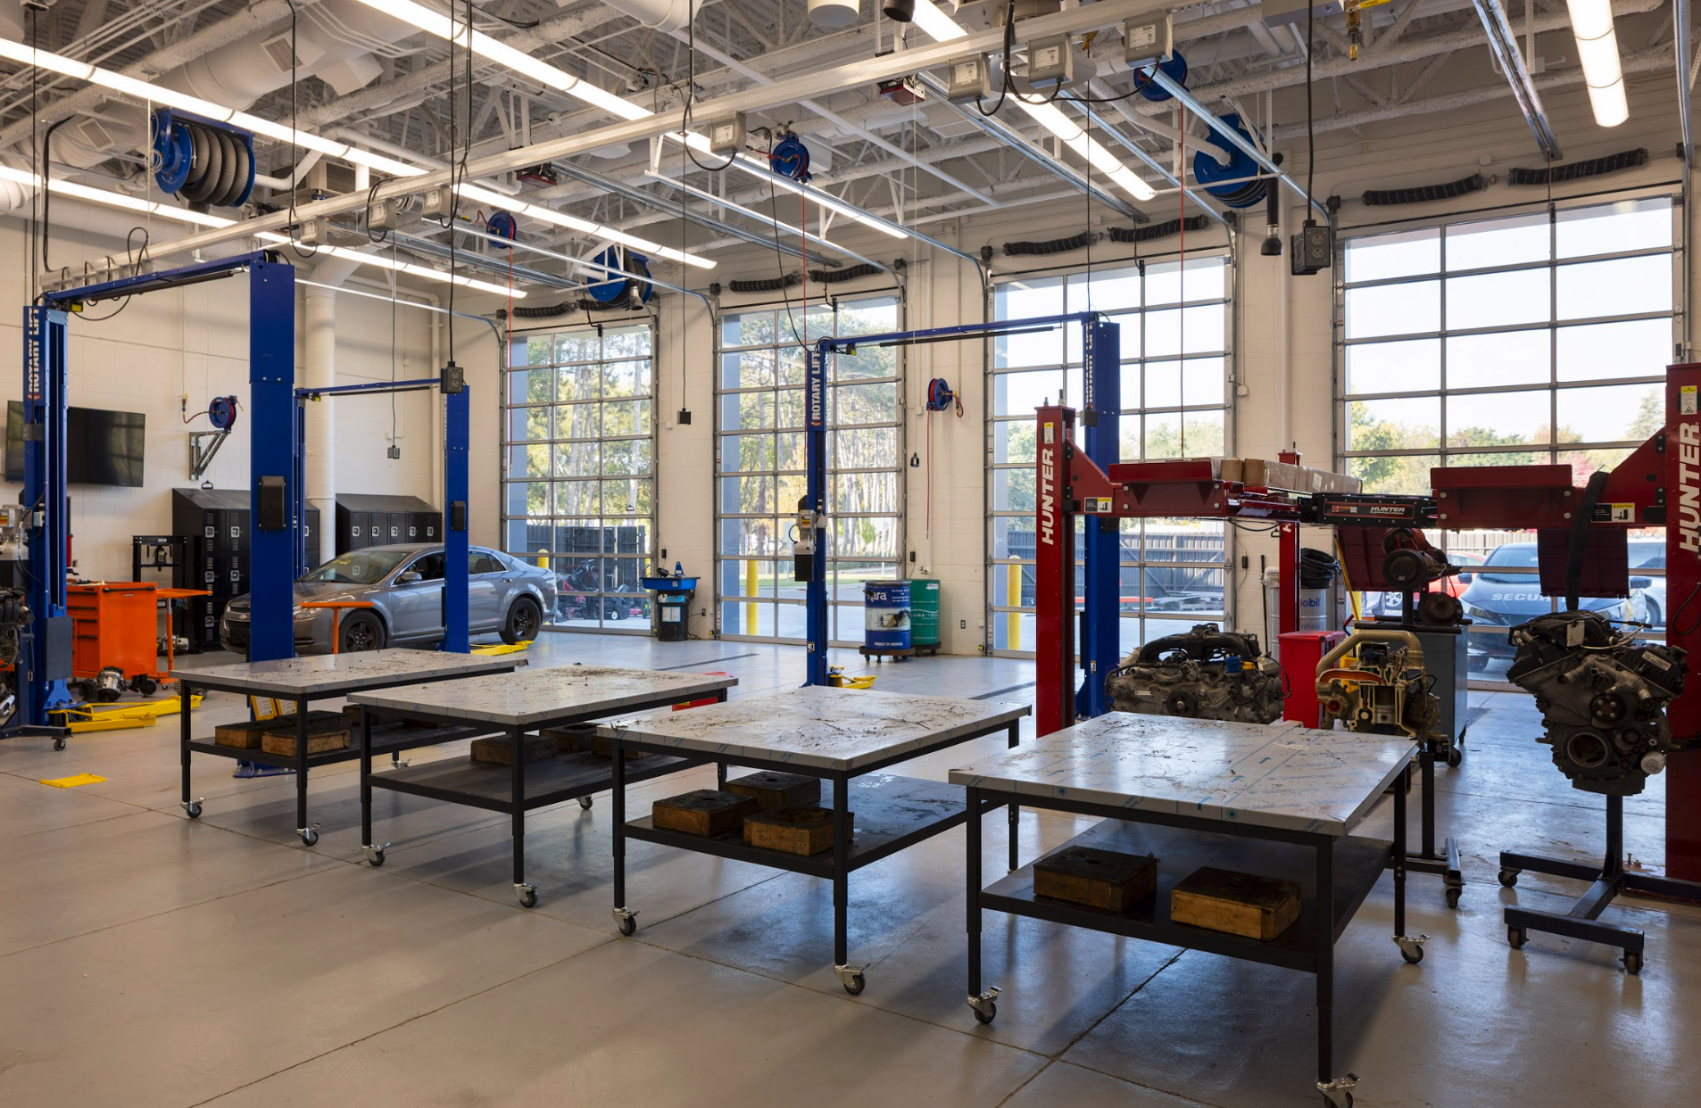
DESIGN & “IS THIS MEANINGFUL?”
Design Strategy 1 - Career Pathways & Professional-Grade Spaces
State-of-the-art, industry-standard spaces for CTE and beyond
  CNA, Construction, Manufacturing, Automotive, Culinary Arts, Business and Performing Arts
Learning becomes tangible & aspirational
Career Pathways program is booming
Notes:
Matt. Moving beyond traditional programming and to an emphasis on Career Pathways. Expand on Career Pathways and Industry Partners.

Slide 45
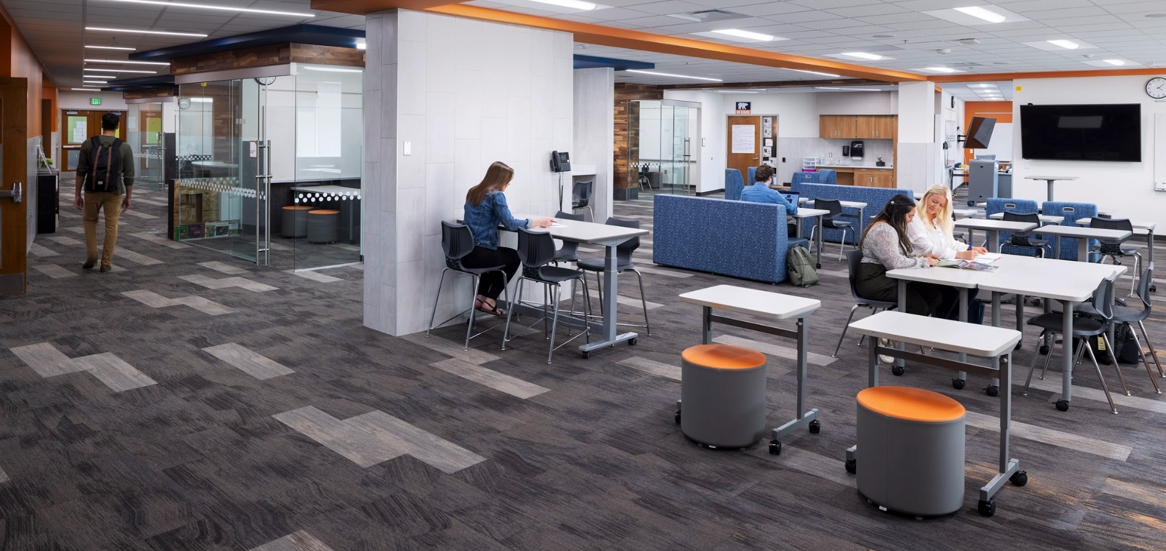
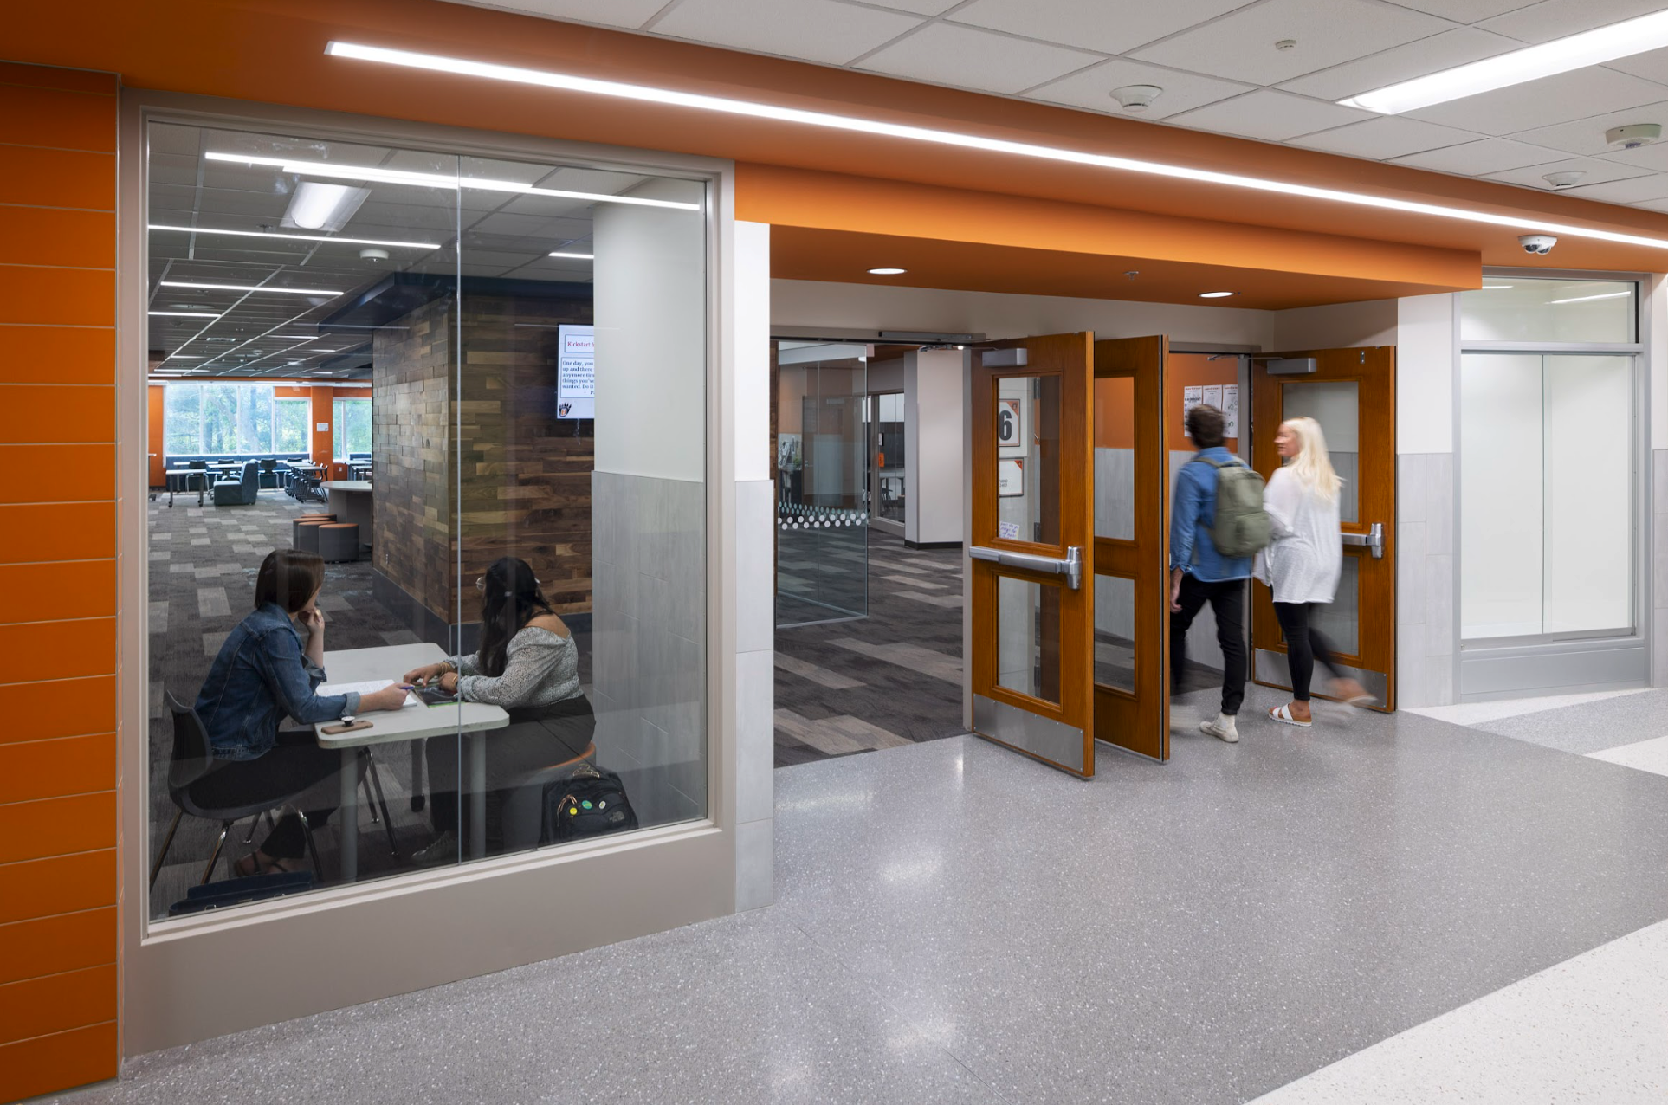
DESIGN & “IS THIS MEANINGFUL?”
Design Strategy 2 - Learning & achievement on Display
Significant use of glass in all spaces
Sparks Curiosity
Increases student ownership
Improves awareness of learning
Highlights the great things all students are doing in every classroom
Notes:
Matt. Highlight Ownership, Awareness (raising our game because others see). See learning is happening, trigger curiosity. Idea of students seeing themselves in spaces. See what is possible. See themselves in the space,

Slide 46
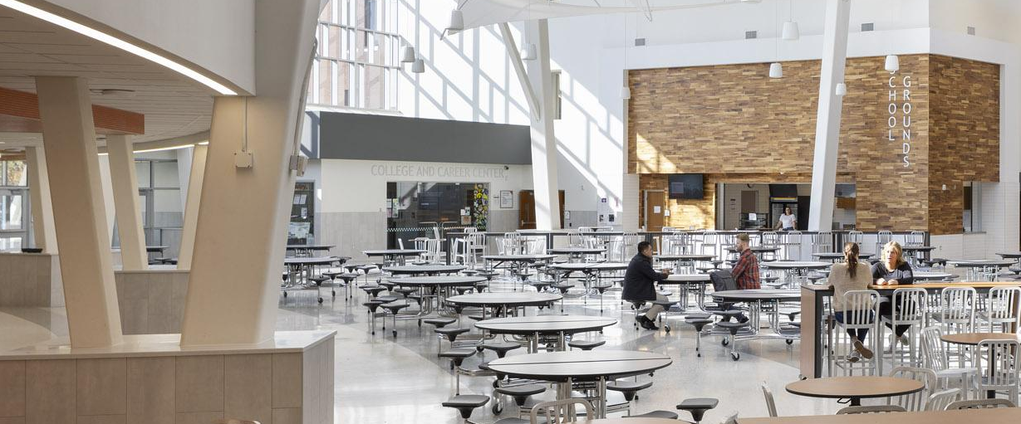
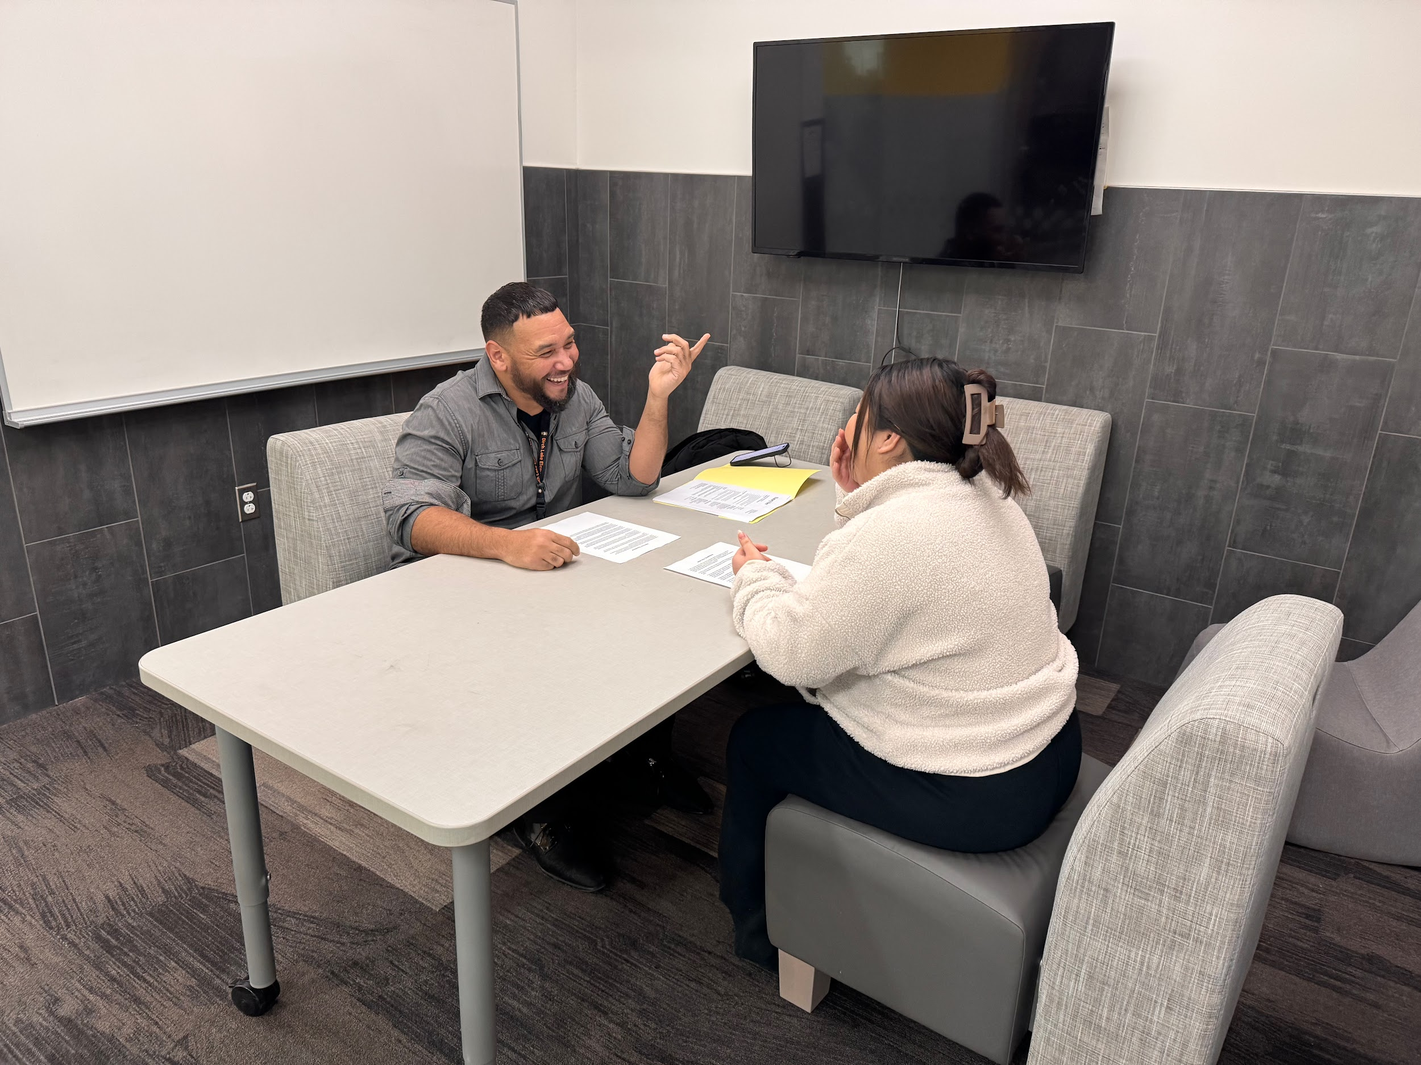
DESIGN & “IS THIS MEANINGFUL?”
Design Strategy 3 - Centralized & Visible College and Career Center
Placed strategically within the Union
Industry partnerships are highlighted
Moving beyond 4-year college
  Highlighting apprenticeship, 2-yr, and 4-yr options
400% increase in student visits
Notes:
Matt - Thoughtful layout and design that allows access… subtle reminder of what may be next . Brining outside resources, industries, opportunities to student now. Creating opportunities for student to get out in the field to experience enterprise

Slide 47
“CAN I DO THIS”
Notes:
Russ/Matt to add data on decrease in absences / improved attendance and decrease in behavior concerns including fights, chemical use and suspensions

Slide 48
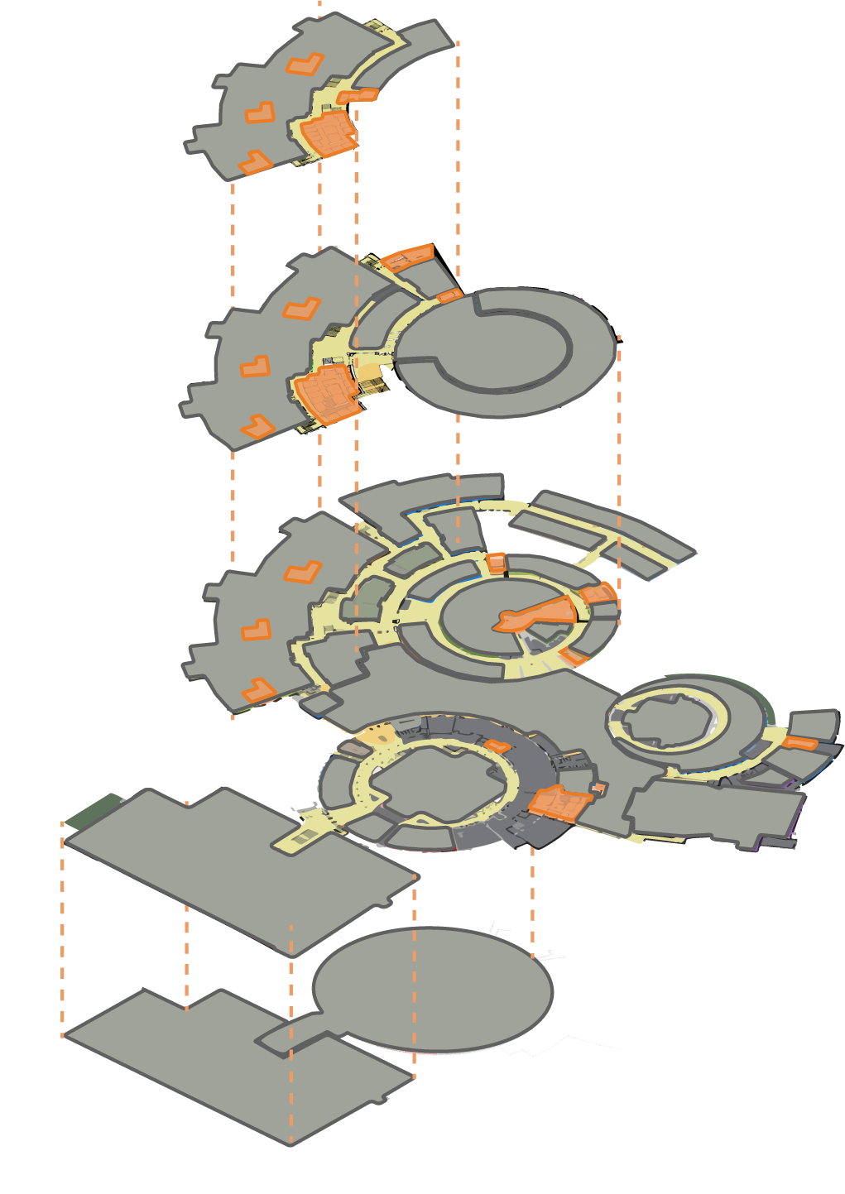

DESIGN & “CAN I DO THIS?”
Third Level
Design Strategy 1 - Distributed Support Systems
Support Offices throughout building
Centrally located Tutoring Center & Testing Center
Assistance is always close and accessible
The need for support is destigmatized
Second Level
Main Level
Lower Level
Notes:
WOLD TO UPDATE GRAPHIC TO SHOW ALL STUDENT OFFICES - Russ. A new method of distributing supports. No longer 1-2 office spaces. Staff is available in all major areas of the building. Emphasis on normalizing assistance/supports improves a student’s well being and belief in themselves.
Wold to emphasize offices on our simplified plan showing their distribution (in Google slides) - maybe consider reducing text on slides.
Notes:
Add simplified plan and highlight staff space (salmon/peach)

Slide 49

DESIGN & “CAN I DO THIS?”
Design Strategy 2 - A Shift in Instructional Practice
A fundamental shift in instruction
From “my classroom” to “our studio”
More collaboration among teachers and between classrooms
Collective efficacy of staff has
transferred to the students
Greater flexibility means more students get their needs met and find success
Notes:
Russ
Adjust logos for remainder of slides

Slide 50

DESIGN & “CAN I DO THIS?”
Design Strategy 3 - Wide Spectrum of Learning Spaces
Increase student agency and ownership
  students are empowered with choice
Students find a spaces that fits their needs
Open spaces evoking the feeling of flexibility and freedom
Quiet study nooks
Small & large group
flexible rooms
Flexible classrooms and furniture
Notes:
Russ

Slide 51
SURPRISE & NEXT STEPS
Notes:
Russ/Matt to add data on decrease in absences / improved attendance and decrease in behavior concerns including fights, chemical use and suspensions

Slide 52

Notes:
Video illustrating a surprising thing or images/bulleted list? SKOL chant video?

Slide 53


Slide 54

NEXT STEPS
Getting the last 15% to full adoption
  100% staff adoption of instructional strategies
  Setting the anxious minds at ease about building safety.
  LS mindset in our more traditional environments
Notes:
Russ

Slide 55
Q & A
Notes:
Russ/Matt to add data on decrease in absences / improved attendance and decrease in behavior concerns including fights, chemical use and suspensions

Slide 56


Slide 57


Slide 58

Building Layout
Lower Level
Main Level
Notes:
Paul
Include the union

Slide 59


Building Layout
Third Level
Second Level
Notes:
Paul
Remove gold on second floor
Add black outline around all floorplans on 26 and 27

Slide 60


