Slide 1


#edspaces
Designing to Elevate the Human Experience in the Era of AI
November 5 | 1PM

Slide 2
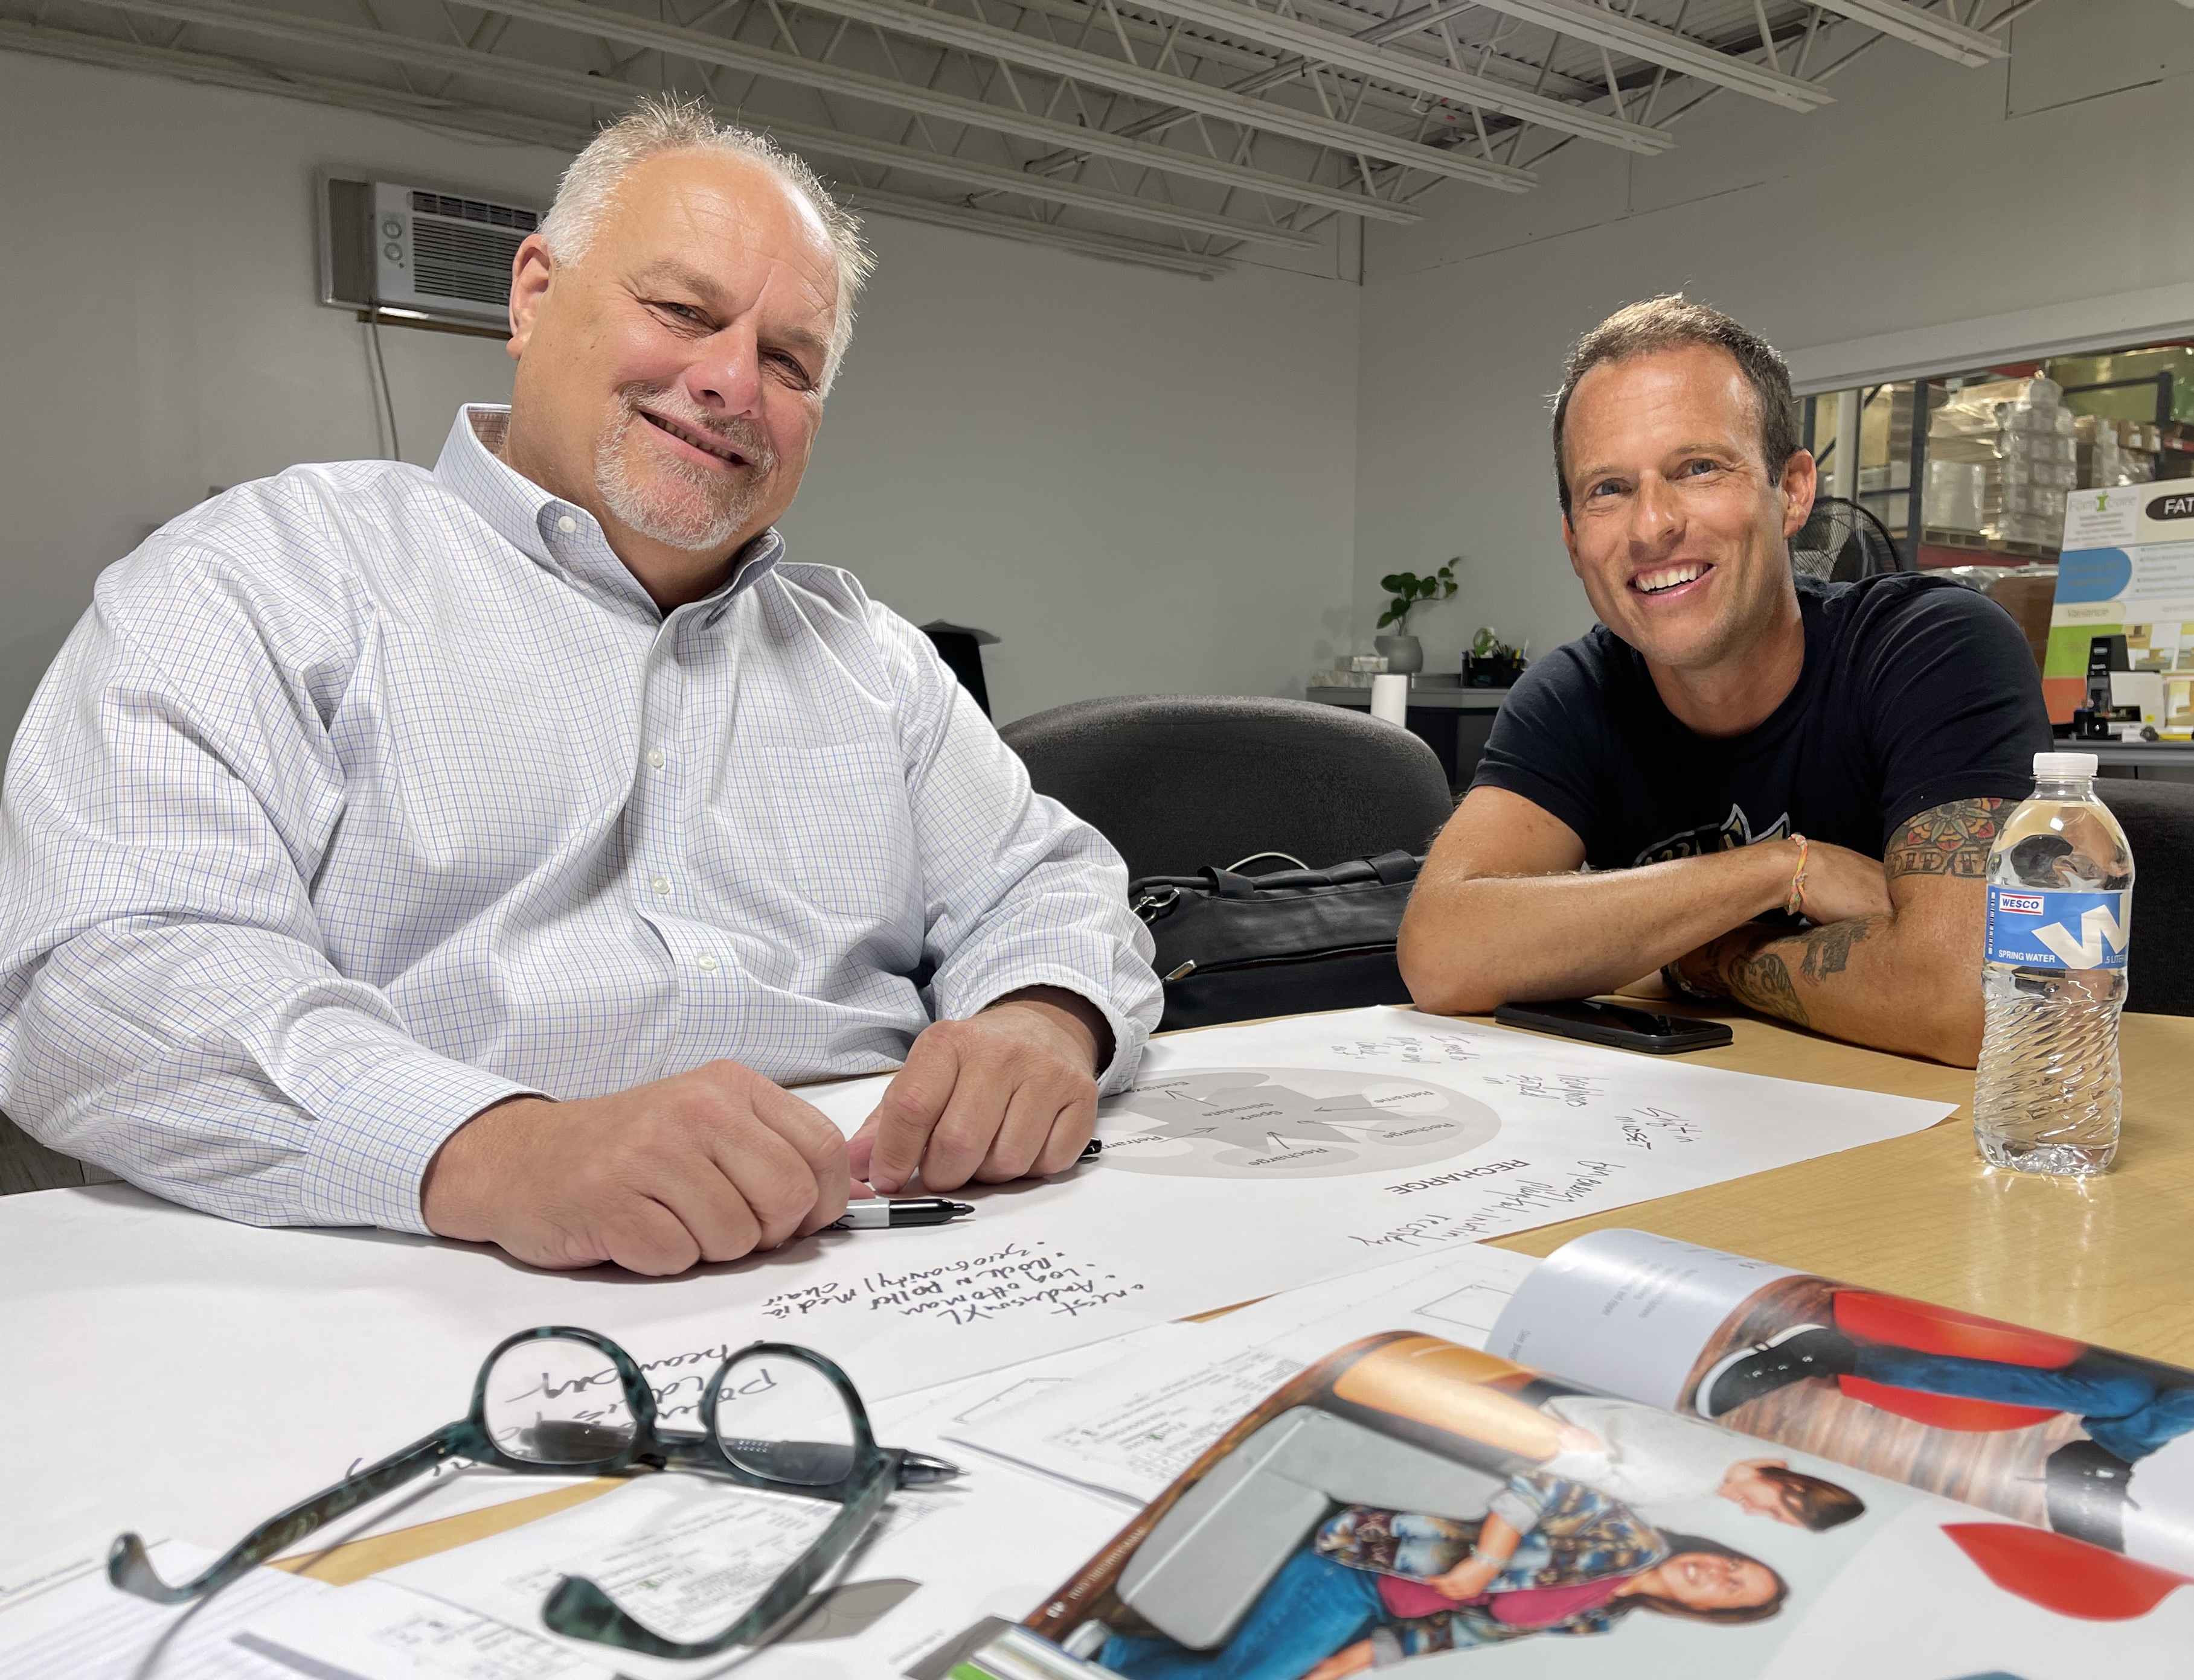
WELCOME
Introductions Dave Diller and David Jakes
Our shared question
What does it mean to design for the human experience in the era of AI?

Slide 3


PRESENTATION FOCUS
We’ll explore how artificial intelligence has the potential to reshape design practices in education and architecture and how we can ensure AI elevates the human experience rather than replaces it.

Slide 4

EVERYONE IS A DESIGNER
Whether you design spaces, experiences, lessons, or systems…
…you’re shaping the conditions for human beings to learn, connect and thrive— the essence of human experience.

Slide 5

DEVELOPING/EVOLVING A POINT OF VIEW
This presentation is designed to challenge your thinking about the use of AI and help you continue to develop your point of view about the use of AI in design.
We’ll introduce a three-part framework to address the development and evolution of a point of view.

Slide 6

WHAT IS A POINT OF VIEW?
A point of view is a human-centered lens through which you see and frame a design challenge.
It shapes how you interpret possibilities and make design decisions, ensuring your work remains grounded in human experience even as AI expands what’s possible. It informs engagement, process, and outcome.

Slide 7

OUR BELIEF: HUMAN QUALITIES THAT SHAPE A POINT OF VIEW
Understanding of context
Use of empathy
Engaging in sensemaking
The Three I’s: intuition, imagination and ingenuity

Slide 8

OPENING STATEMENTS: OUR POINT OF VIEW
What drives our curiosity and caution about AI in design?

Slide 9

THE CURRENT LANDSCAPE OF AI IN DESIGN
What are the challenges and opportunities of using AI in design?

Slide 10
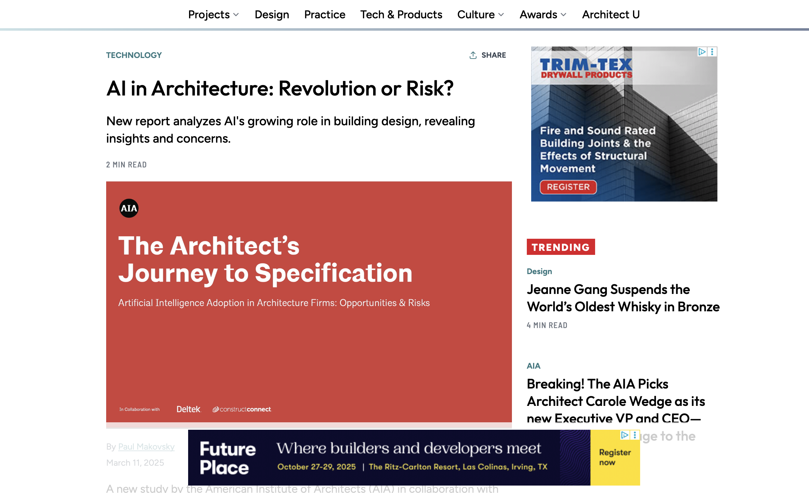
https://www.architectmagazine.com/technology/ai-in-architecture-revolution-or-risk_o

Slide 11
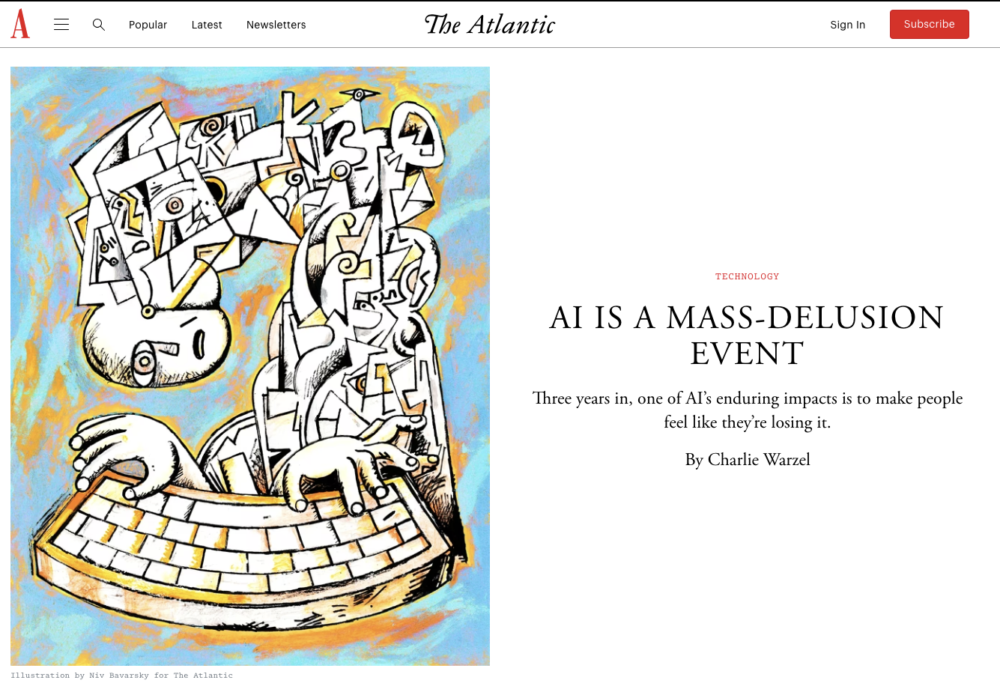
https://www.theatlantic.com/technology/archive/2025/08/ai-mass-delusion-event/683909/

Slide 12
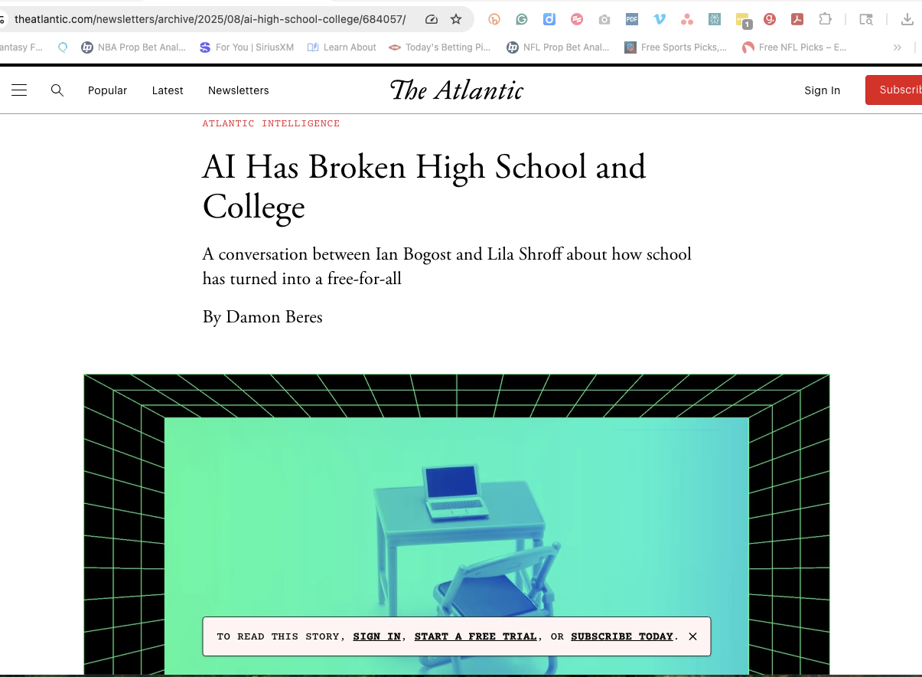
https://www.theatlantic.com/newsletters/archive/2025/08/ai-high-school-college/684057/

Slide 13
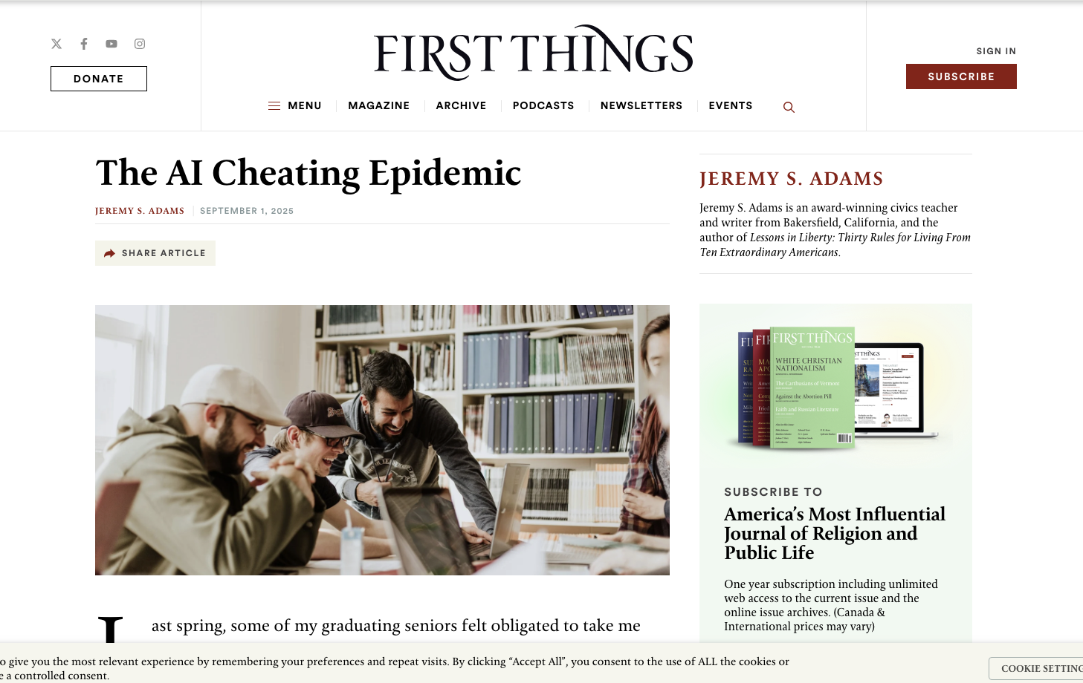
https://firstthings.com/the-ai-cheating-epidemic/

Slide 14
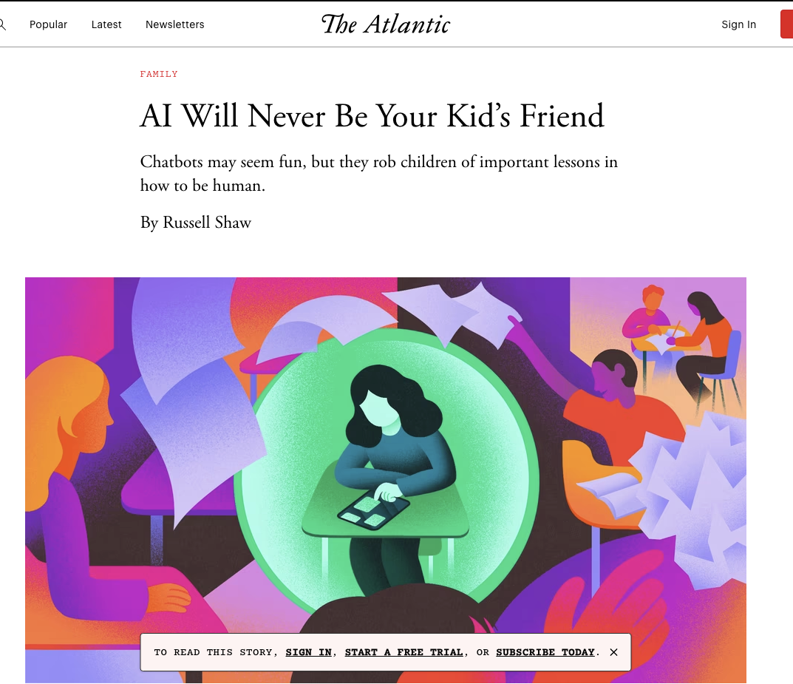
https://www.theatlantic.com/family/archive/2025/07/ai-companion-children-frictionless-friendship/683493/

Slide 15
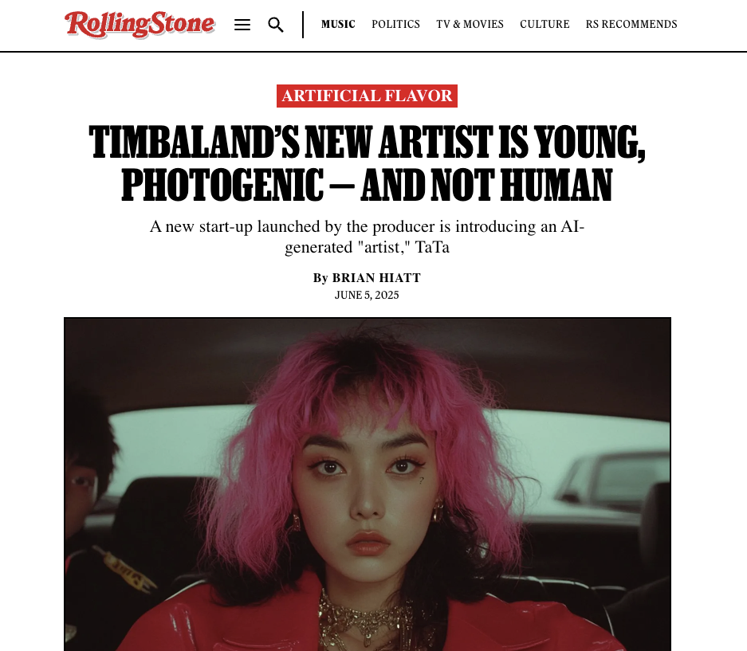

Slide 16
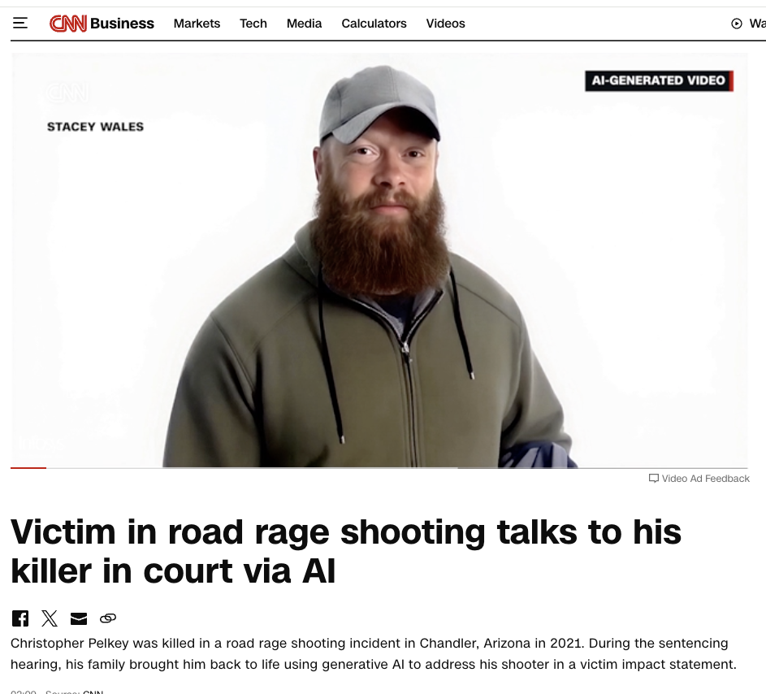

Slide 17
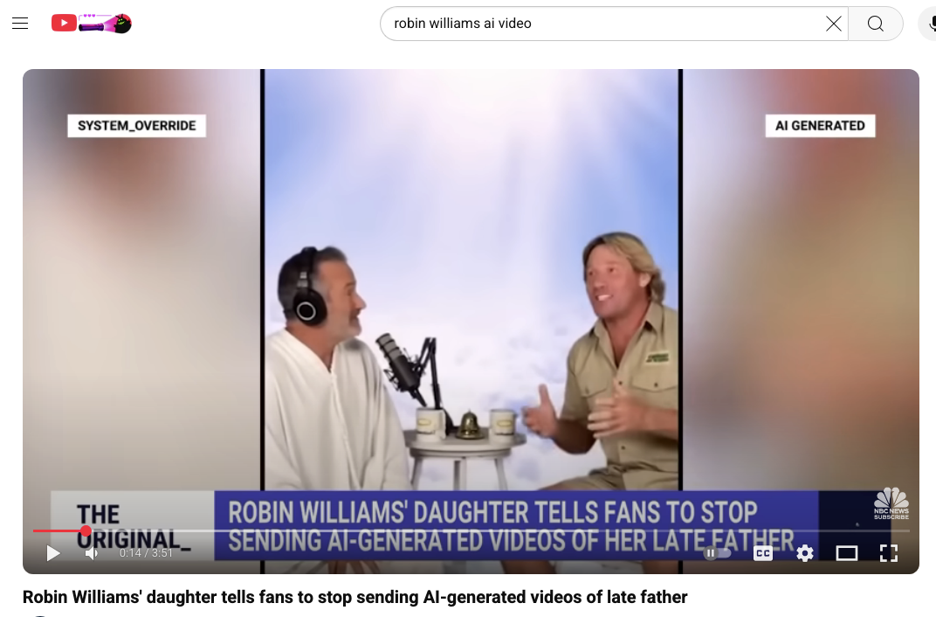
https://www.youtube.com/watch?v=d0tWyByHtRM

Slide 18
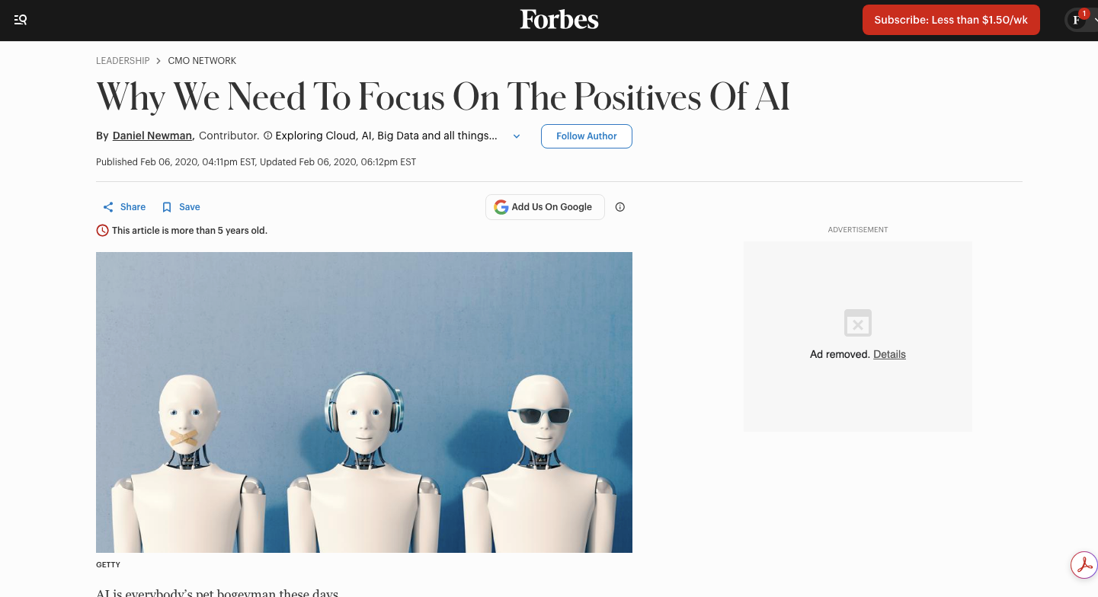

Slide 19


Slide 20

From: The Creative Act by Rick Rubin

Slide 21

THE CONVERGENCE OF DESIGN AND AI
Design and AI form a complex ecology of evolving roles, tools, and capacities. Understanding this ecology helps us identify where human capacity matters most.

Slide 22

COMPLICATED VS. COMPLEX SYSTEMS
COMPLICATED
COMPLICATED SYSTEMS
predictable, linear, technical (e.g., modeling, documentation, curriculum design).
COMPLEX SYSTEMS
emergent, relational, cultural
(e.g., learning, discovery, the individual human).
COMPLEX
AI thrives in the complicated, human flourish in the complex.

Slide 23

NAVIGATING COMPLEXITY
One way to address complexity is by developing and applying frameworks that promote clarity and reflection and help to define expectations while staying adaptable.

Slide 24
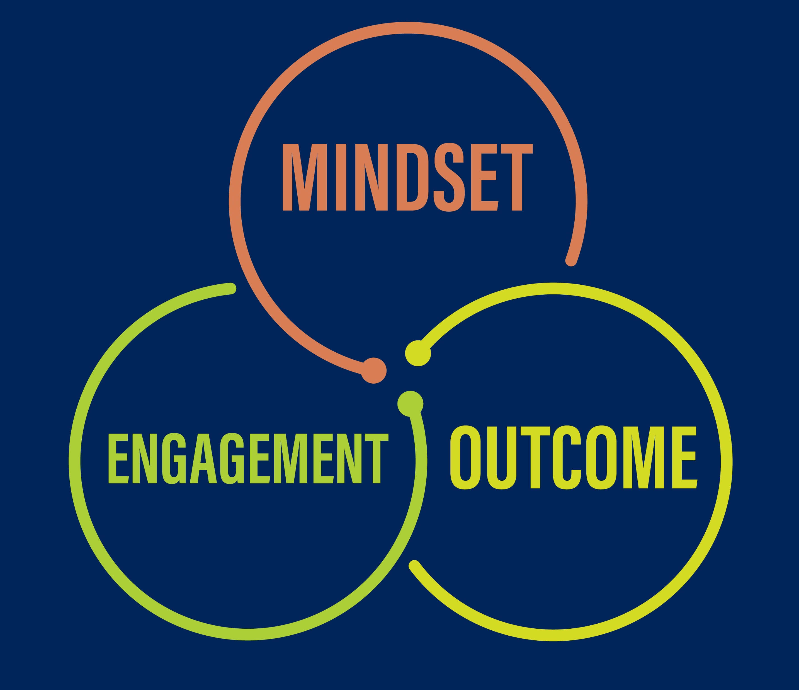
INTRODUCING A FRAMEWORK FOR REFLECTION AND ACTION
Mindset – How we think about our work
Engagement – How we approach and conduct our work
Outcome – How others perceive and value our work

Slide 25

MINDSET: HOW WE THINK ABOUT OUR WORK
Shift from resistance and hyperbole to responsible optimism.
AI disrupts how we think, but disruption invites growth.
Base mindset in the human dimensions of design: contextual awareness, empathy, intuition, imagination, ingenuity.
Moving from “What Can AI do for Me?” to “What Can Humans Do that AI Cannot Do?”

Slide 26
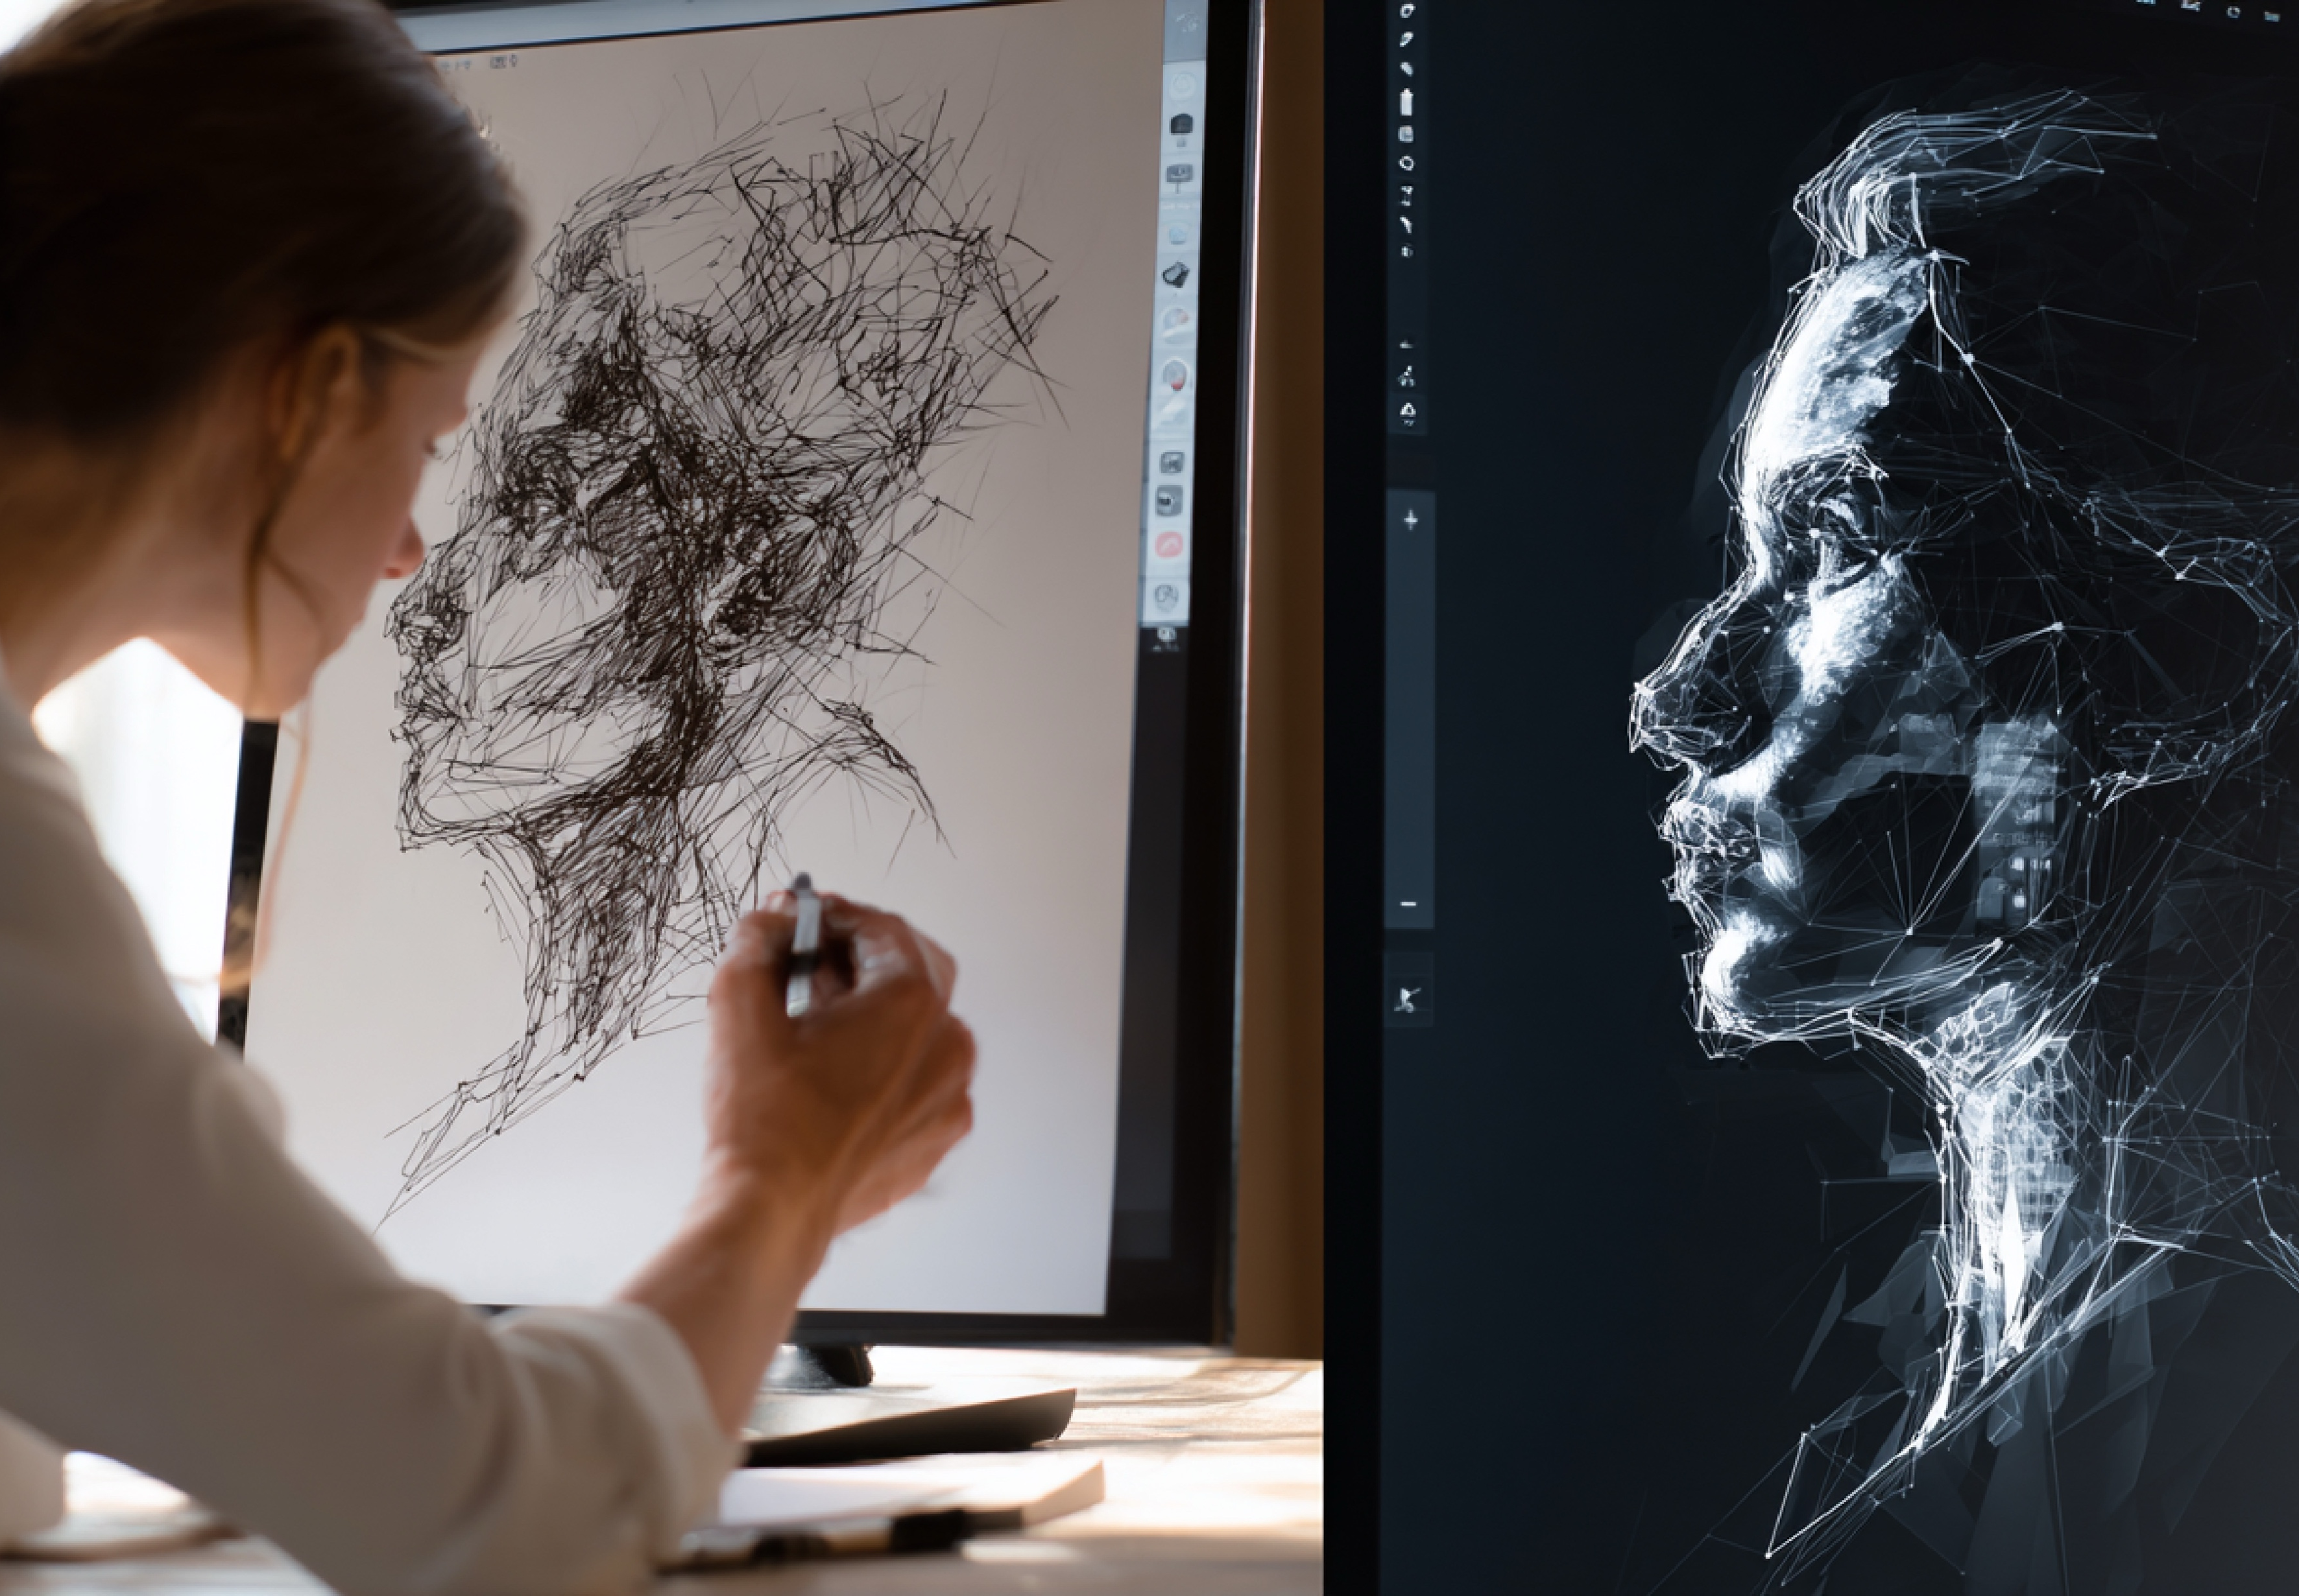
ENGAGEMENT: HOW WE APPROACH AND CONDUCT OUR WORK
Our intent: productivity and efficiency vs. creativity and amplification of the imagination
Our roles:
Humans as: sense-makers, storytellers, ethicists
AI as: accelerator, analyzer, amplifier
Our processes:
Architecture
Education
A shift from a transactional approach to a transformational approach.
How does AI add value instead of distracting from it?

Slide 27
OUTCOME: HOW OTHERS SEE AND VALUE YOUR WORK
How will you position your use of AI with clients? How will you communicate your point of view?
How will you address their concerns about AI? How will you address the use of their data in AI systems?
The New Question:
What represents meaningful value in an AI world? They have access to AI too.
The bottom line: Clients will increasingly look to designers not for what AI can produce, but for what only humans can provide.

Slide 28

WHAT HAPPENS TO THE ROLE OF DESIGNERS WHEN AI CAN DO MUCH OF THE TASK?
AI can generate countless variations of form — but it doesn’t know why a place matters.
Designers infuse the human story…

Slide 29


Slide 30
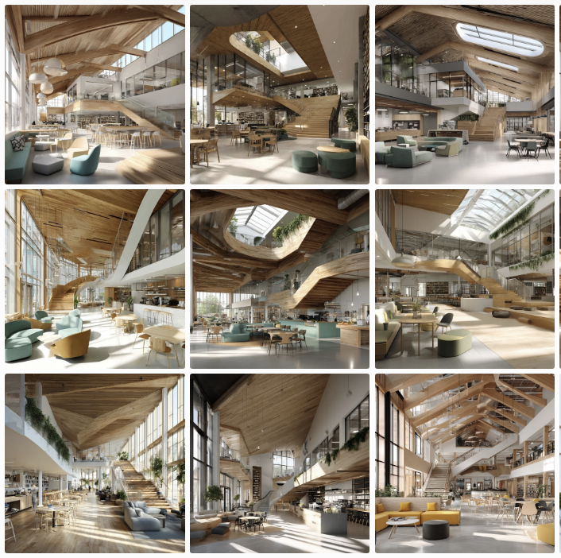
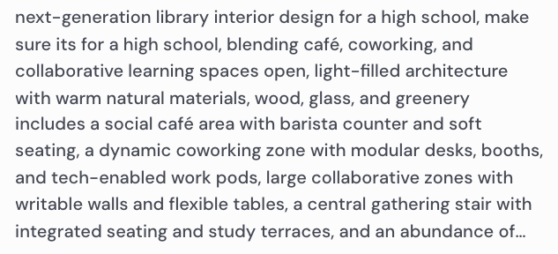

Slide 31

YOUR THOUGHTS ON EMERGENT IDEAS ABOUT AI?
Where do you stand?
Human-AI Relationship?
AI as colleague, critic, archivist, provocateur, co-designer?
Human in the Loop?
Hybrid intelligence?

Slide 32
THE EVOLVING WORK OF DESIGNERS IN AI ENVIRONMENTS: SUMMARY AND PREDICTIONS
Intentional Use: Not if, but how and why we use AI. Acknowledging he human experience as differentiator.
Evolving Roles & Relationships: Always in motion, a partner to support insight and innovation?
Creative application defines emergent value: Imagination, Ingenuity > Tools. These are the new currency of the AI era.
A new definition of outcome: From Product to Meaning
Human distinction as irreplaceable value: Context, empathy, sensemaking, the 3i’s, and ethics endure.

Slide 33

MOVING FROM INSIGHT TO ACTION
AI Revisit and evolve your point of view on AI.
Safeguard and celebrate the human attributes central to design.
Determine where AI is useful and where it is not.
Develop and guarantee equal and equitable use of AI across your organization.
Create metrics for responsible and successful use.
Develop your story, make it transparent, share it, and live it.

Slide 34

QUESTIONS FOR REFLECTION
What will remain distinctly human in your work?
Where will you draw the line with AI?
How will you ensure your designs elevate the human experience?

Slide 35

DESIGNING TO ELEVATE THE HUMAN EXPERIENCE
“AI will not diminish human insight, creativity, and effort - it will magnify the need for it.” — David Jakes

Slide 36
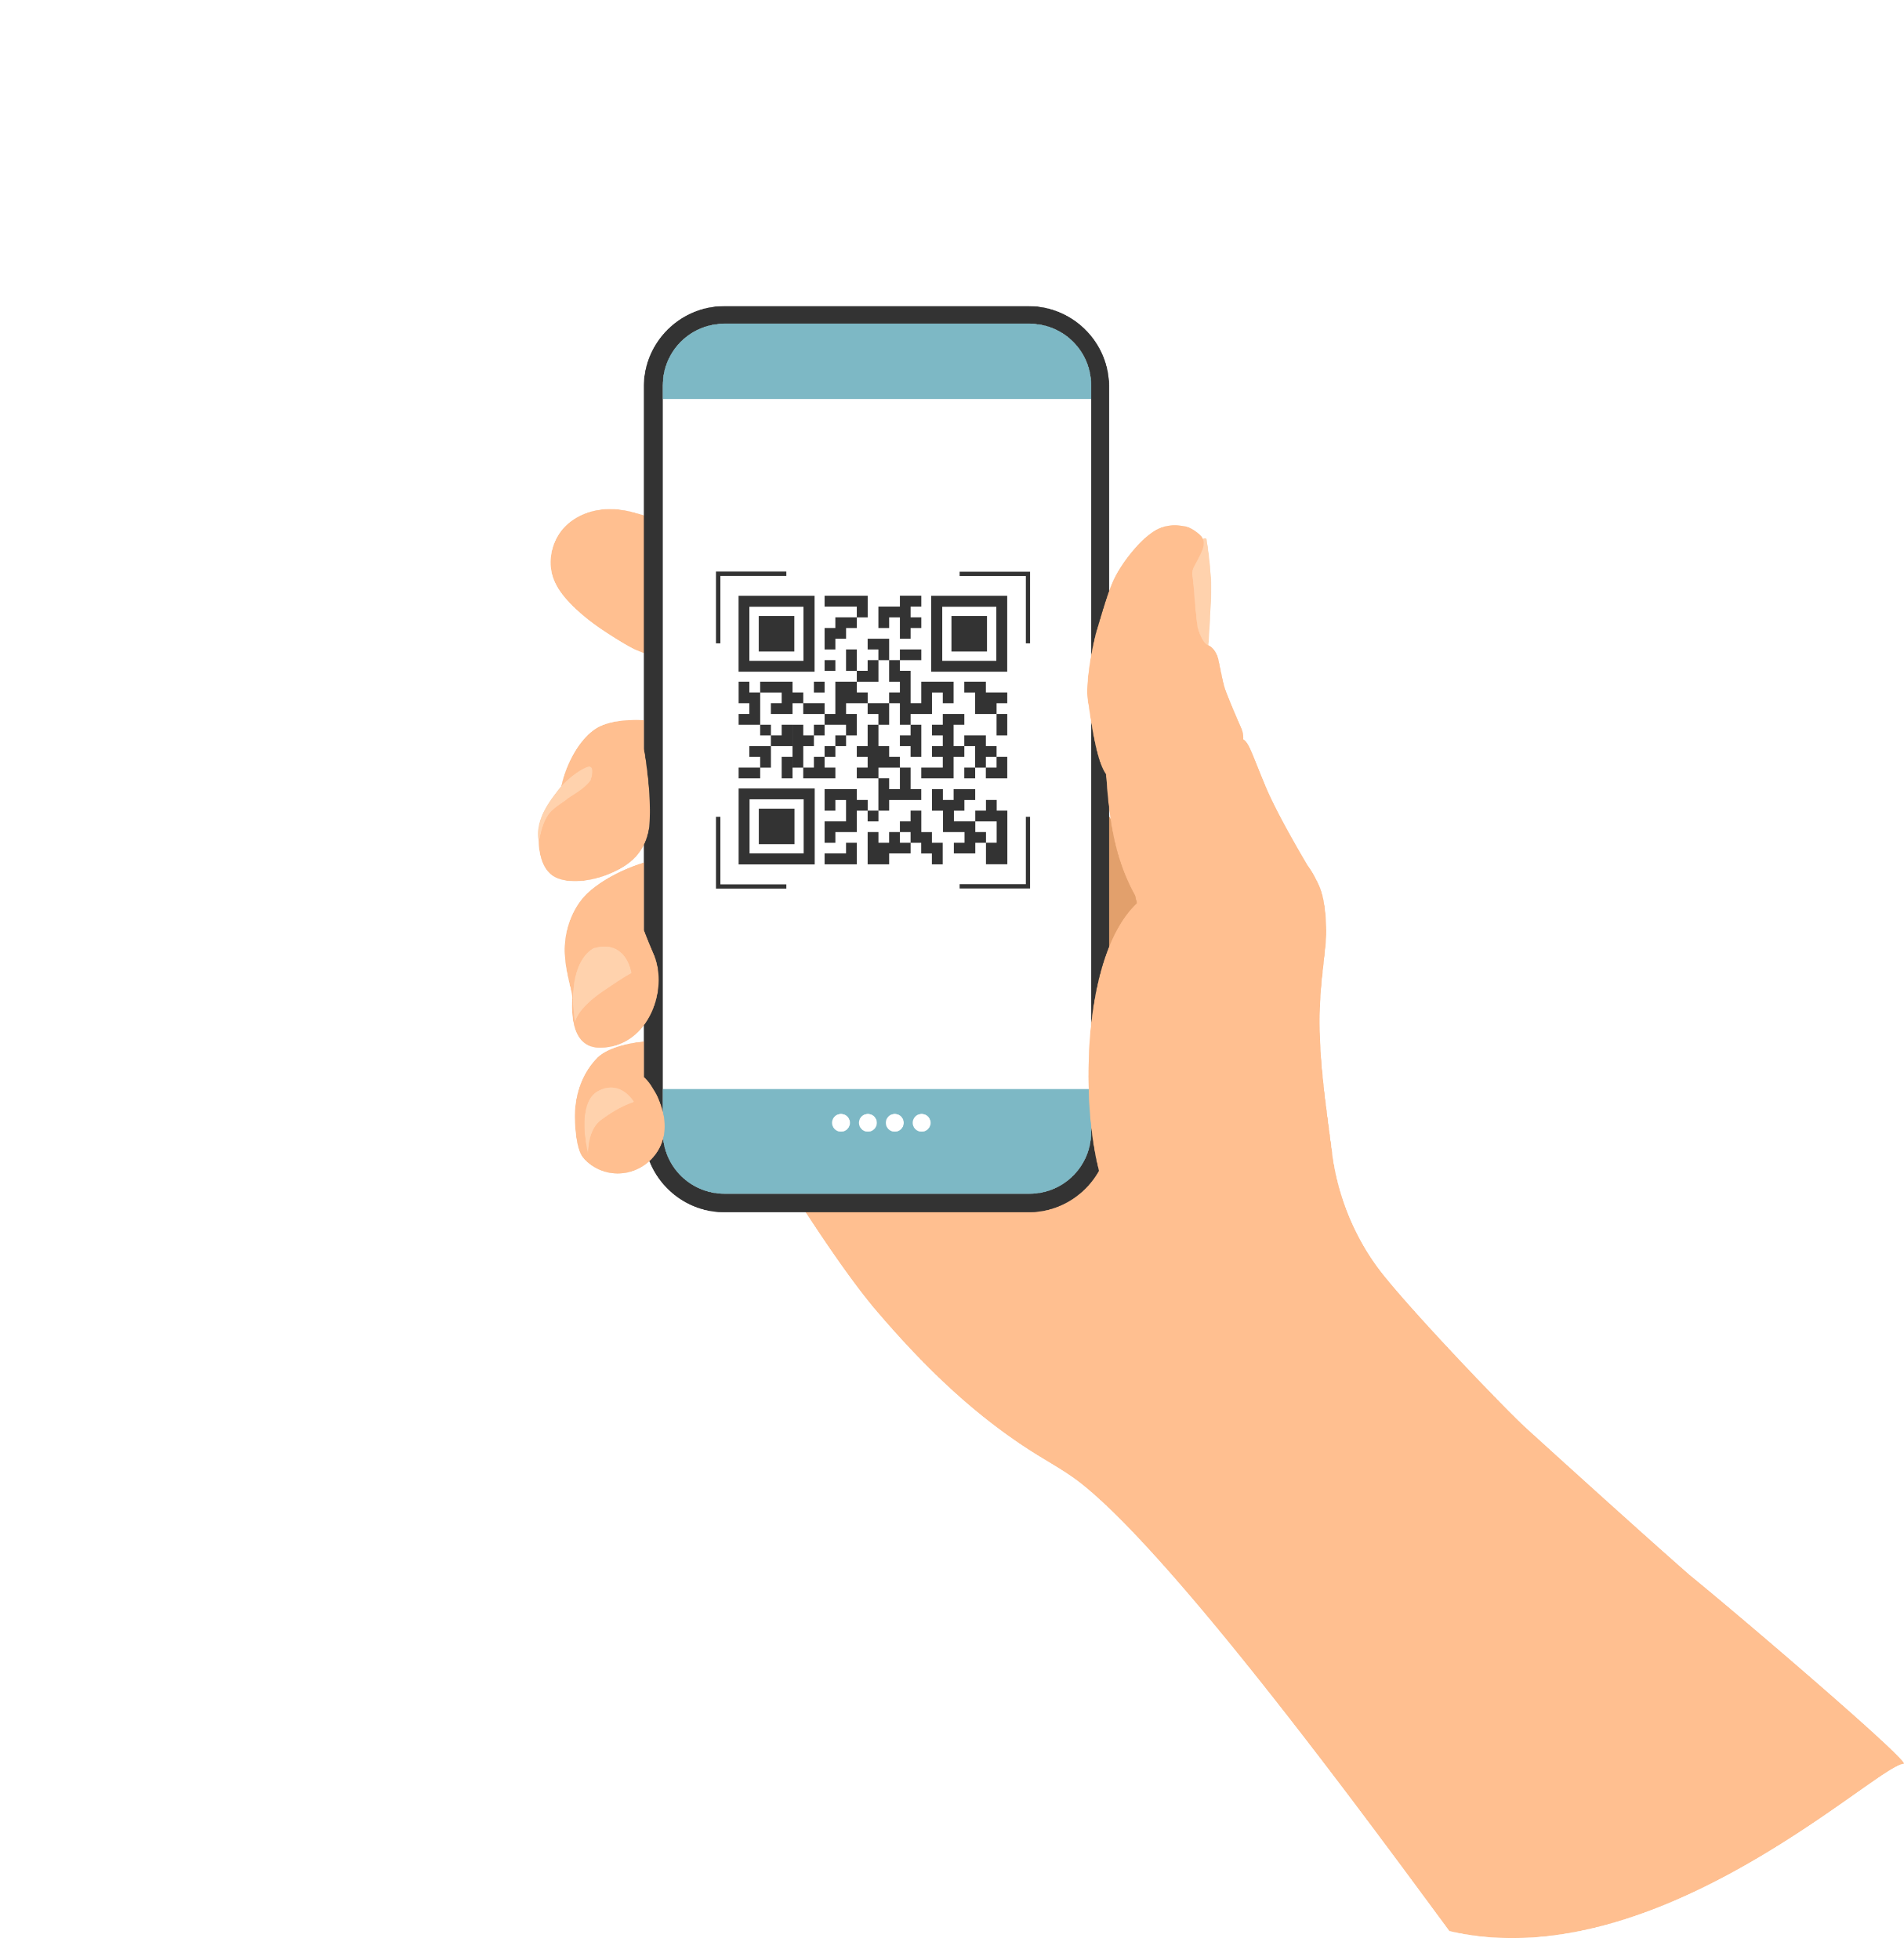

Thank You!
#edspaces
Please scan the QR code to provide session feedback.

Slide 37
#edspaces
Thank You!
Please scan the QR code to provide session feedback.
Mobile App - If you have not done so already, please download the mobile app through your device’s app store.
Session Evaluations - Rate Sessions Through the Mobile App Instructions:
Open and load mobile app
In the left sidebar, tap “Schedule”
Locate and select the session you are attending
After opening the individual session page, tap the “Session Survey” link to evaluate the session.

