Slide 1


#edspaces
Designing Impactful Learning Spaces Within Real-World Constraints: Alief ISD’s Story
November 5, 2:30-3:30

Slide 2
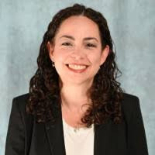


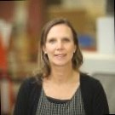

María Martinez
Early Childhood Coordinator
Alief ISD
Introductions
Sarah Pfeiler
Education Business Consultant
Exhibit Concepts
Colleen Incandela
Education Instructional Designer
Exhibit Concepts

Slide 3


Slide 4
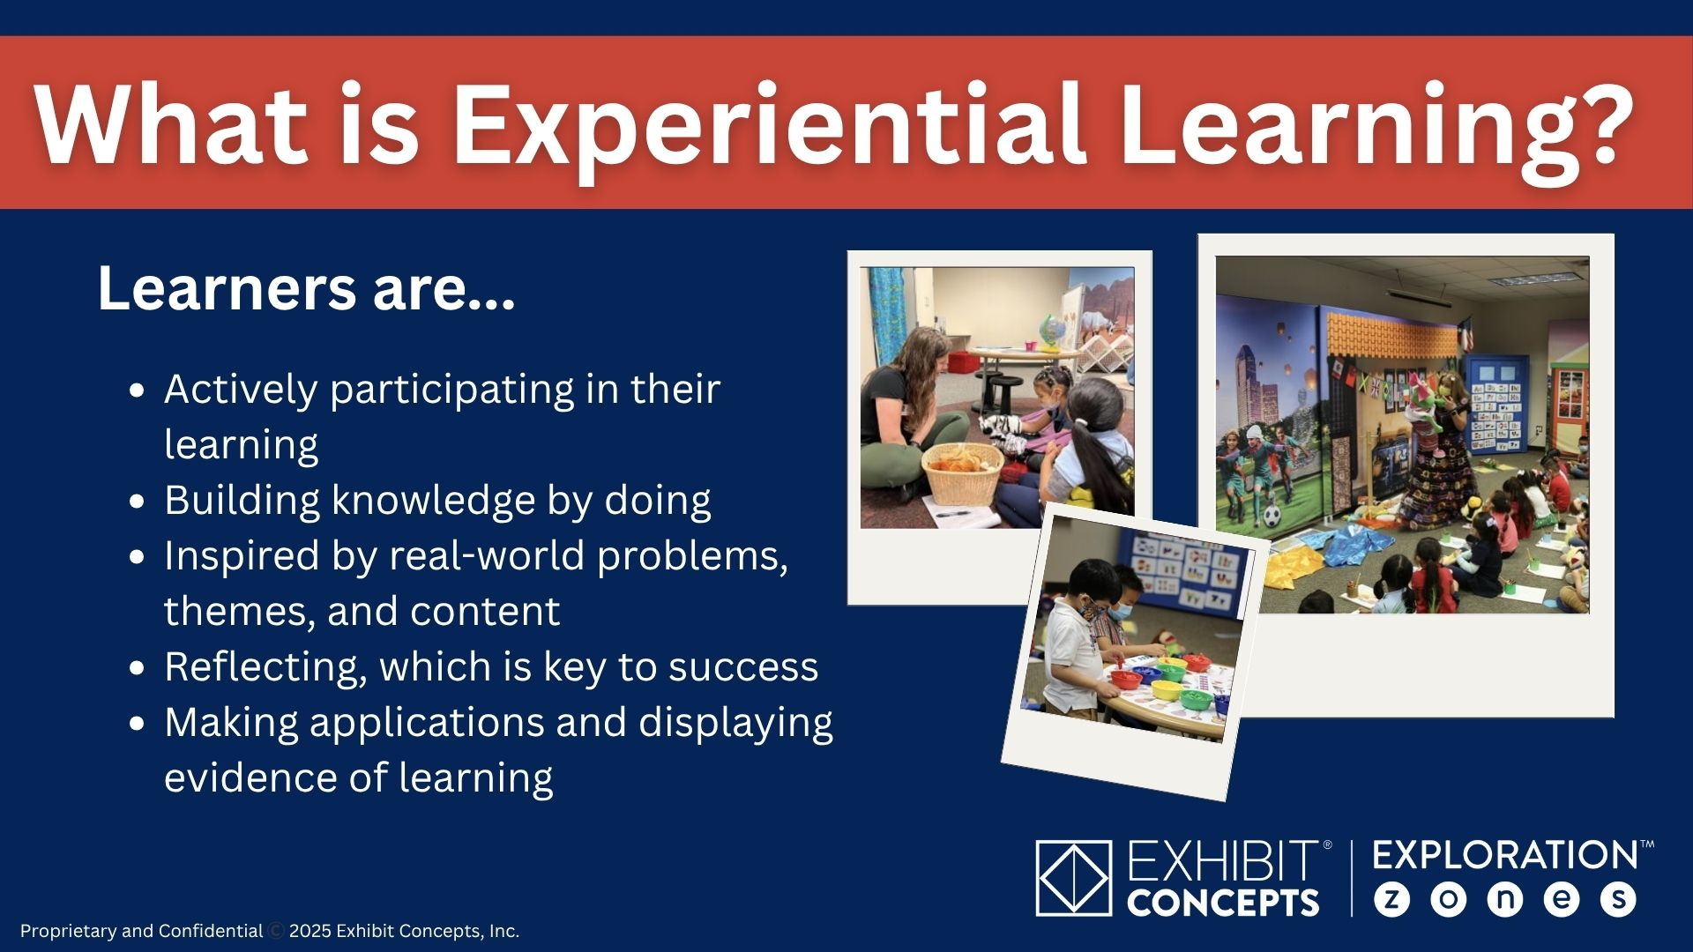

Slide 5
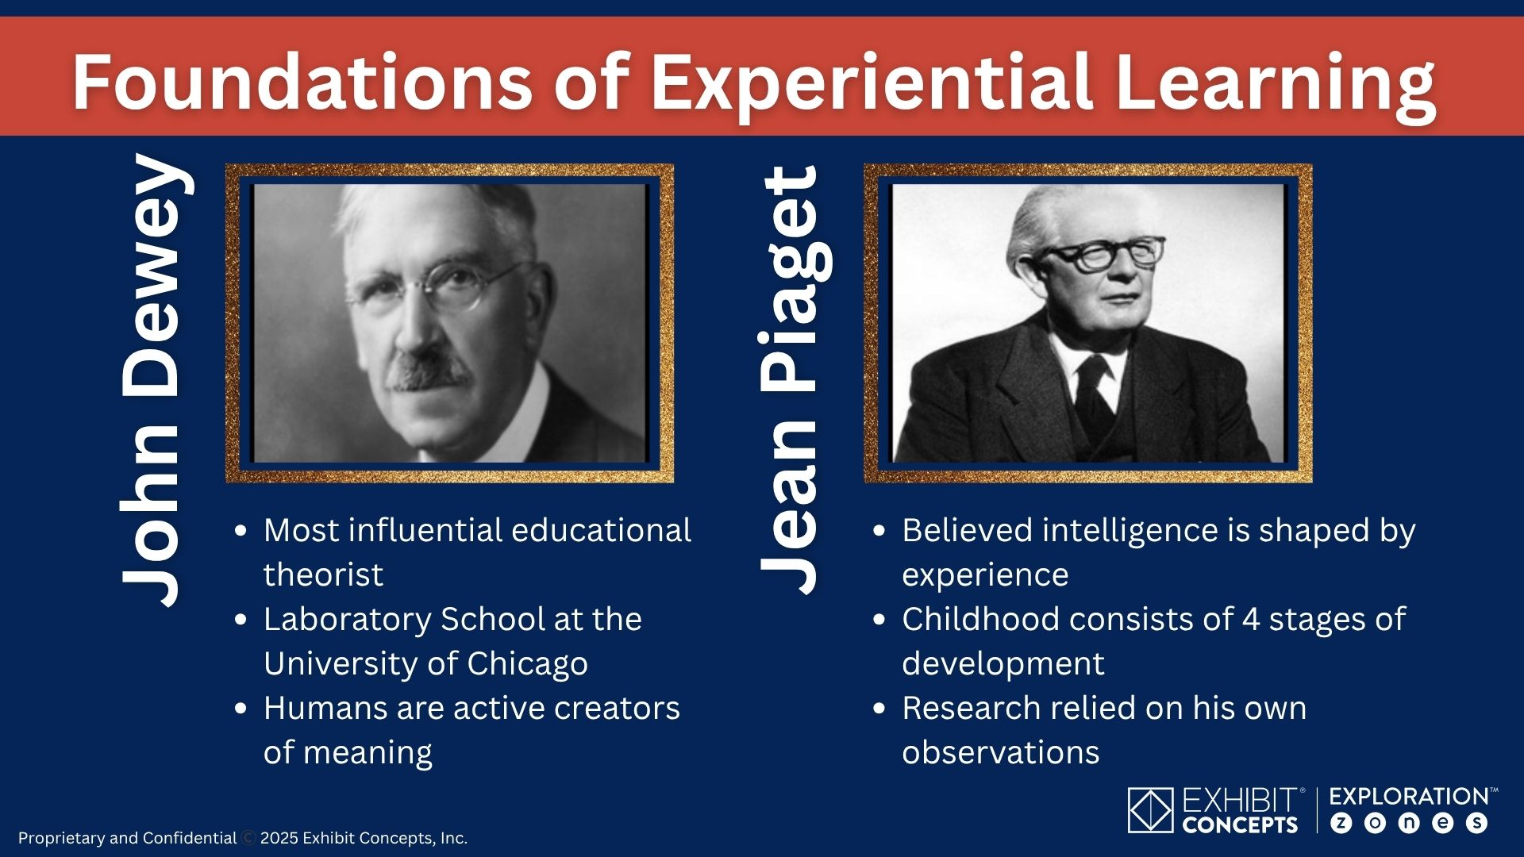

Slide 6
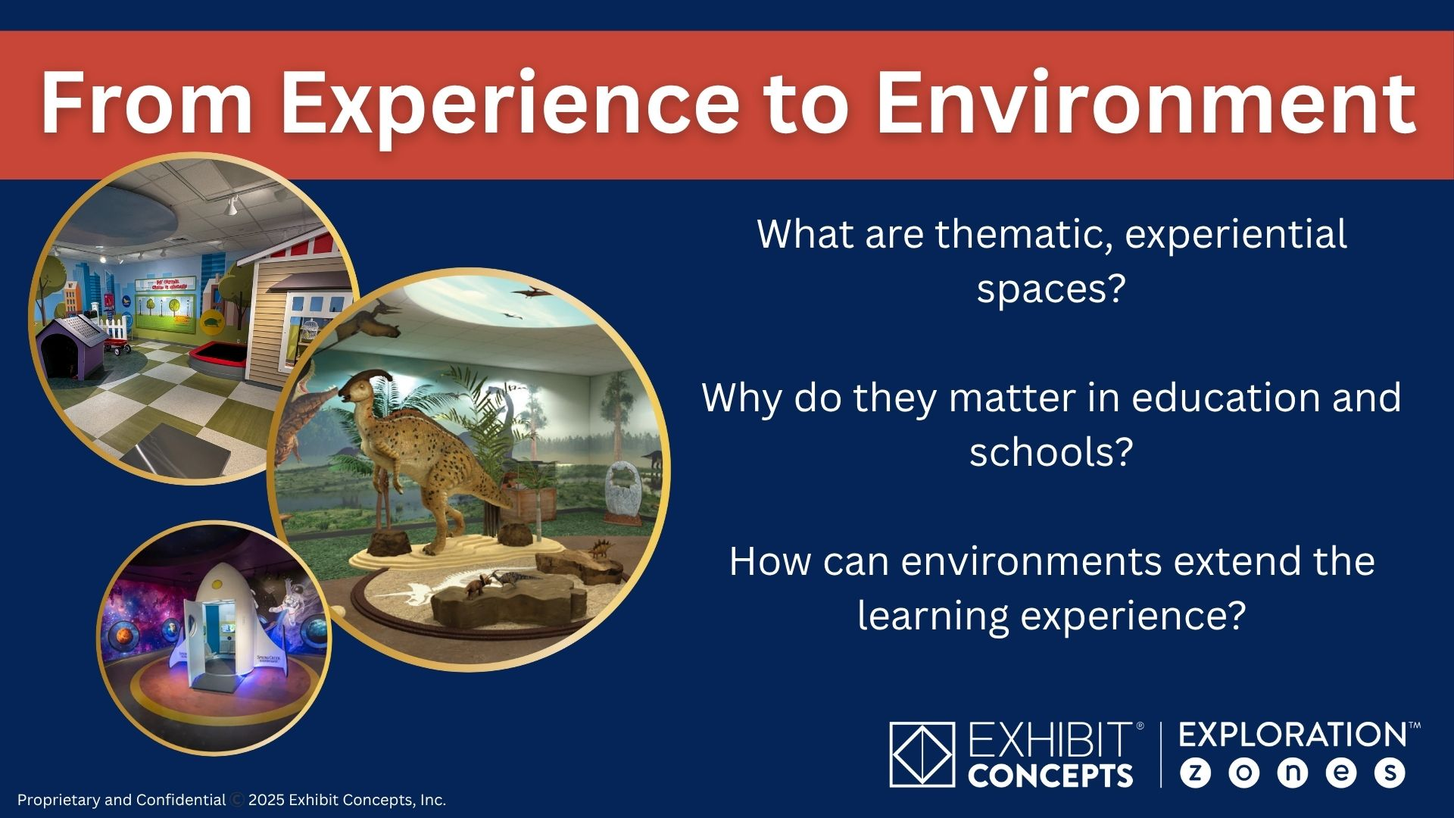

Slide 7
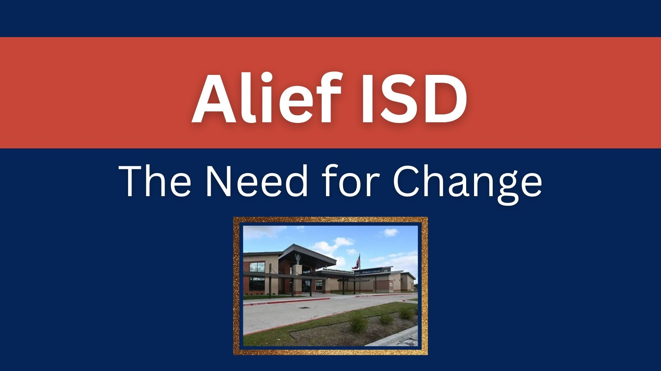
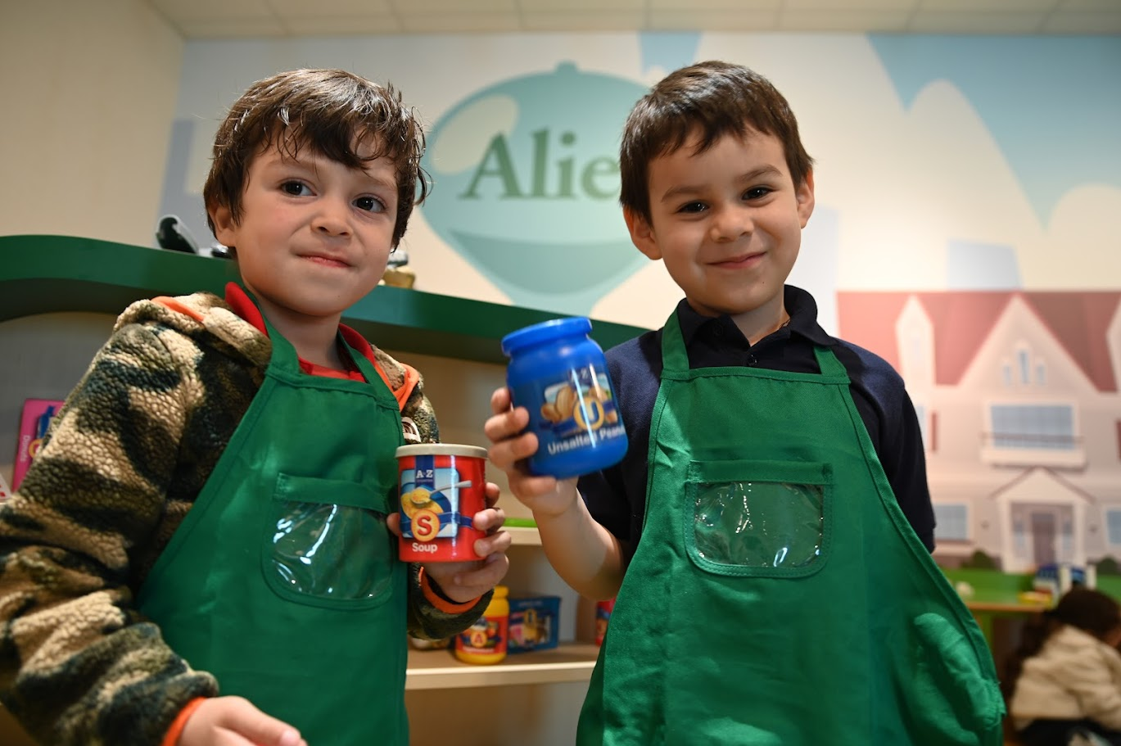

Slide 8
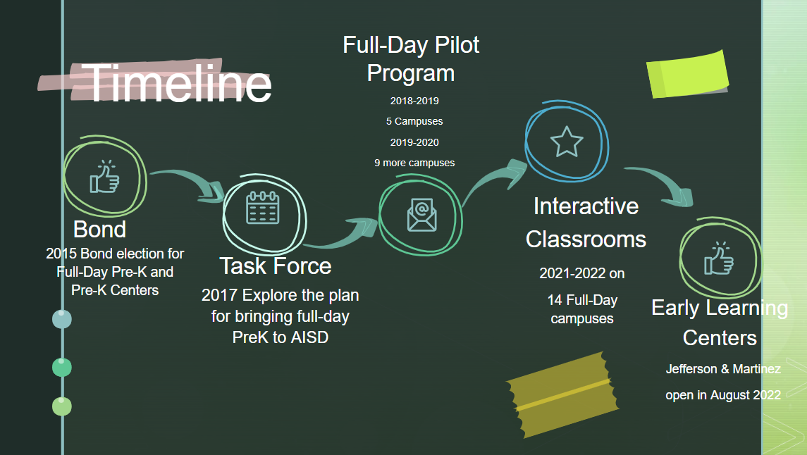

Slide 9
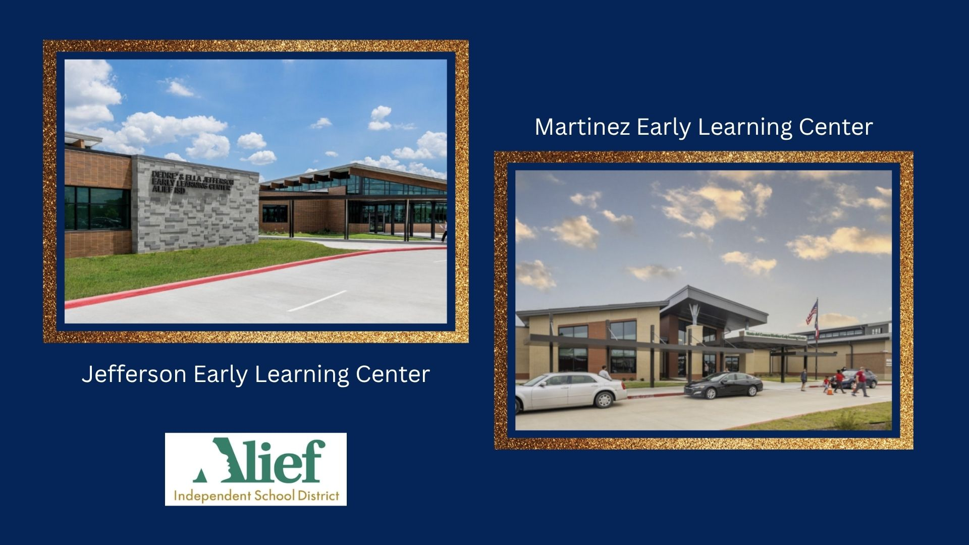

Slide 10
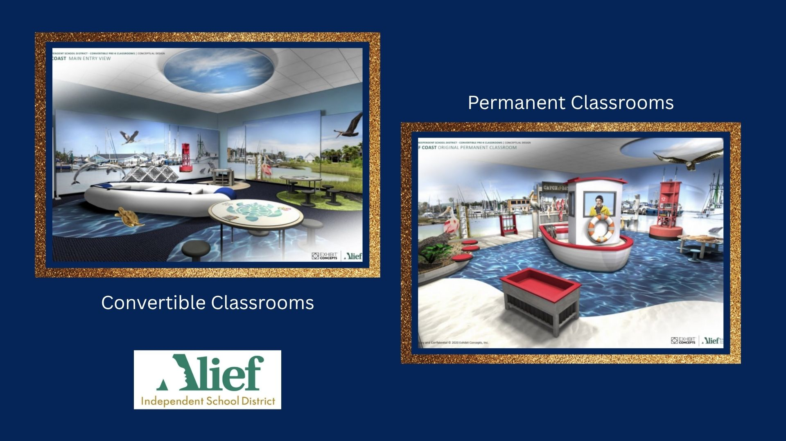

Slide 11
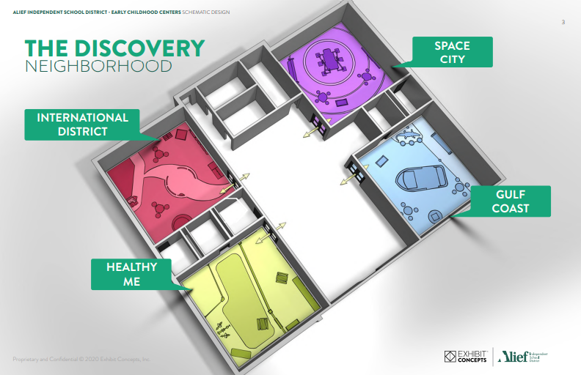
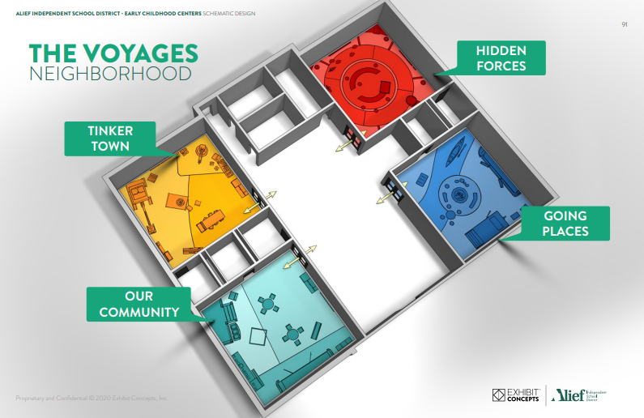
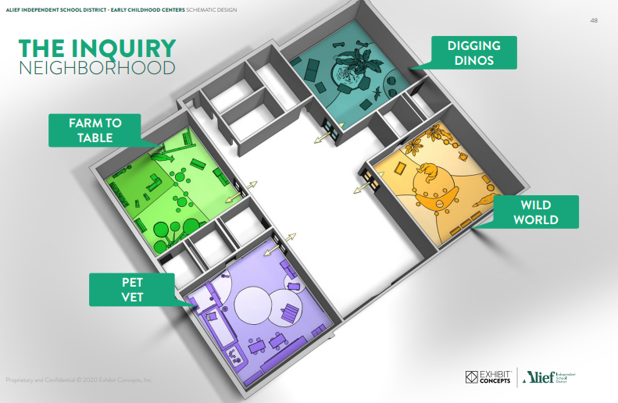
3 Pods & 12 Experience Rooms

Slide 12


Slide 13
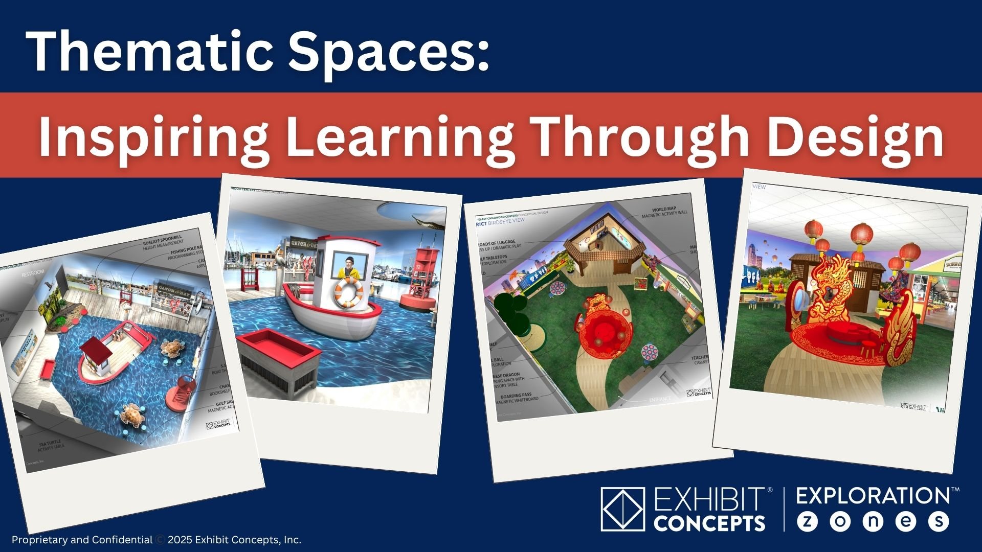

Slide 14
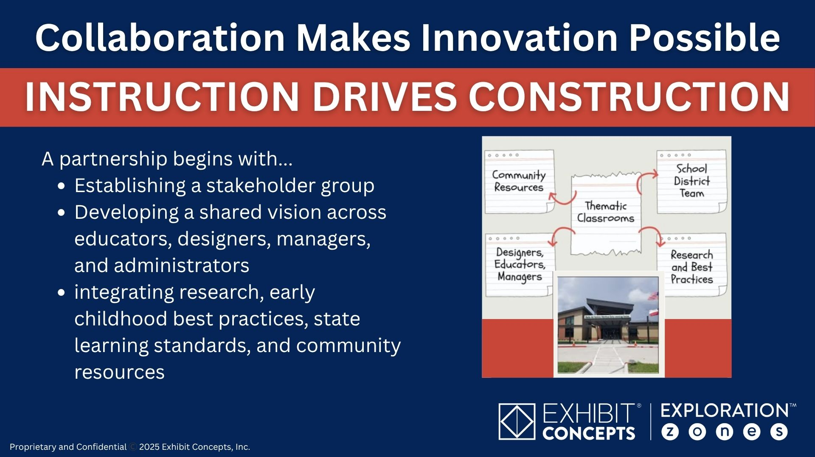

Slide 15
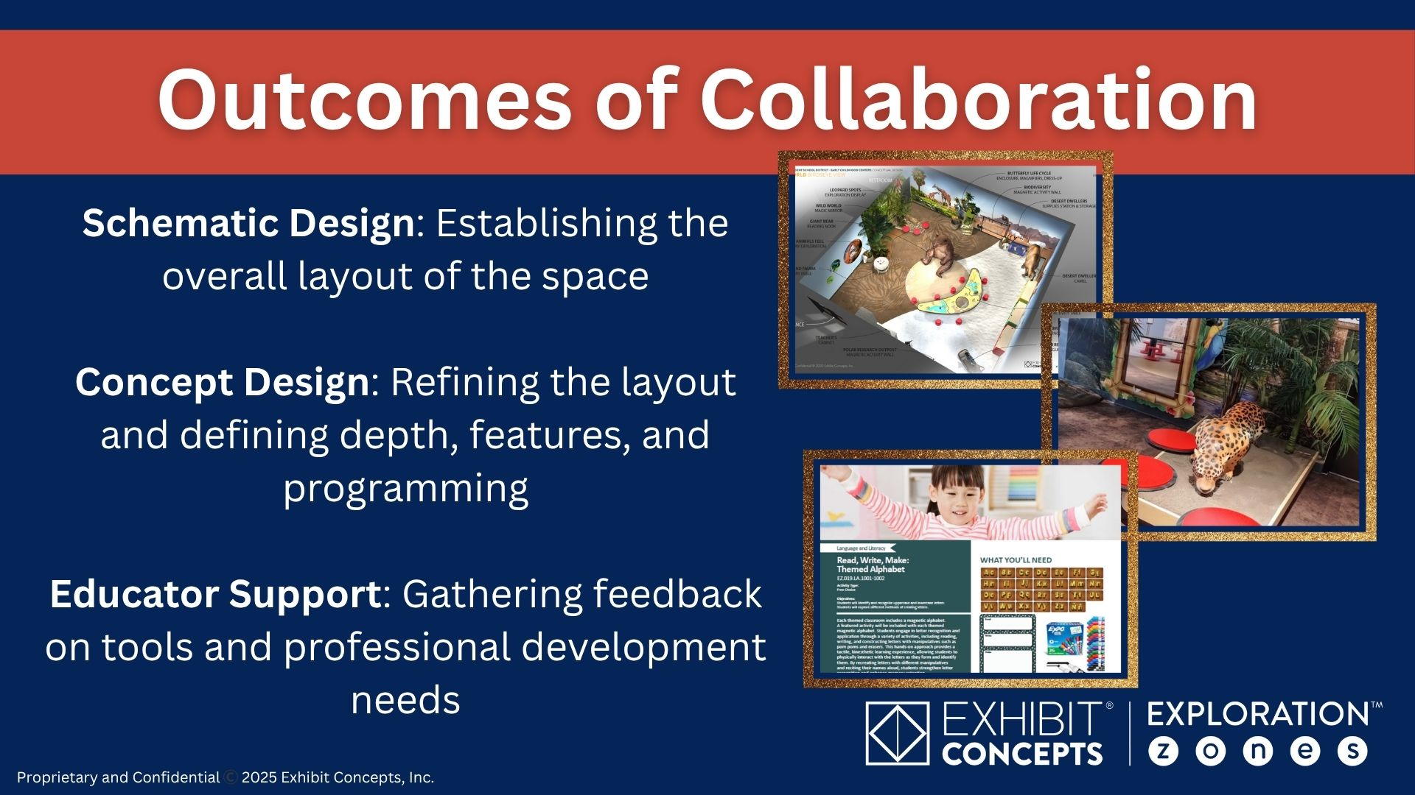

Slide 16
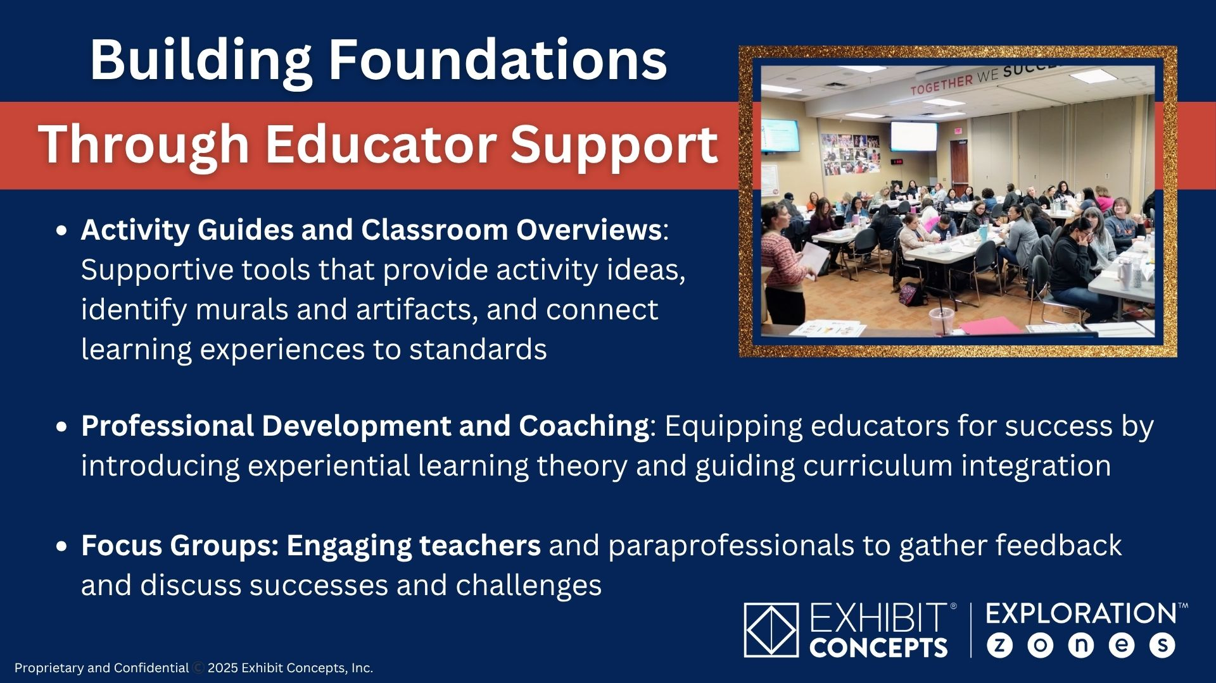

Slide 17
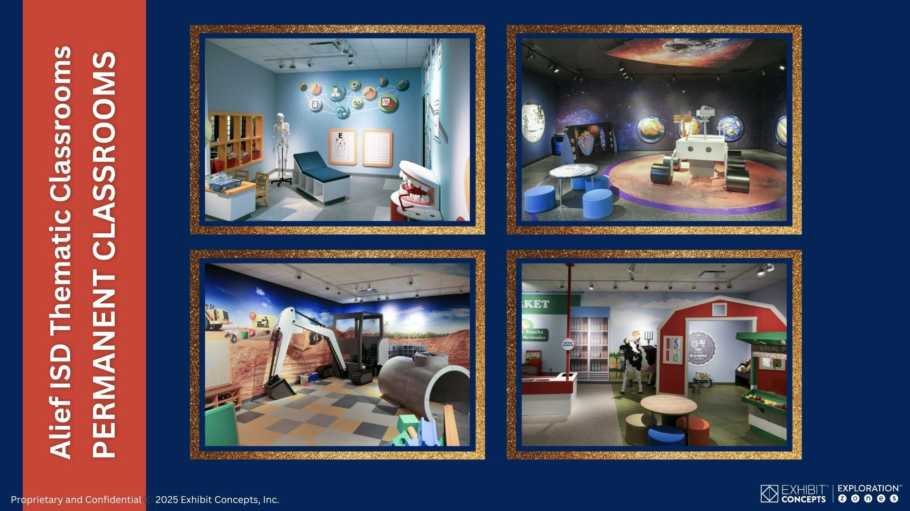

Slide 18
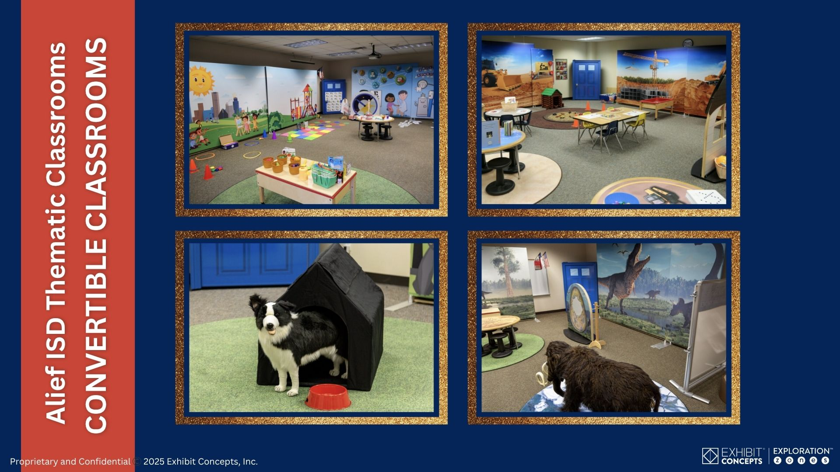

Slide 19
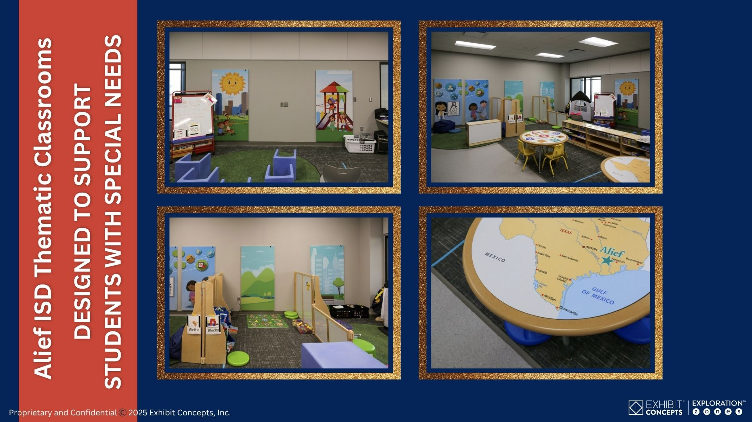

Slide 20
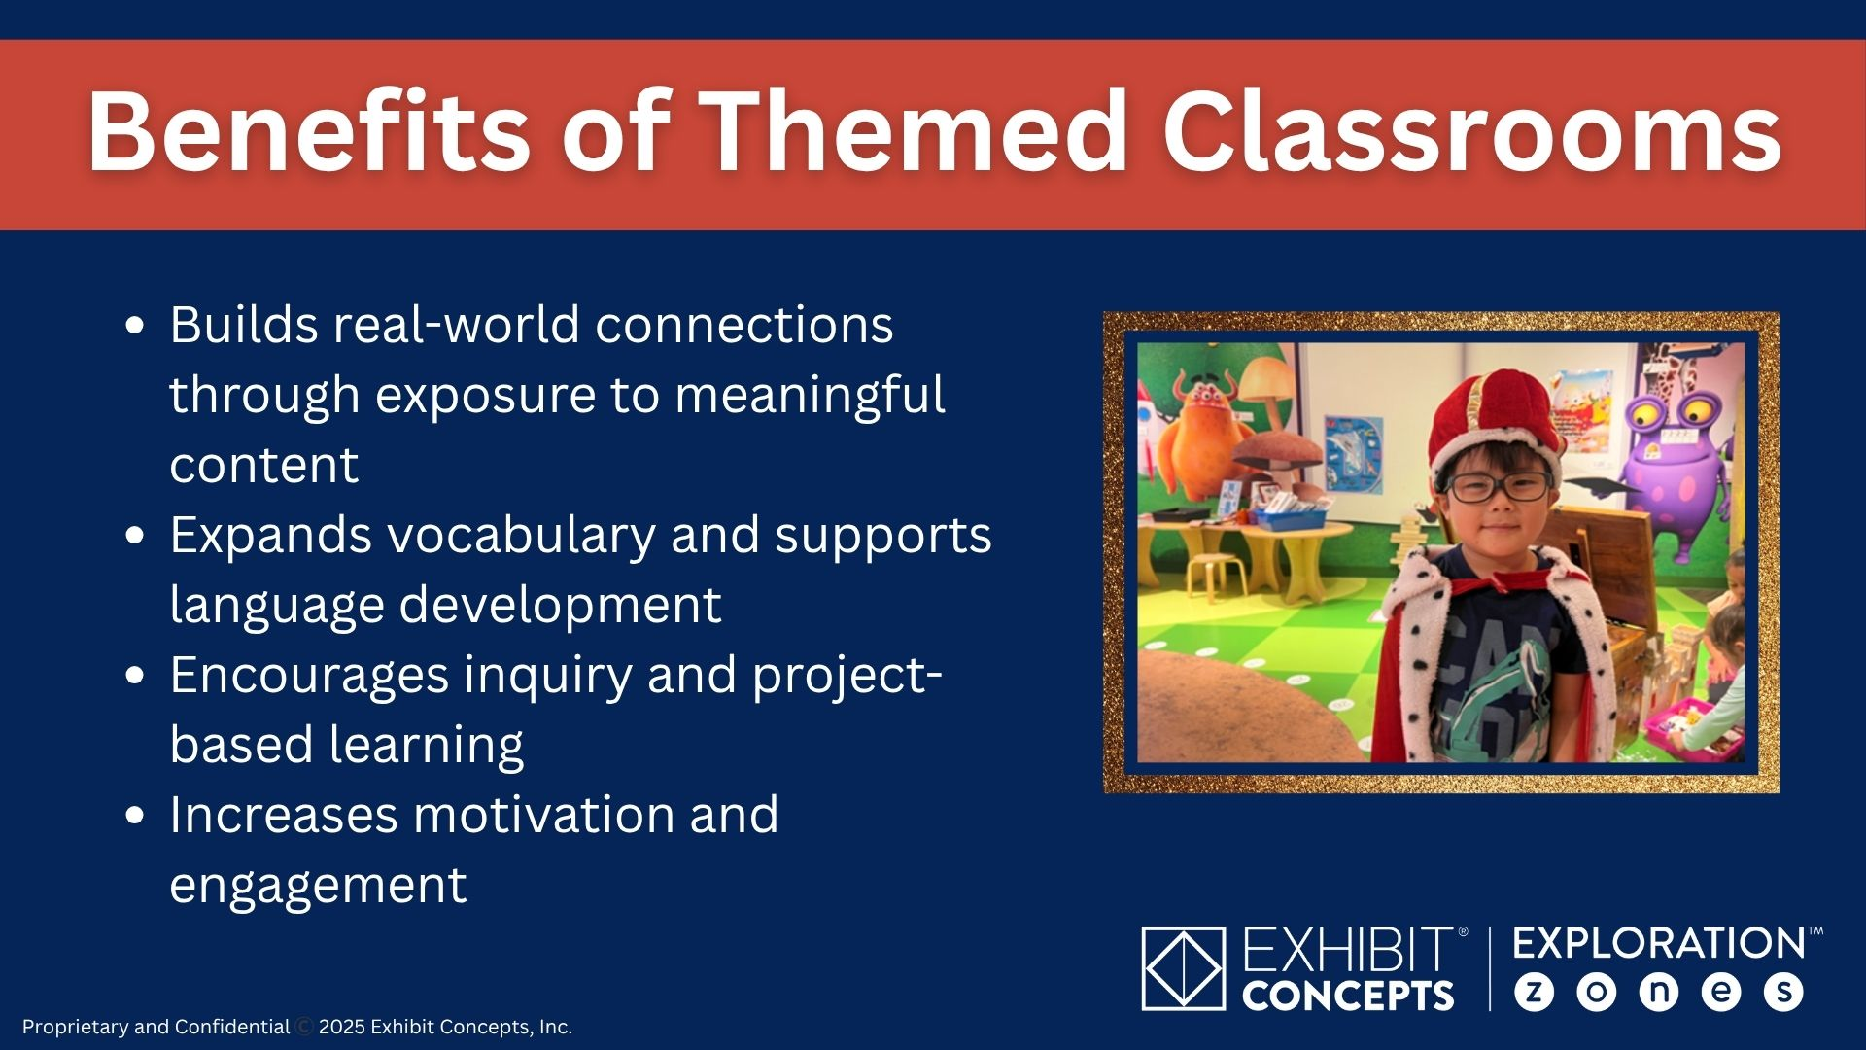

Slide 21
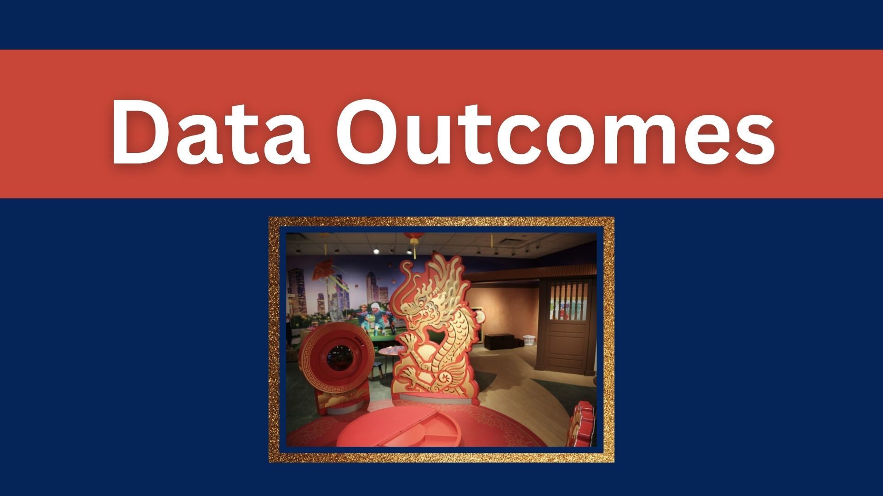

Slide 22
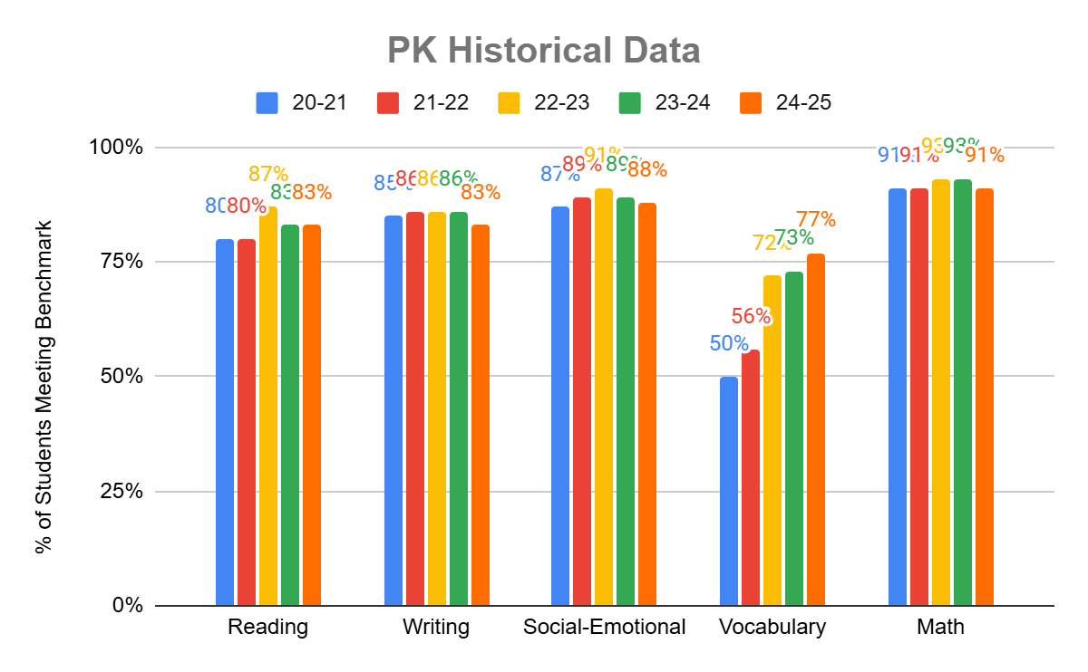
PK HISTORICAL DATA
Since the start of full day and experiential learning in Alief

Slide 23
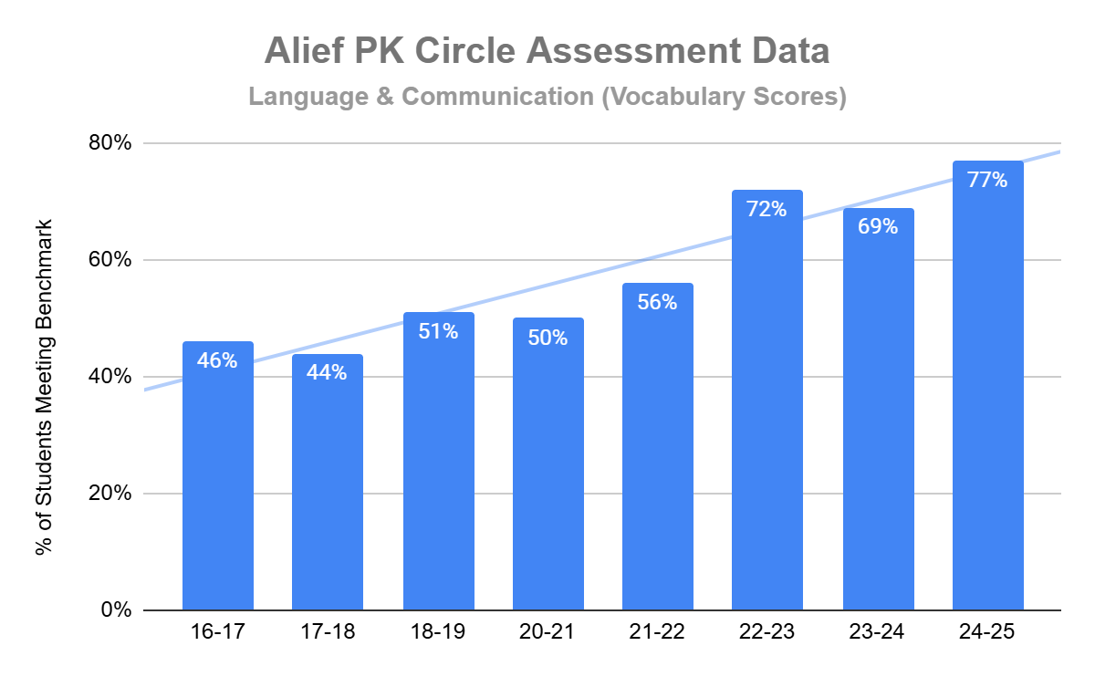
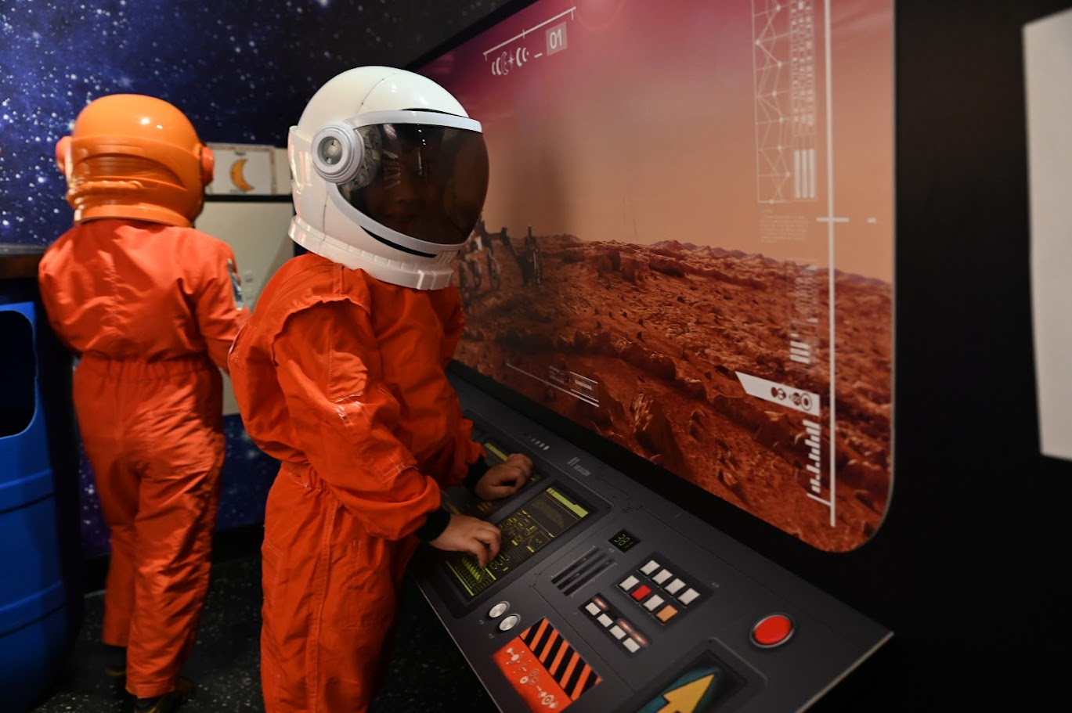
ALIEF VOCABULARY SCORES

Slide 24
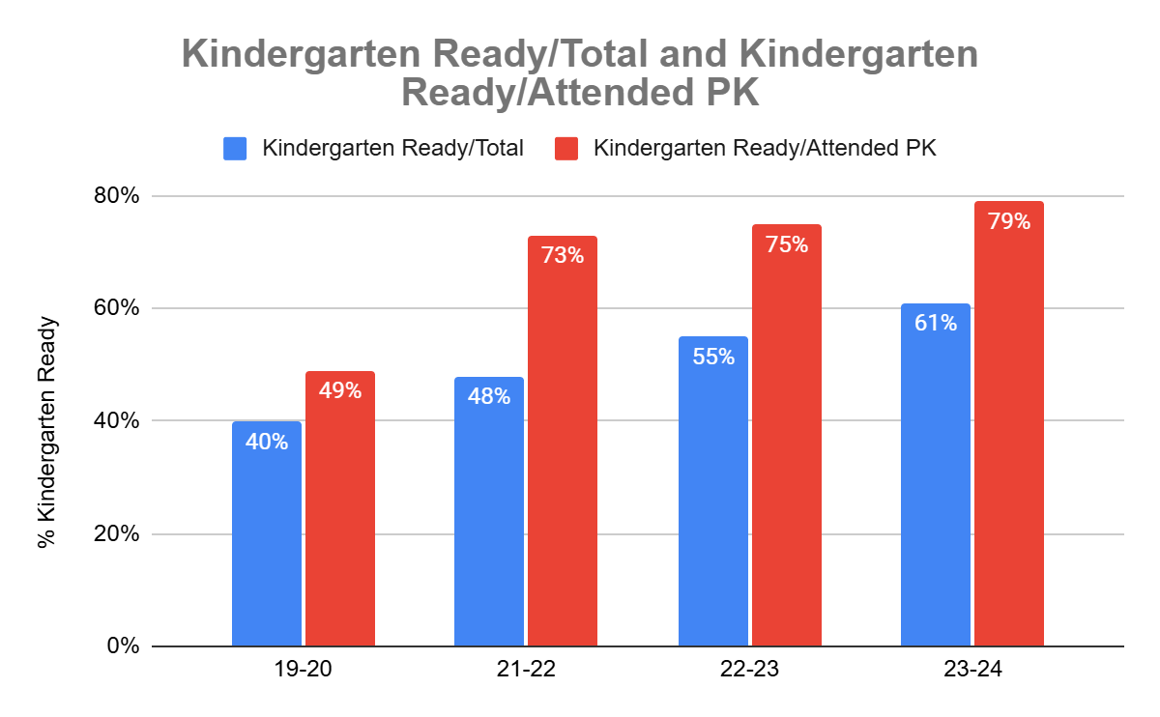

ALIEF KINDERGARTEN READINESS

Slide 25
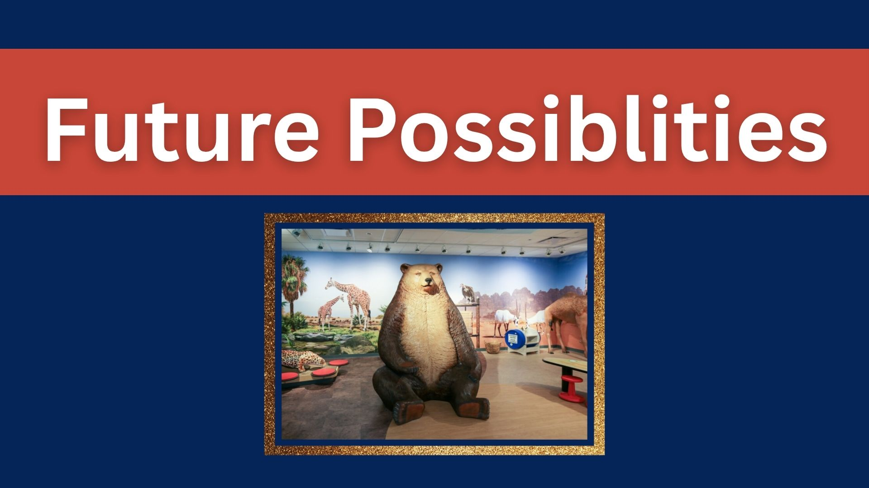

Slide 26
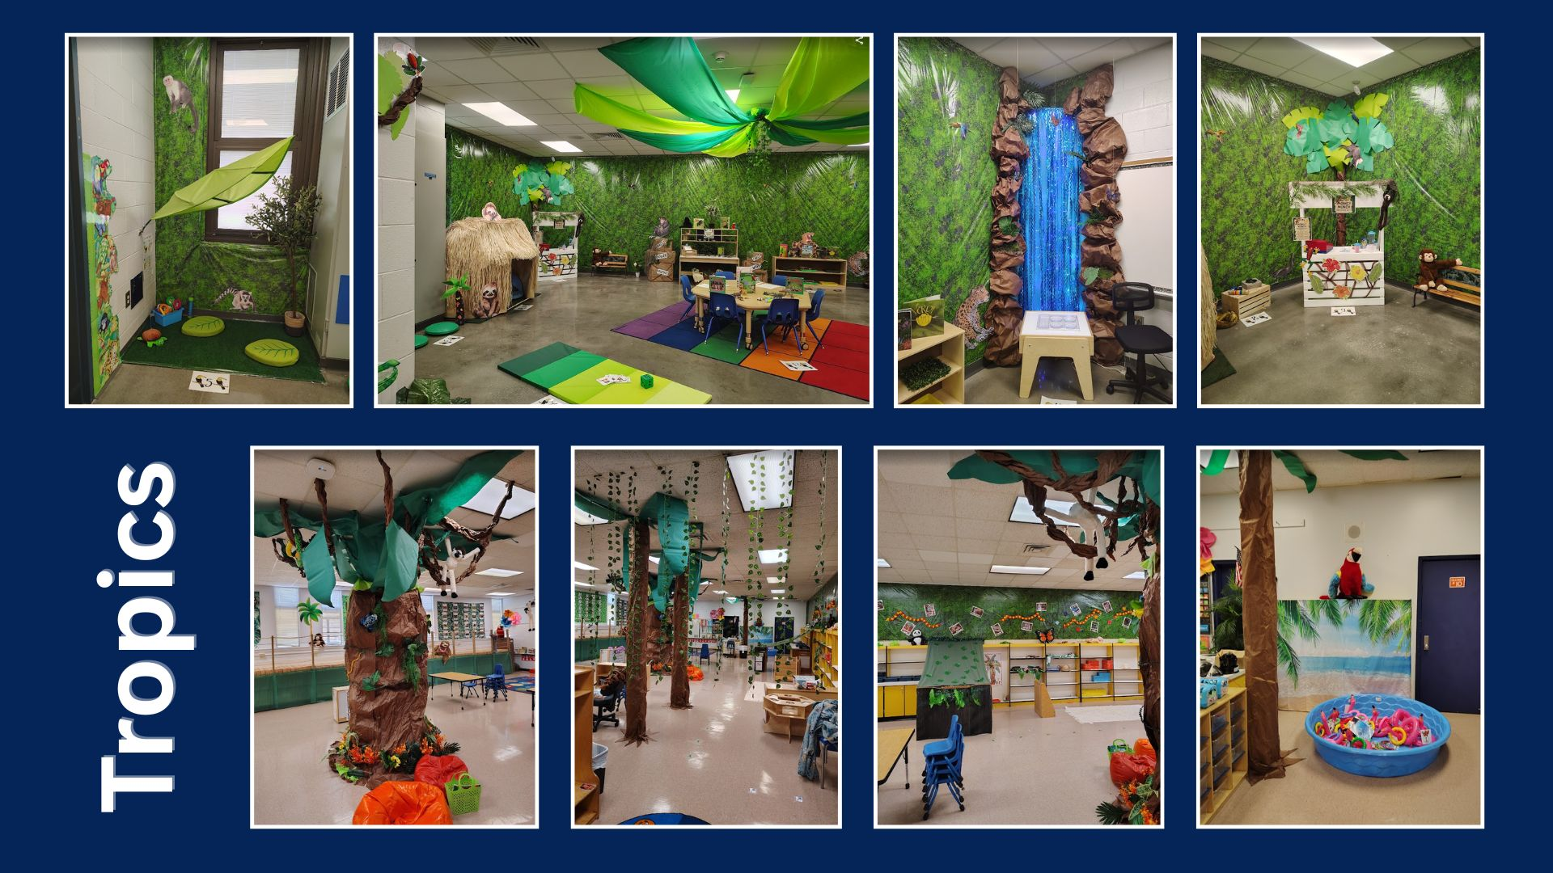

Slide 27
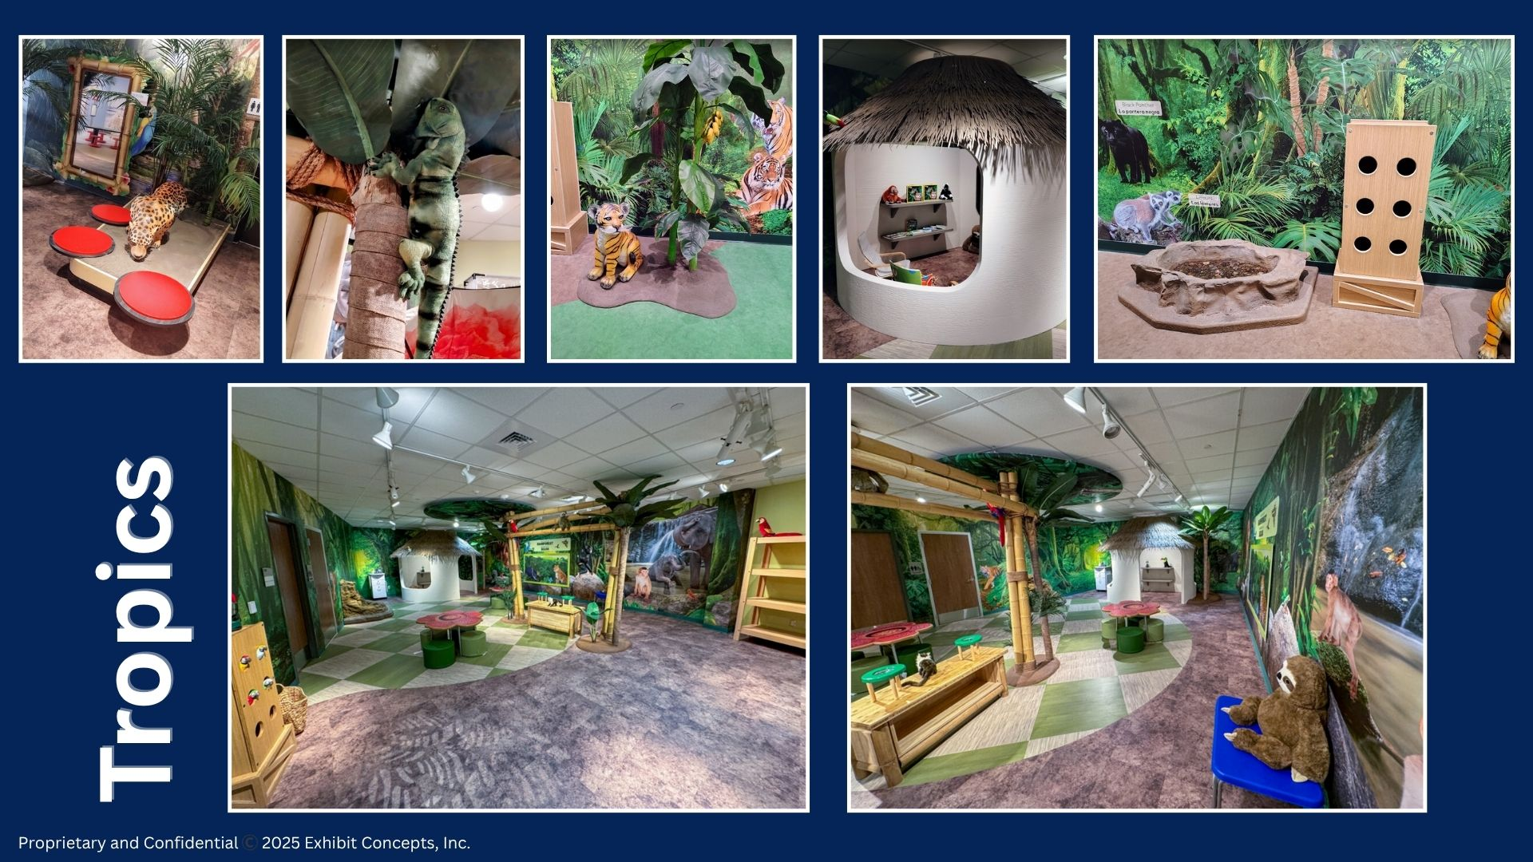

Slide 28
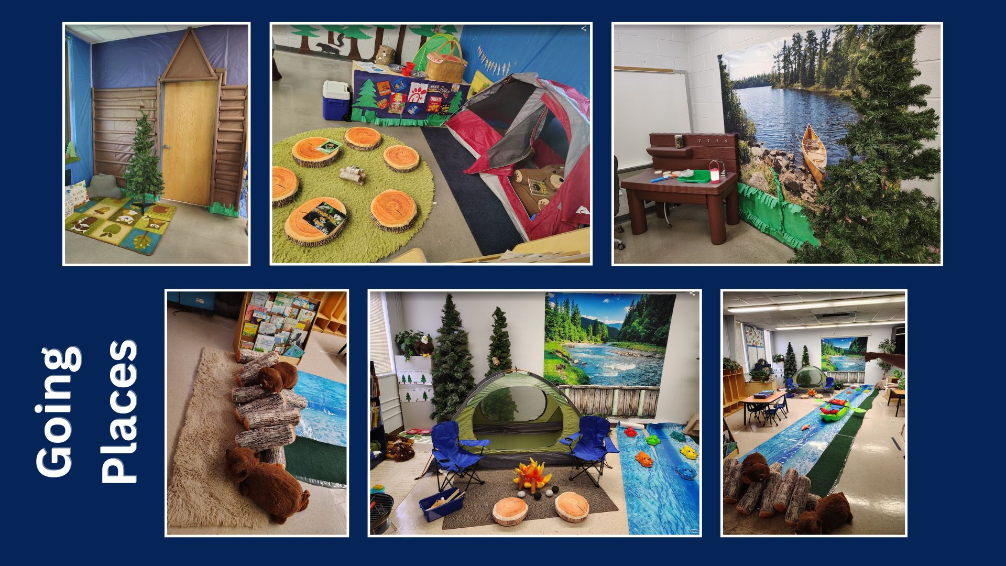

Slide 29
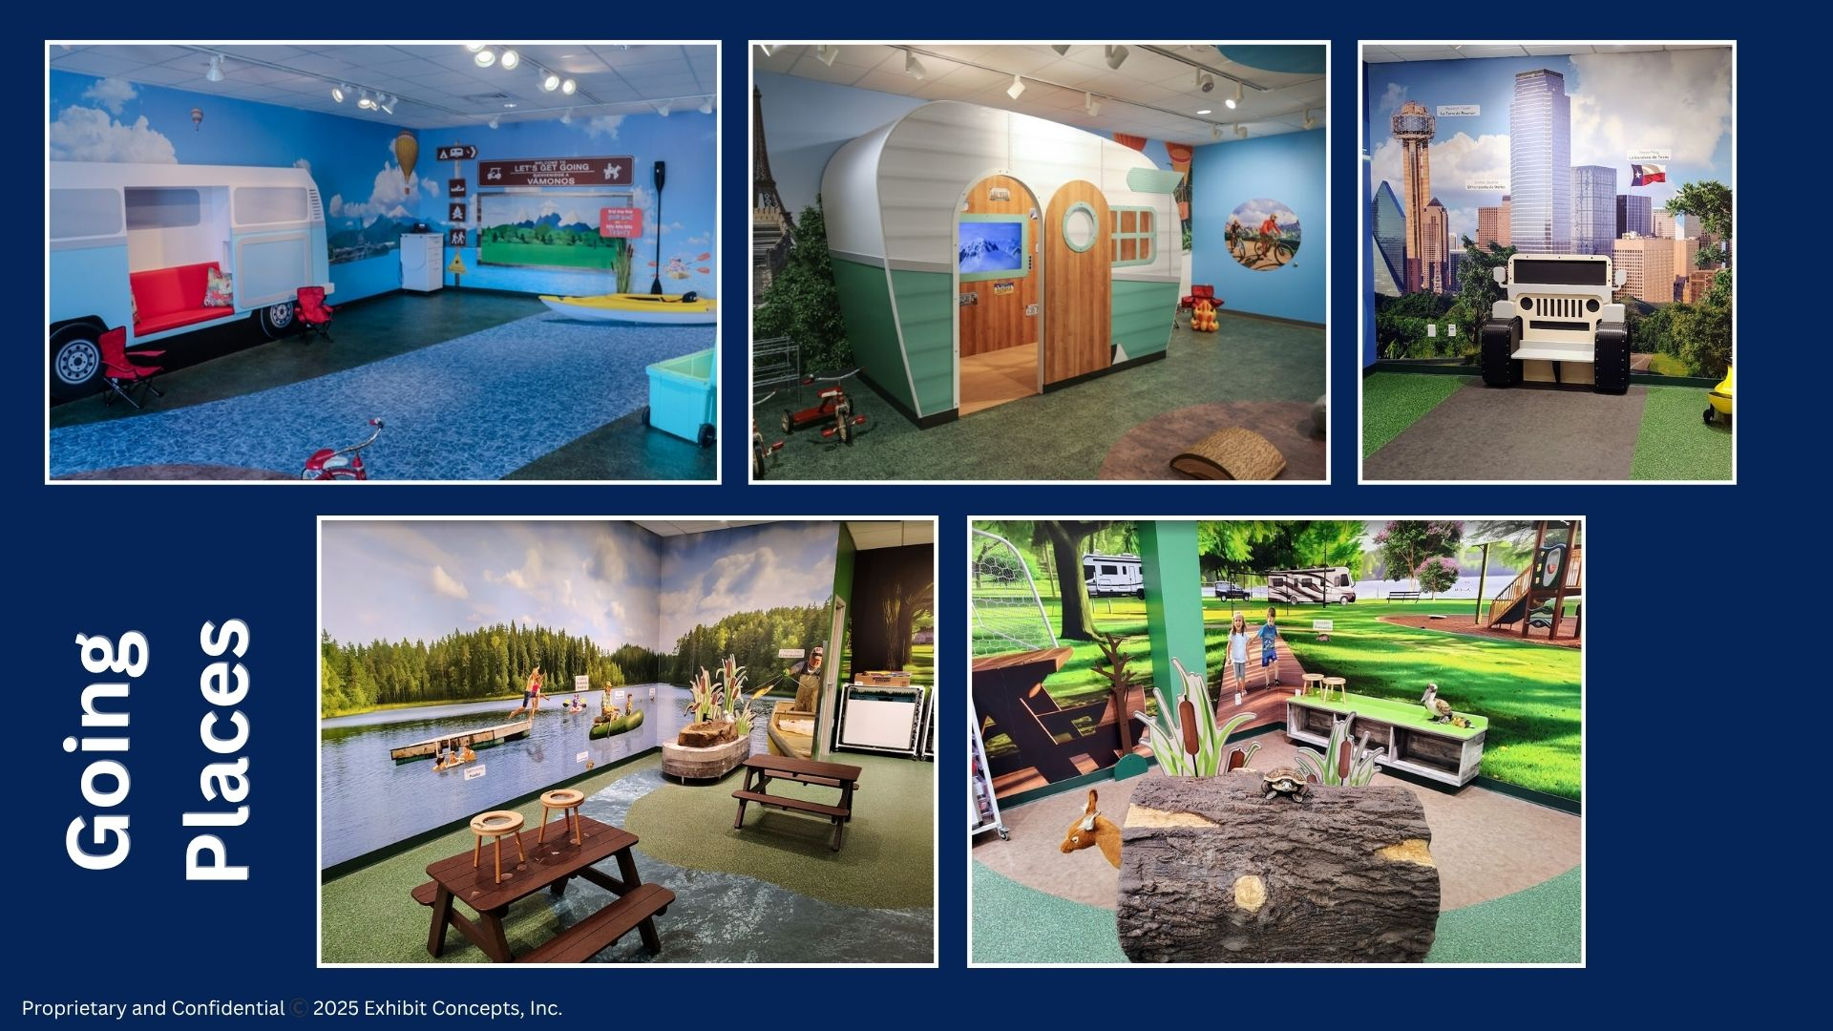

Slide 30
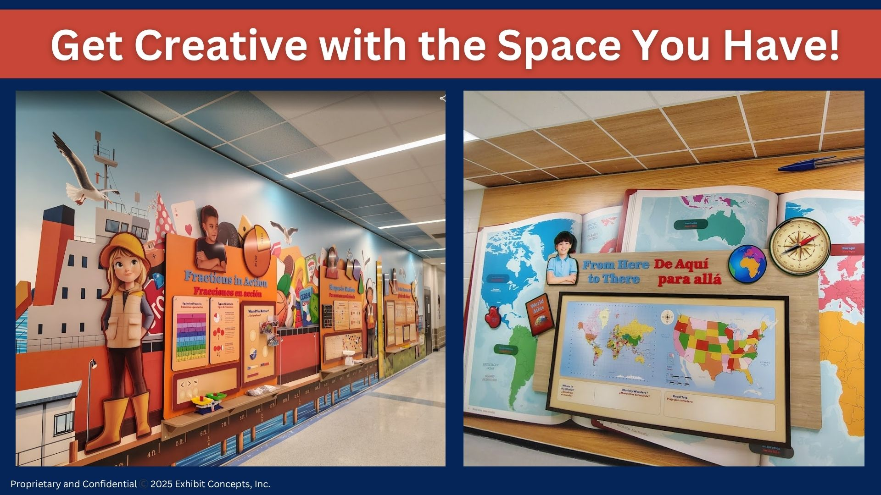

Slide 31
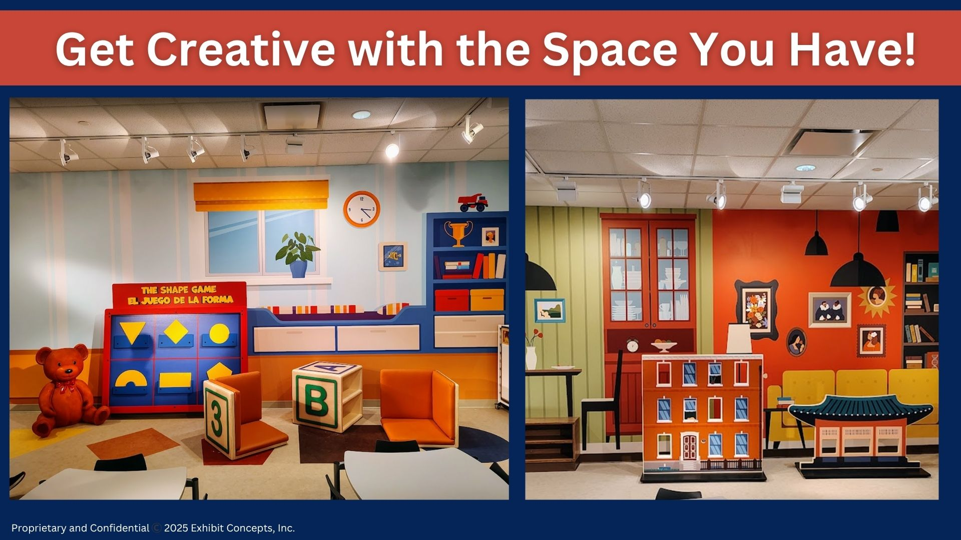

Slide 32
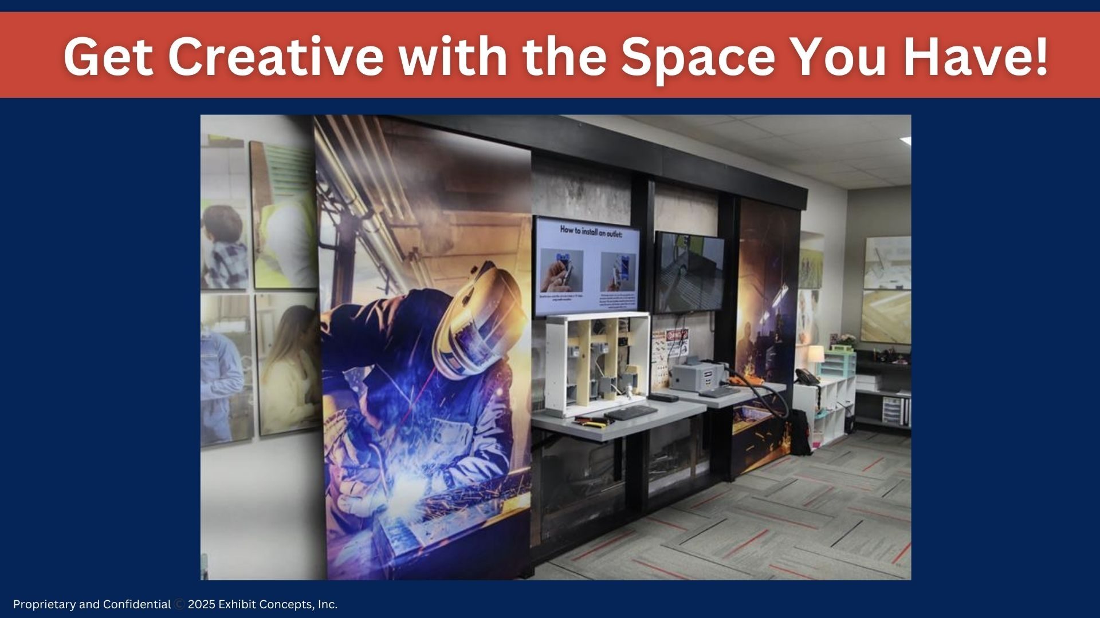

Slide 33
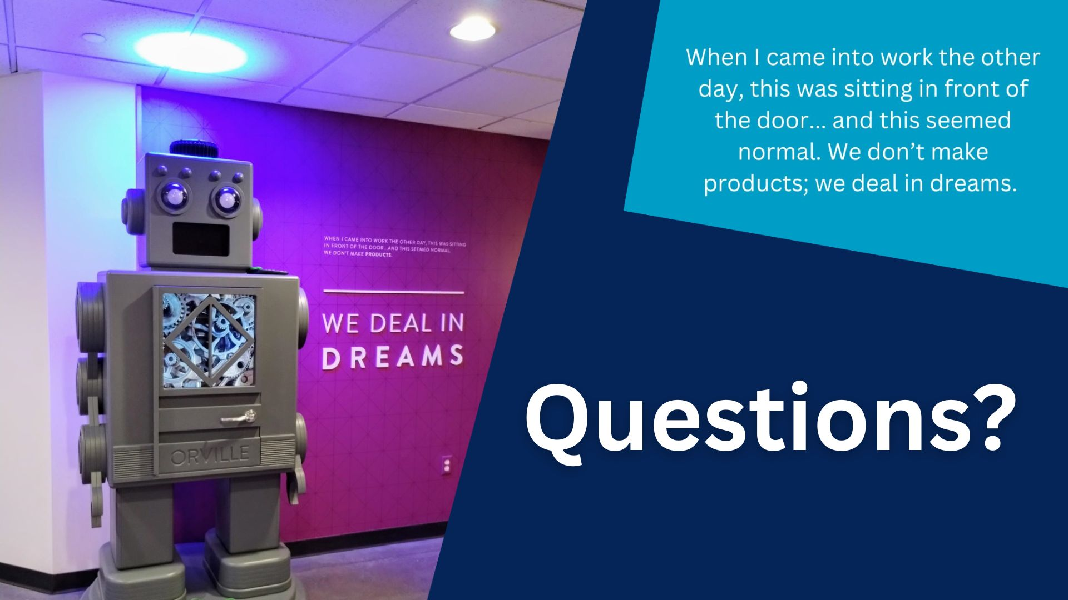

Slide 34
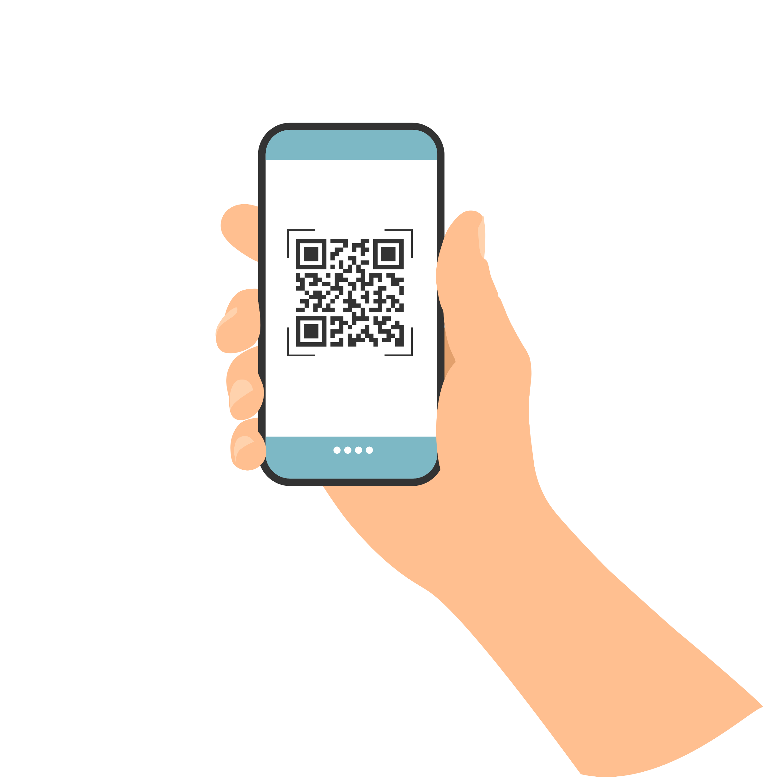

Thank You!
#edspaces
Please scan the QR code to provide session feedback.

Slide 35
#edspaces
Thank You!
Please scan the QR code to provide session feedback.
Mobile App - If you have not done so already, please download the mobile app through your device’s app store.
Session Evaluations - Rate Sessions Through the Mobile App Instructions:
Open and load mobile app
In the left sidebar, tap “Schedule”
Locate and select the session you are attending
After opening the individual session page, tap the “Session Survey” link to evaluate the session.

